Slide 1
Year 3
L.I – Can I multiply 2-digit by 1-digit numbers?
Steps to success
I can use multiplication facts or a multiplication grid
I can use place value to partition numbers
I can use an efficient method to add numbers
Challenge: Convince me
Year 4
L.I. – Can I divide 1-digit and 2-digit numbers by 100?
Steps to success
I can use a place value grid
I can find the effect when I move the digits 2 places to the right
I can recognise that hundredths arise when dividing an object by one hundred
Challenge: True or false

Slide 2
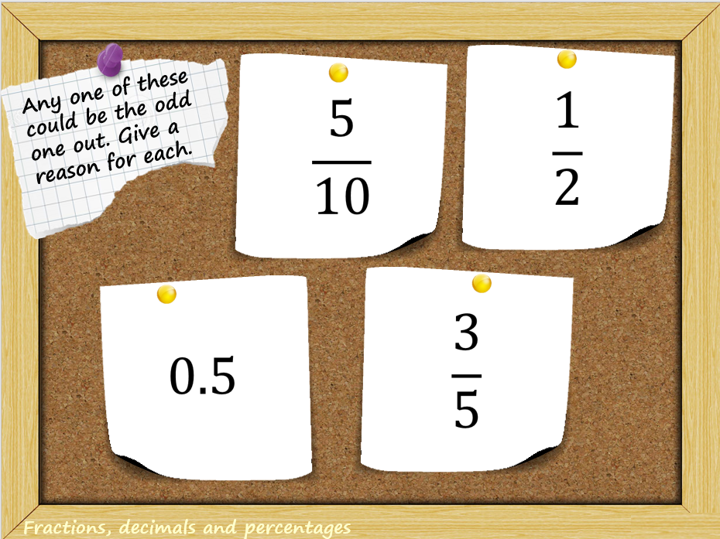
In Focus Task
Which one do you think is the odd one out? Explain.
Can you find a reason for each one of them to be the odd one out?

Slide 3
Talk Task
Year 3
How would you find the answer to 35 x 6?
Year 4
What happens when you divide by 100?

Slide 4
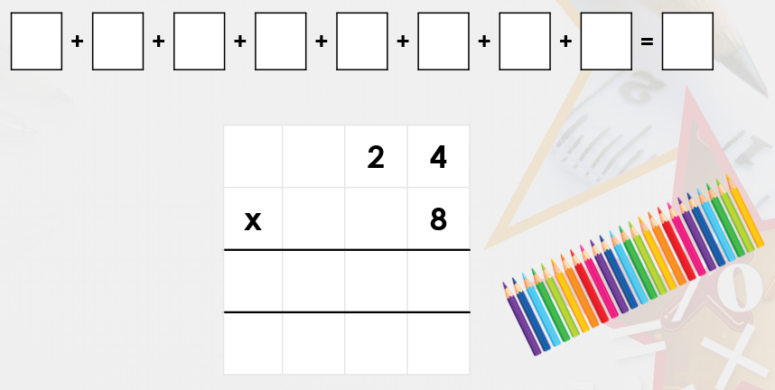
New Learning
Year 3
There are 24 pencils in a pack. How many are there in 8?
Year 4
Stem sentence:
If I divide by 100, I move the digits two places to the right.
The decimal does not move.

Slide 5
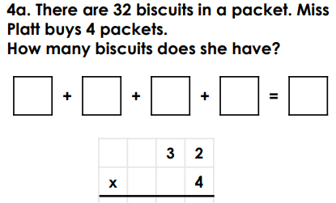
New Learning
Year 3
Year 4
What is 3 ÷ 100?

Slide 6
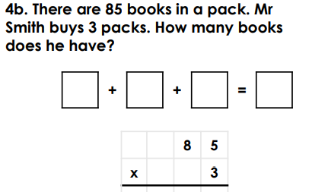
New Learning
Year 3
Year 4
How do I divide these by 100?
Write a sentence in your book explaining it.

Slide 7
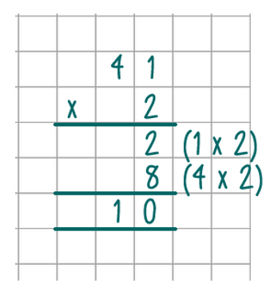
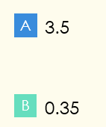
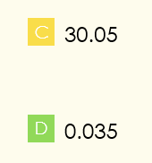
Develop learning
Year 3
Year 4
35 ÷ 100 =
Can you explain why the other answers are wrong?
Can you explain what went wrong?

Slide 8
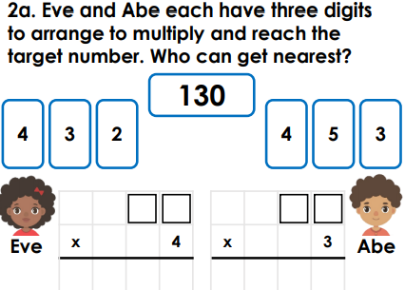
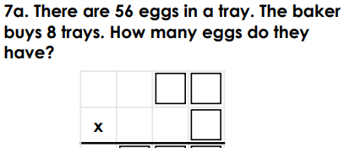
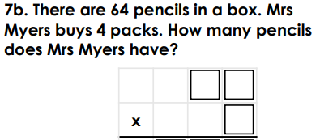
Independent Task
2
Year 3
1
1
3

Slide 9
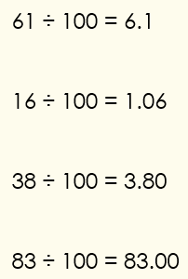
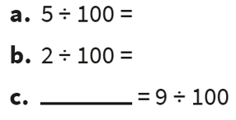
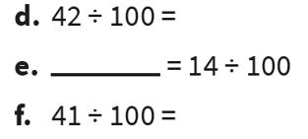
Independent Task
Year 4
1
What is 7 ÷ 100?
3
Check these calculations and correct any errors made.
What is 92 ÷ 100?
2

Slide 10
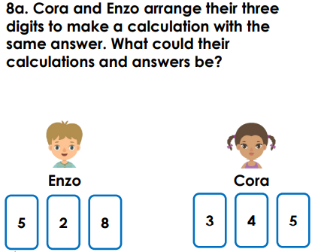
Independent Task
Year 3
Year 4
Tom says, “When you divide by 100, you can just put two zeros in front of the number.”
Explain Tom’s mistake.

Slide 11
Plenary
Year 3
Year 4
Convince me:
27 x 6 = 136
What do you think?
Convince me!
Convince me:
0.61 is the same as 61/100
What do you think?
Convince me!

