Slide 1
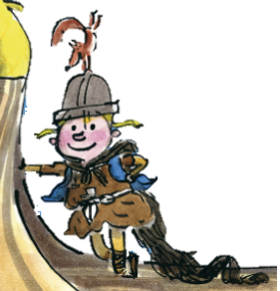
The Littlest Viking
Stories with different points of view
Monday 17 May 2021

Slide 2
LI: Can I plan a story written from one character’s point of view?
Stories with different points of view
Steps to success:
I can plan the plot points (paragraphs)
I can gather vocabulary to use
I can write my lens sentence to include in the final piece.

Slide 3
Planning your independent write
We have brainstormed story ideas
You have planned what will happen next in the story
You have selected your lenses to include as your steps to success

Slide 4
Planning your independent write
Use the detailed planner to add more detail to your plan.
You can change your mind about your story and plotpoints.
Gather good vocabulary to help your write your lens sentence
Then, write your lens sentence to include in your writing tomorrow.

Slide 5
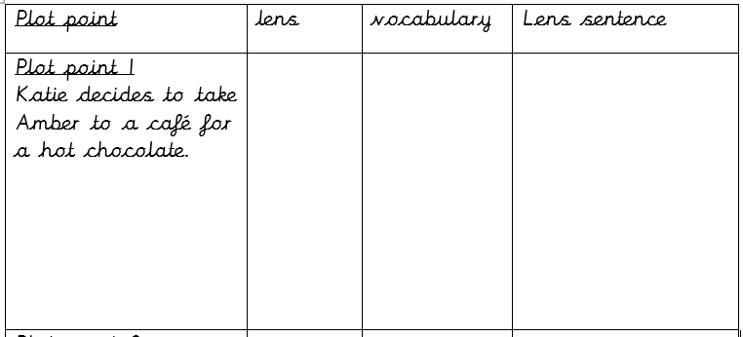
Planning your independent write - Example
Aroma
Sweet
Pleasant
Satisfying
Katie breathed in the sweet aroma, it was a satisfying smell that stopped her worries about Amber for a moment.
Brief summary of the plot point (paragraph)
Draw the lens you are going to use.
Gather lens vocabulary
Write your sentence. You can always deepen the moment

Slide 6
Share and feedback
Share your work
What sentence are your proud of?
What does the class think of the work?
How could we make it even better?

