Slide 1
I can explain what happens in a Christian marriage service.
I can identify the sequence of events in a marriage service in church.
I know that a marriage is a legal and religious event. It is a sacrament in Christianity.
I know that a marriage vow is an agreement made before God.
I can recognitise that some marriages break up.

Slide 2
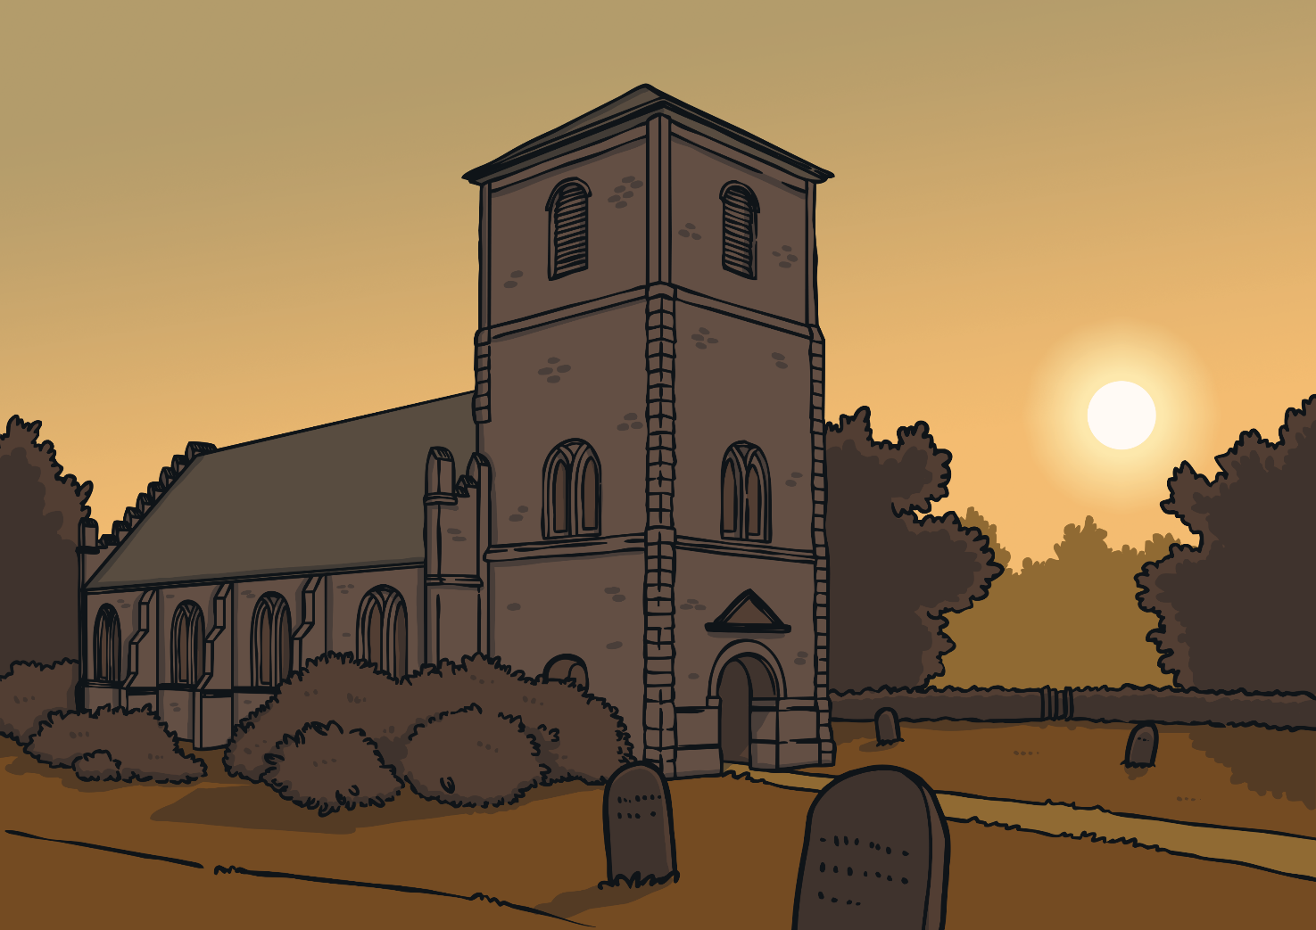
Who Are Christians?
Christians are a group of people who follow Jesus. Their special building is called a church and
their special book is the Bible.
Tell your partner anything you
know about the Christian faith.
Talk About It

Slide 3
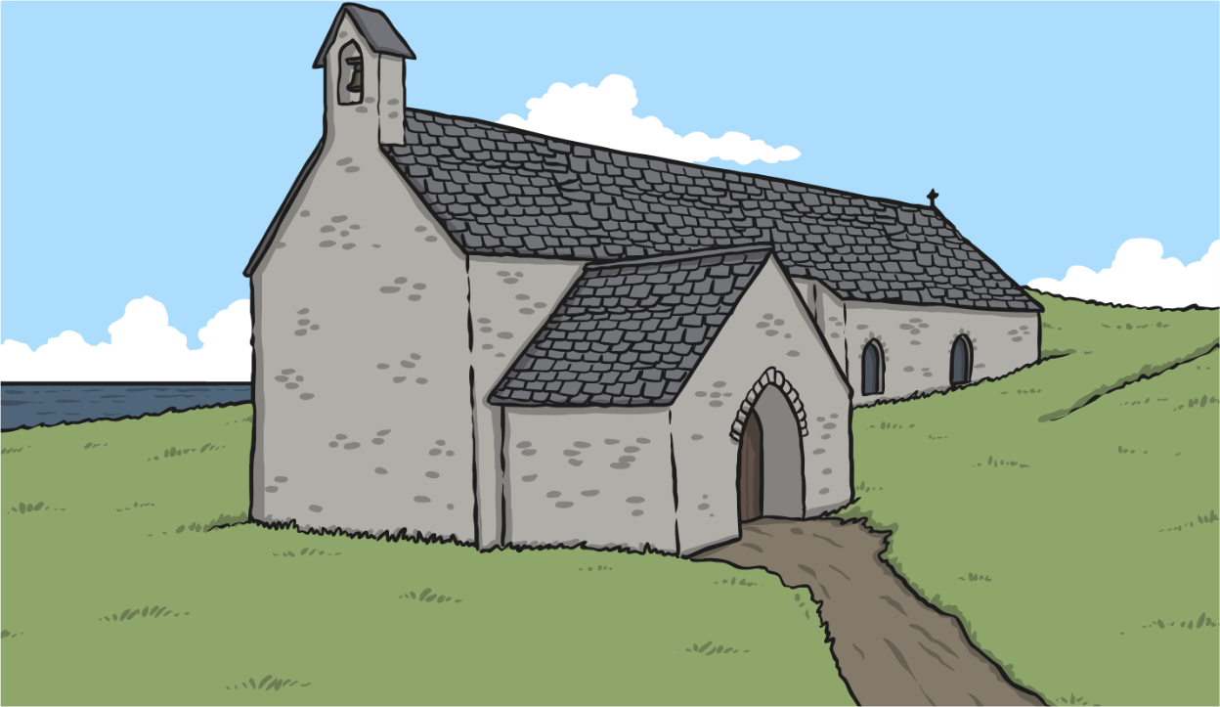
Before the Wedding
The people getting married decide when they are going to get married.
They send invitations to their friends and family.
Sometimes they send out a gift list. The guests
can buy presents from this list.
What would you put on a wedding gift list?
Wedding
Invitation
Talk About It

Slide 4
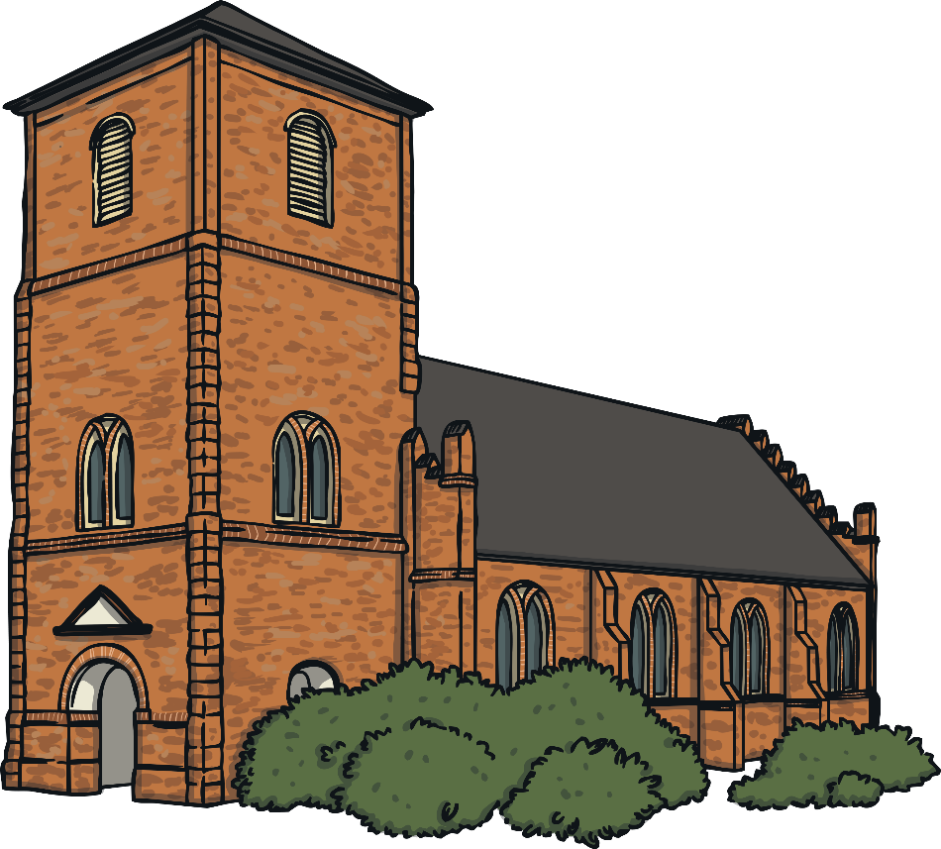
Where Does a Christian Wedding Take Place?
A Christian wedding happens in a church.

Slide 5
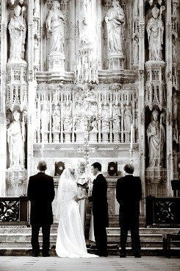
Church wedding
The picture shows a traditional Christian marriage in a church. You can see the bride is wearing a long white dress. On the left of the picture is the father of the bride and on the right is the best man. (Sometimes a bridesmaid may stand behind.) The priest stands between the bride and groom.

Slide 6
Who Takes Part in a Christian Wedding?
Click on the circle to find out more about the people in a wedding.
The Couple
Performs the marriage ceremony.
A good friend or relative of the groom.
The people getting married.
The priest, minister or vicar
The best man
The father of the bride
Walks the bride to the front of the church.
Shows the guests where they need to sit before the wedding.
Bridesmaids
Ushers
Friends or relatives of the bride.

Slide 7
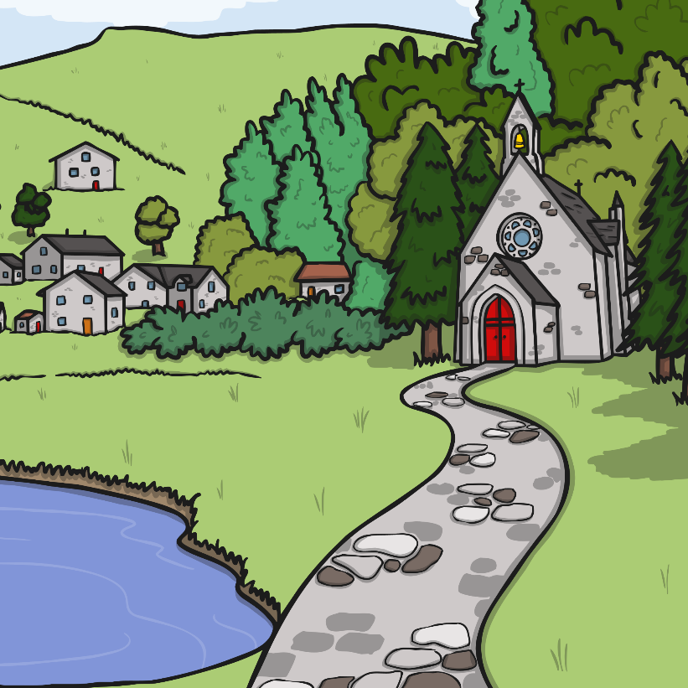
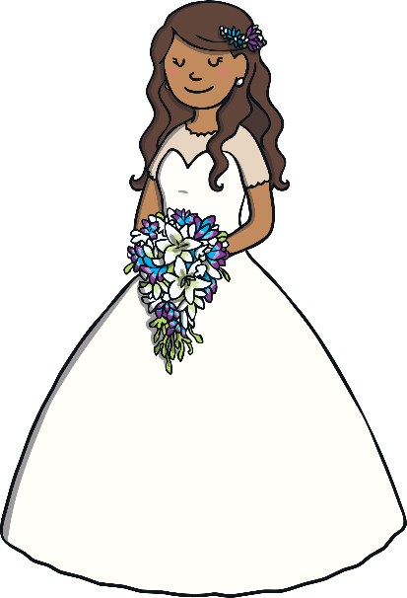
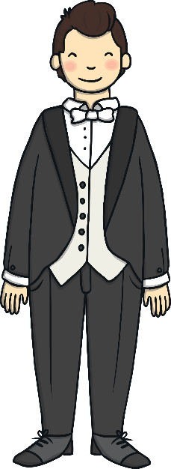
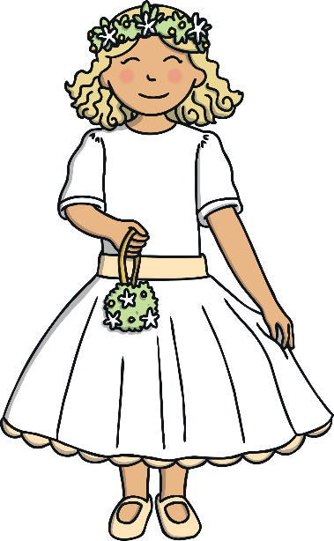
What Do People Wear at a Wedding?
Guests at a wedding will wear smart clothes.
Sometimes women wear big hats.
A groom will wear a smart suit and have a flower in his button hole. Sometimes grooms have a special hat called a top hat.
A bride often wears a long white dress. Sometimes a bride wears a veil, which is a see-through material which goes over her head. The bride often carries a bunch of flowers.
Bridesmaids wear nice dresses. They sometimes wear flowers in their hair and carry a bunch of flowers. They help the bride on her special day.

Slide 8
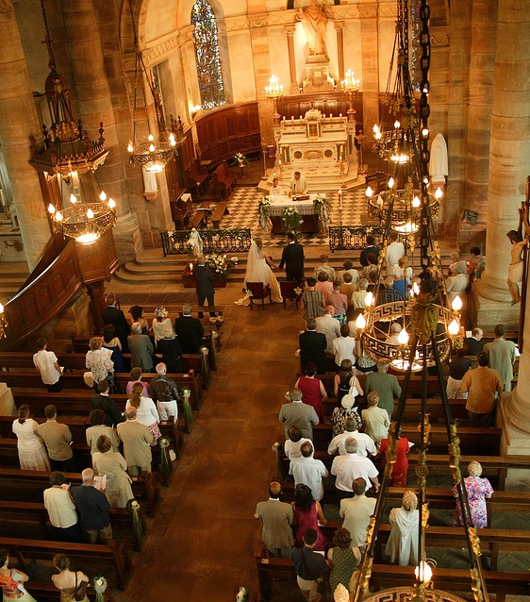
What Happens at a Wedding?
When the couple arrive at the church, special music will start playing. The guests all stand up and the couple walk to the front of the church where the vicar is waiting.

Slide 9
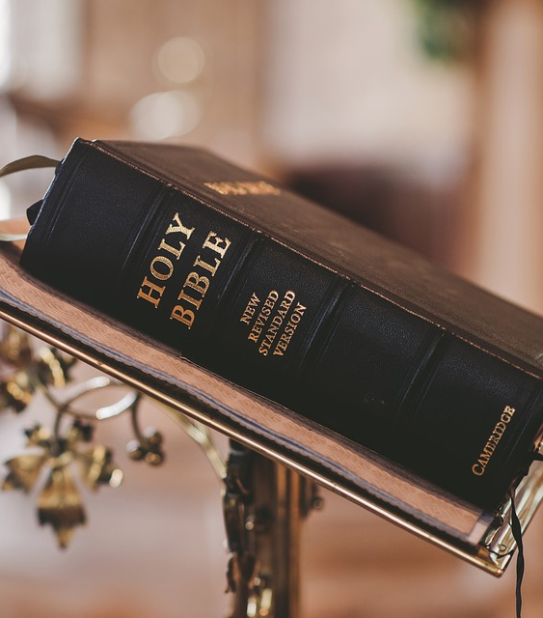
What Happens at a Wedding?
Sometimes special songs called hymns are sung. Parts from the Bible or special poems are read.

Slide 10
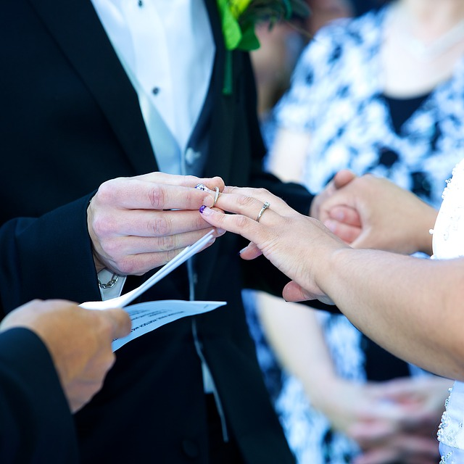
What Happens at a Wedding?
The couple make promises to each other called vows.
These often include these words:
‘…for better, for worse, for richer, for poorer, in sickness and in health, to love and to cherish…’
The couple give each other rings as
a sign of their love and to show that
they are married.

Slide 11
The wedding vows
In the Church of England the priest says,
Heavenly Father, by your blessing let these rings be to N and N a symbol of unending love and faithfulness, to remind them of the vow and covenant which they have made this day through Jesus Christ our Lord.
Amen
Look closely at the words. The priest talks about a vow and covenant. What are they again?

Slide 12
The wedding vows
For Christians the vows are the most important part of the service. They are an agreement or a promise made in the presence of God. Sometimes in a Church, sometimes not but the promise / vows are with God. Christians believe that it is God that joins the two together and not the priest.
The priest says:
The vows you are about to take are to be made in the presence of God, who is judge of all and knows all the secrets of our hearts; therefore if either of you knows a reason why you may not lawfully marry, you must declare it now.

Slide 13
The wedding vows
The couple promise God that they will love and care for each other until death:
(Name), will you take (Name) to be your wife? Will you love her, comfort her, honour and protect her, and, forsaking all others, be faithful to her as long as you both shall live?
A marriage in Church is both a legal and a religious event. After the marriage the couple sign a document to seal the contract that they have made with each other.

Slide 14
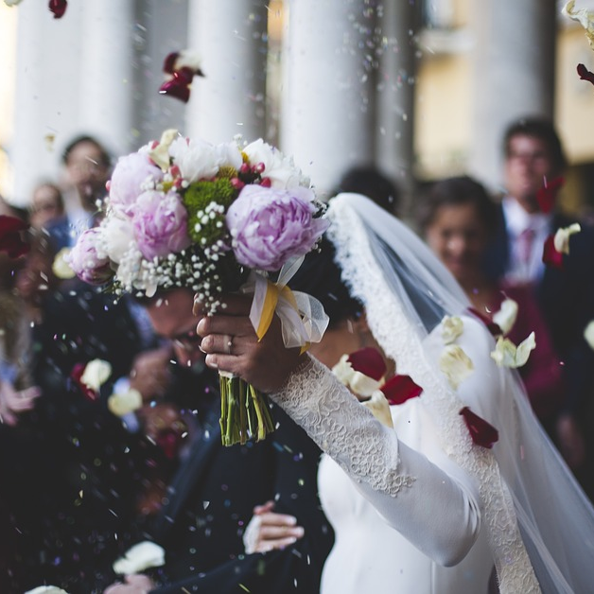
What Happens at a Wedding?
After the vows and giving of the rings, the vicar, minister or priest says that the couple are now married. Often they
then kiss.
The couple sign a register, which is a
legal record to show that they are
now married.
After that, special music will play
and they walk back up the church
aisle and outside.
Guests sometimes throw confetti or
flower petals in celebration.

Slide 15
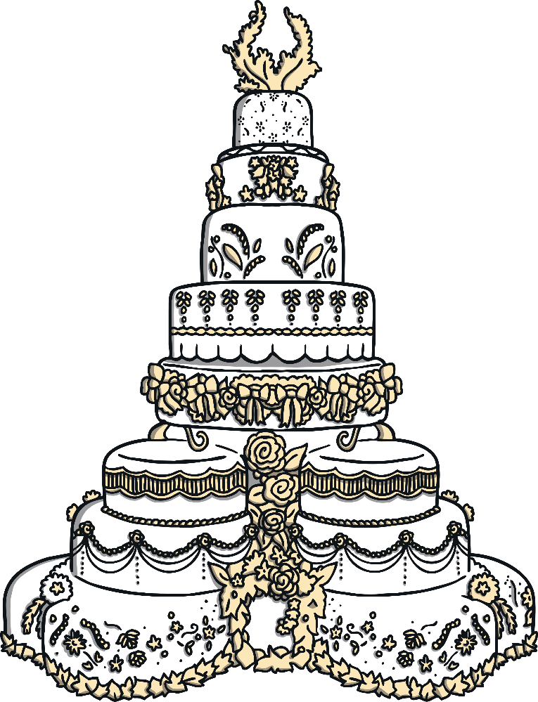
What Happens After the Wedding?
After the wedding ceremony, there is a big party called a wedding reception.
The guests have lots of yummy food.
Some of the people make speeches about the special day. There is a cake which the couple cut.
After the food, people sometimes dance to a
band or a DJ. It is a happy time.

Slide 16
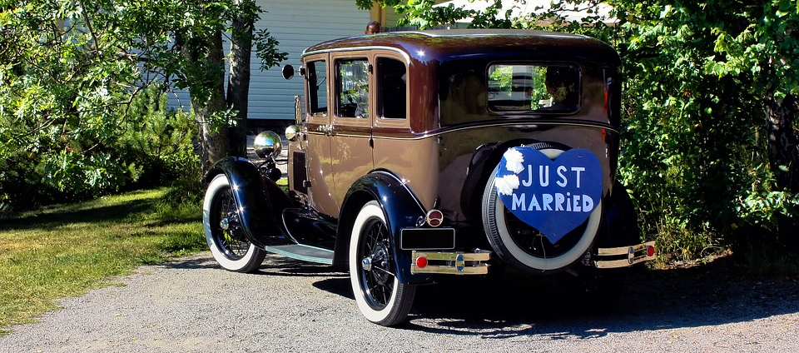
What Happens After the Wedding?
At the end of the wedding reception, the guests go home.
The newly-weds go on a special holiday called a honeymoon.

Slide 17
What Happens After the Wedding?
A marriage in Church is both a legal and a religious event. After the marriage the couple sign a document to seal the contract that they have made with each other.
Today however people generally live longer and a lifetime commitment can be very difficult for some people. Christians recognise that sometimes people grow apart no matter how hard they try. All Christian churches try to help couples stay together but they realise that there might be a real problem and divorce is inevitable
When these couples form new relationships they often want to remarry in Church. Some priests will remarry divorced couples but others will not because they feel that having made the vow to God once, a blessing is more appropriate.
All Christians believe that God is forgiving and understanding and would not want people to live in an unhappy relationship

Slide 18
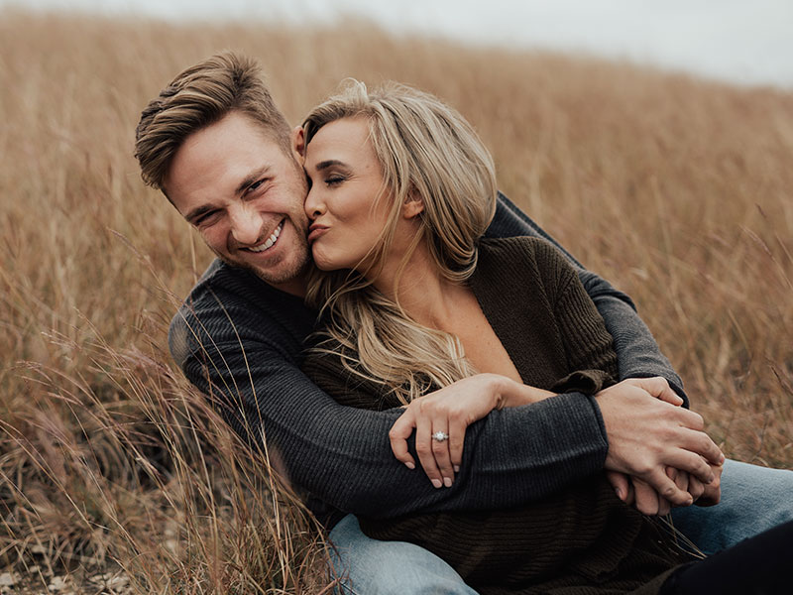
Be a wedding planner
Wedding planners help people to plan their wedding day.
They make a itinerary of the day (a timetable).
You are going to be a wedding planner for this couple.
What are they going to do on their ‘Big Day’ and in what order?

