Slide 2
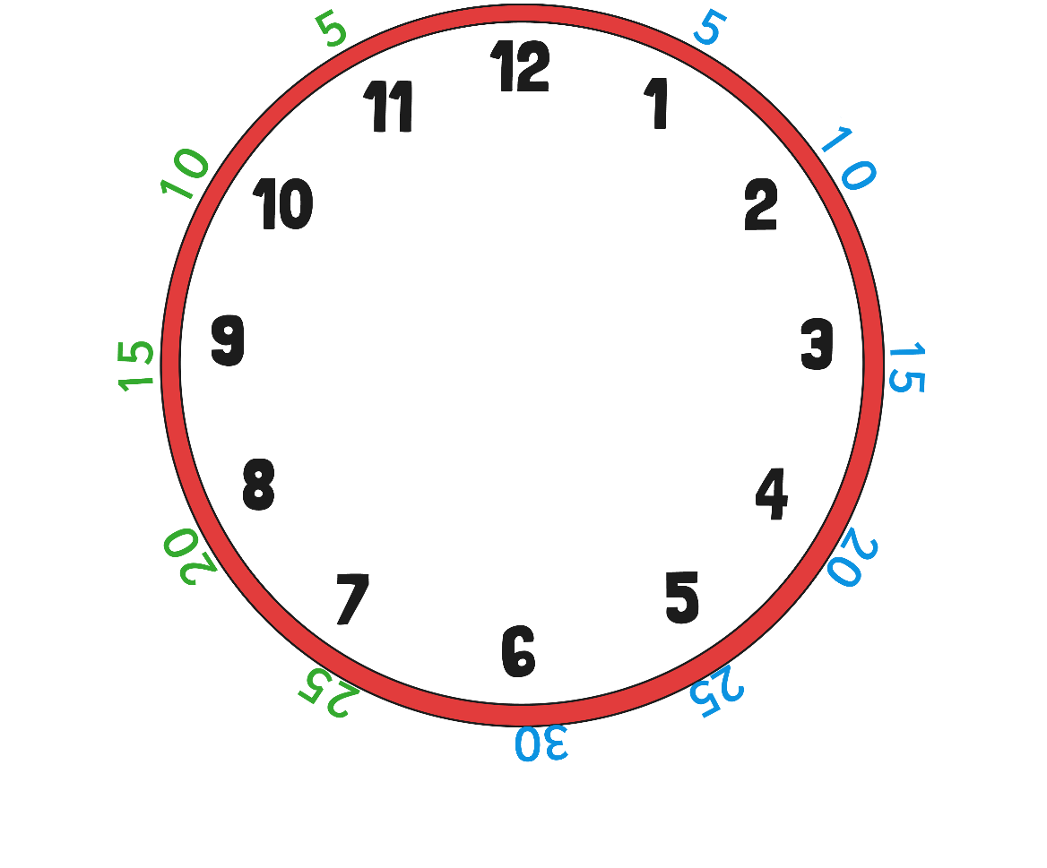
00
Each number on the clock represents 5 minutes. So we can count round in 5s.

Slide 3
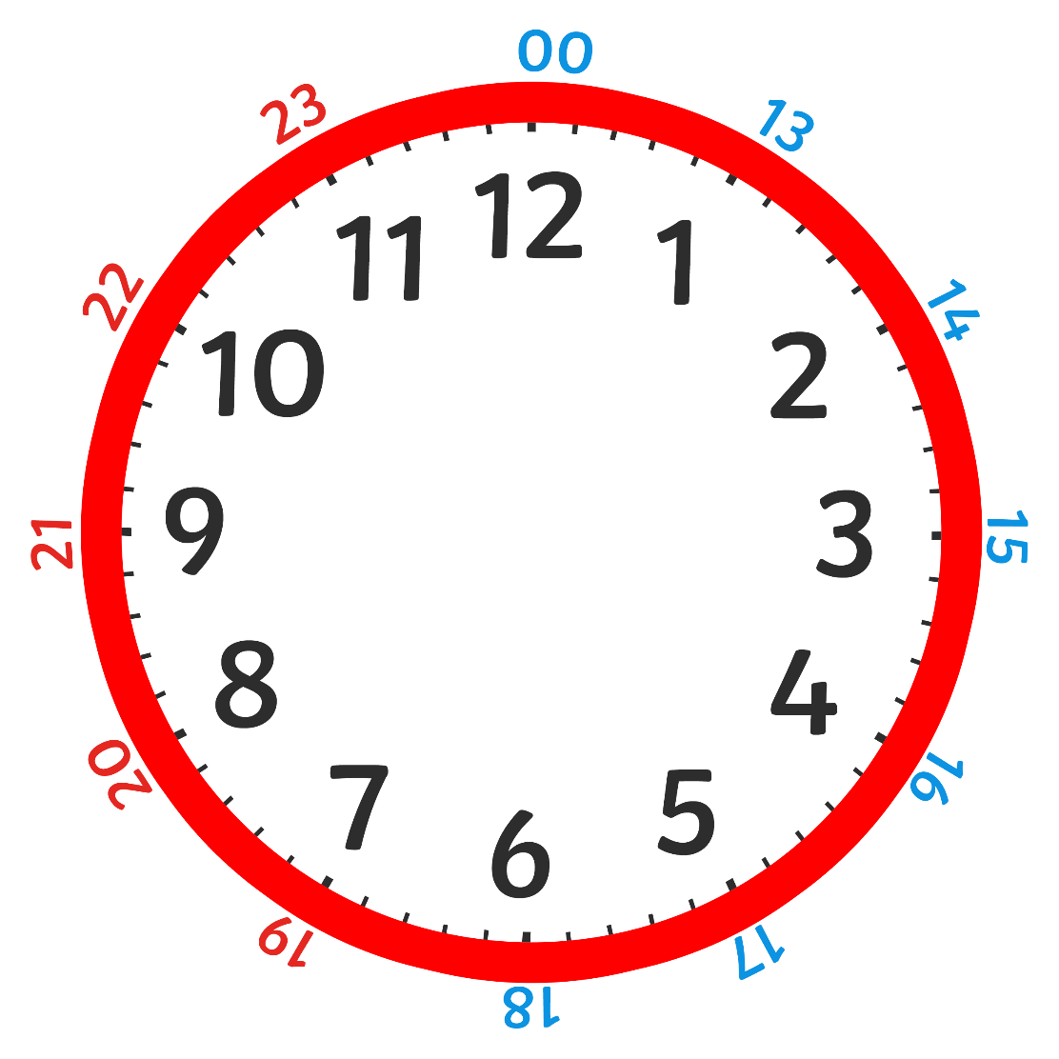
On a 24 hour clock, once we get past 1pm we add 12 hours on to the time shown on the clock face.

Slide 4
24 Hour Digital Clocks
2
1
1
5
24 hour digital clocks also have an hour and minute display, separated by a colon.
The hours will always be before the colon. The hours go from 0 to 23.
The minutes will always be after the colon.

Slide 5
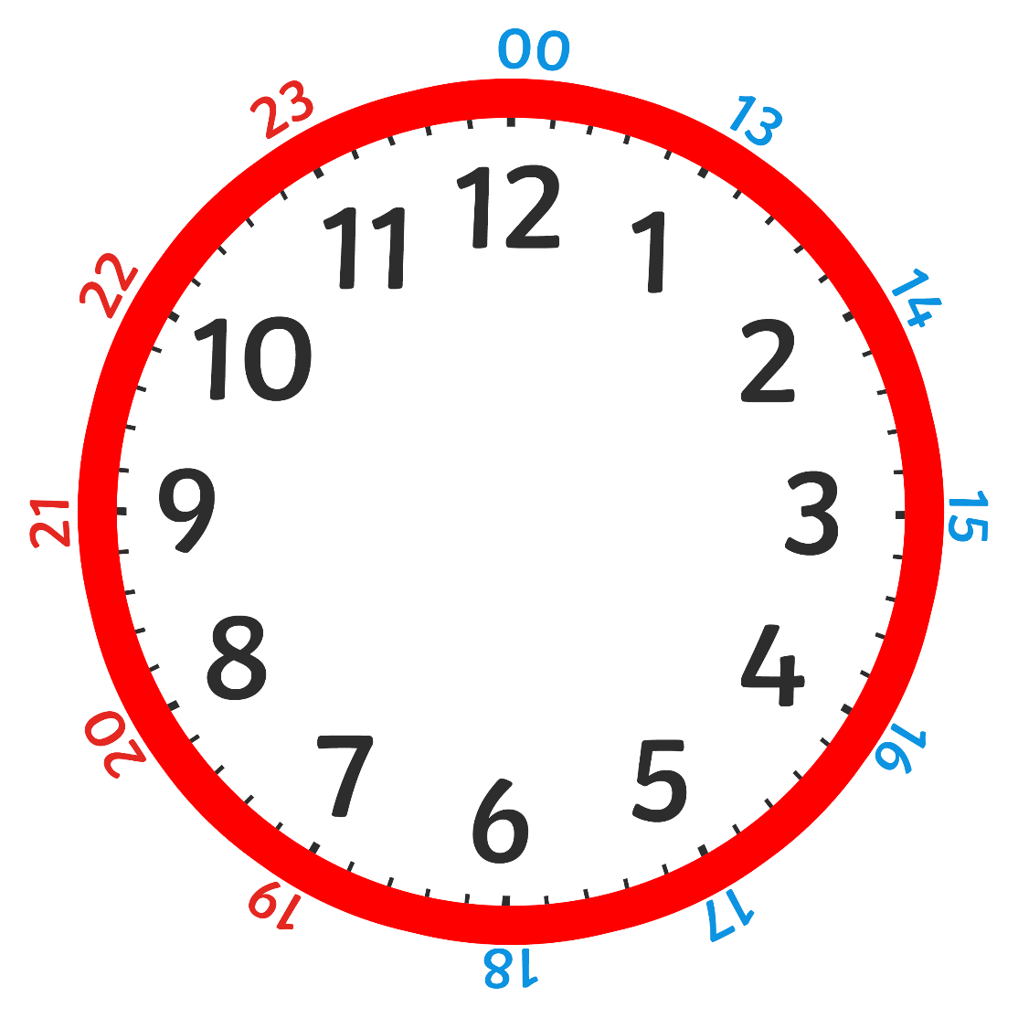
Converting From 12 to 24 Hour Clocks
1
5
0
0
Do the clocks show the same time?
What is the same about the clocks?
What is different?

Slide 6
Converting From 12 to 24 Hour Clocks
0
3
3
0
1
5
3
0
What is the digital time represented by the analogue clock?
On a 24 hour clock this could be two different times, what would they be?

Slide 7
Try This One
0
1
4
5
1
3
4
5

Slide 8
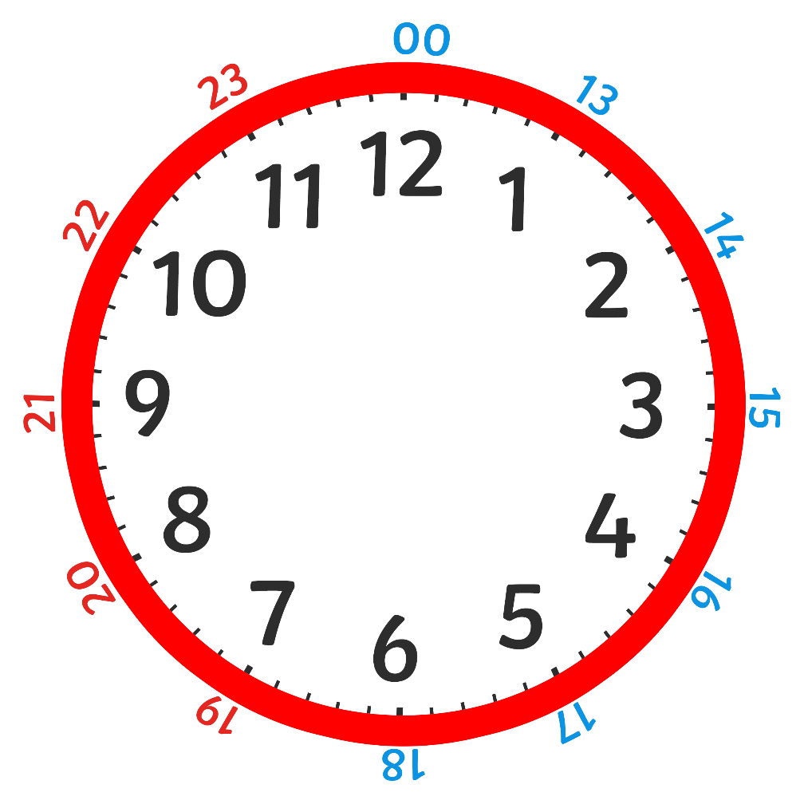
What About This One?
0
7
2
5
1
9
2
5

Slide 9
Feeling Confident?
0
3
5
0
1
5
5
0

Slide 10
https://vimeo.com/542539608

