Slide 1
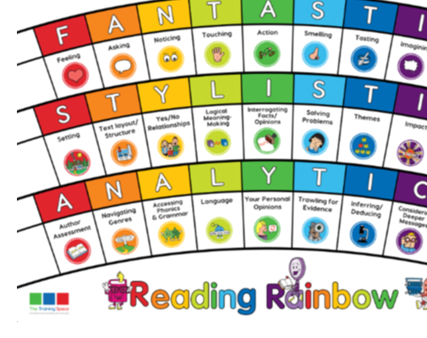
BOOK TALK
Lesson 1: Initiate

Slide 2
Our LI’s for the week: Band 3/4 - Can I draw inferences such as inferring characters' feelings, thoughts and motives from their actions, and justifying inferences with evidence clearly taken from the text? - Can I identify main ideas drawn from more than one paragraph and summarise these?

Slide 3
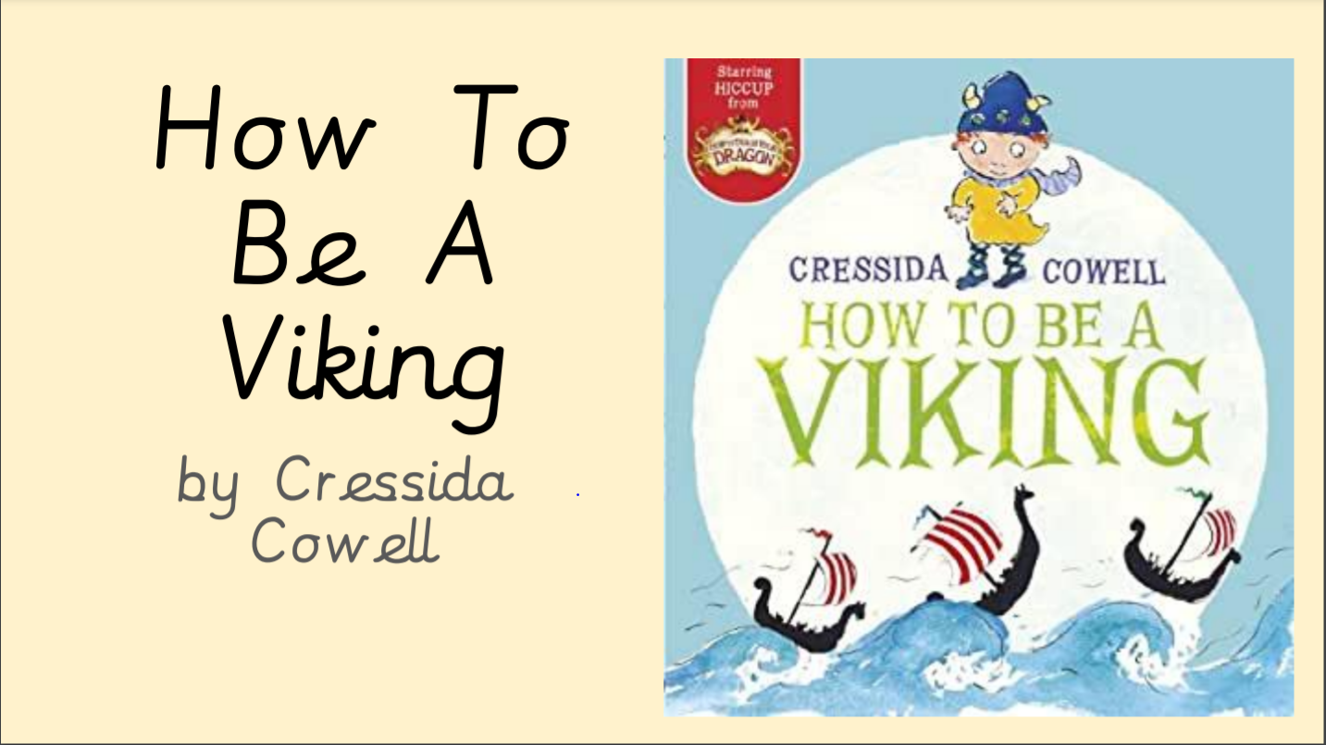
Fiction: How to be a Viking
We are focusing on these 2 lenses
this week:
FANTASTICS: Action
ANALYTICS: Trawling for evidence

Slide 4
Sentence starters:
In your books, write down the following sentence starters for each of the lenses. These will help you when you write your answers this week.
Action:
The action of the central character reflects…
A gripping, action-packed part of the story is…
Trawling for evidence:
Evidence that Hiccup is seasick is…
The writer doesn’t directly state, but hints that Hiccup is frightened through…

Slide 5
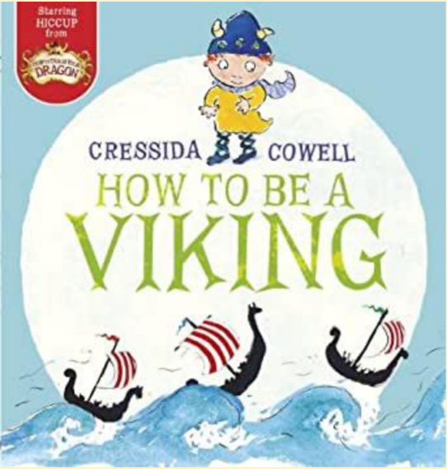

Slide 6
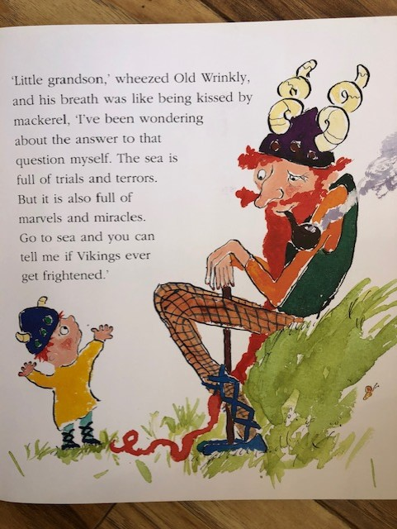
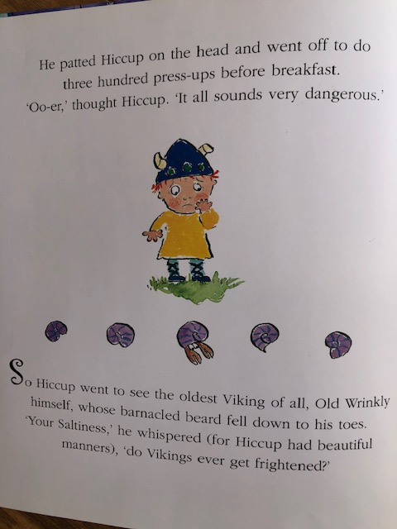

Slide 7
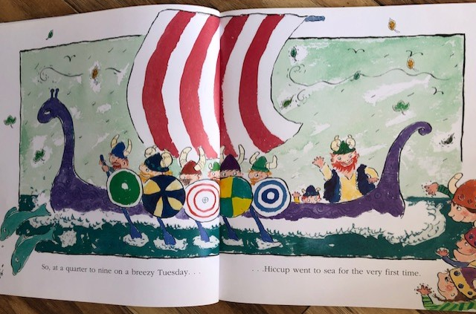

Slide 8
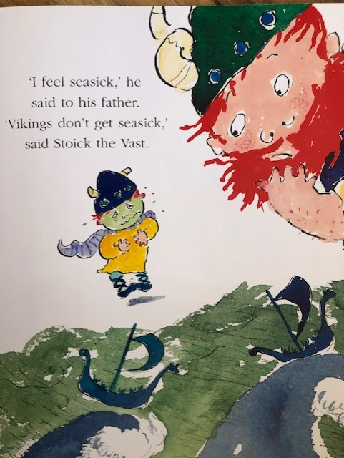
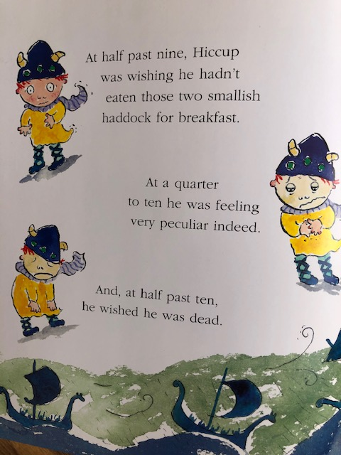

Slide 9
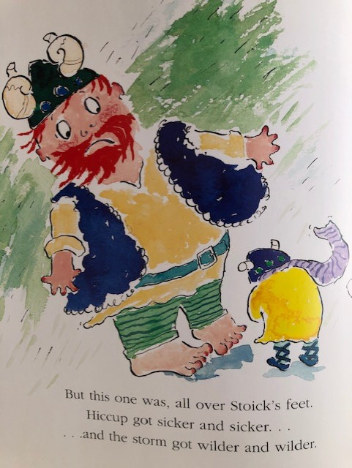

Slide 10
Action:
Can you verbally answer the questions using a sentence starter? (2 points)
Why do you think Hiccup reacted the way that he did on the ship?
The action of the central character reflects…
Can you explain a part of the story that really grips you?
A gripping, action-packed part of the story is…

Slide 11
Trawling for Evidence:
Can you verbally answer the questions using a sentence starter? (2 points)
Find three pieces of evidence that Hiccup is seasick.
Evidence that Hiccup is seasick is…
How can you tell that Hiccup is frightened to go to sea?
The writer doesn’t directly state, but hints that Hiccup is frightened through…

Slide 12
BOOK TALK
Lesson 2: Model

Slide 13
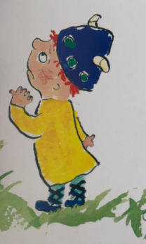
Lesson 2 – Model
We are focusing on these 2 lenses
this week:
FANTASTICS: Action
ANALYTICS: Trawling for Evidence
We will write the answers together, but you can add in extra information if you would like to.

Slide 14
Action:
Trawling for Evidence:
Why do you think Hiccup reacted the way that he did on the ship?
The action of the central character reflects…
Can you explain a part of the story that really grips you?
A gripping, action-packed part of the story is…
Find three pieces of evidence that Hiccup is seasick.
Evidence that Hiccup is seasick is…
How can you tell that Hiccup is frightened to go to sea?
The writer doesn’t directly state, but hints that Hiccup is frightened through…

Slide 15
BOOK TALK
Lesson 3: Enable

Slide 16
Lesson 3: Enable
Today is your turn to answer questions on your own.
Please use the sentence starters from this week to help you.
FANTASTICS: Action
ANALYTICS: Trawling for Evidence

Slide 17
Lesson 3: ENABLE (Independent comprehension)
Year 3
1. Why do you think Hiccup reacted the way that he did on the ship?
The action of the central character reflects…
2. Can you explain a part of the story that really grips you?
A gripping, action-packed part of the story is…
3. Find two pieces of evidence that Hiccup is seasick.
Evidence that Hiccup is seasick is…
4. How can you tell that Hiccup is frightened to go to sea?
The writer doesn’t directly state, but hints that Hiccup is frightened through…
Bonus question
4 ) How does the author use expanded noun phrases to make the story more exciting?
A sentence that ‘caught our eye’ was ______________ because….
Year 4
1. How does Hiccup react when he is on the ship and why?
The action of the central character reflects…
2. Can you explain a part of the story that grips the reader?
A gripping, action-packed part of the story is…
3. Find three pieces of evidence that Hiccup is seasick.
Evidence that Hiccup is seasick is…
4. Which sentence is the story shows that Hiccup is frightened to go to sea?
The writer doesn’t directly state, but hints that Hiccup is frightened through…
Bonus question
4 ) How does the author use expanded noun phrases to make the story more exciting?
A sentence that ‘caught our eye’ was ______________ because….

