Slide 1
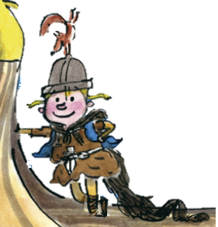
The Littlest Viking
Stories with different points of view
Thursday 6 May 2021

Slide 2
LI: Can I draft and write stories with different points of view?
Stories with different points of view
Steps to success:
I can use the imagining lens
I can write a sentence with a subordinate clause
I can use the basics lens to create expanded noun phrases

Slide 3
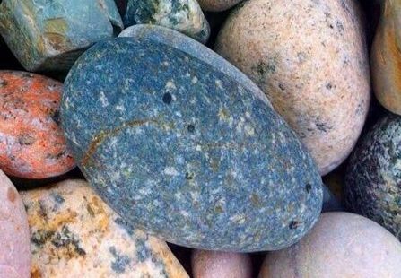
Plot point 2: Finding treasure

Slide 4
Finding treasure
“Here’s something, here’s something”, shouted Joshua.
What do you think Katie and Gary are thinking looking at their excited little brother jumping for joy?
Chot what Katie might think – she is the sensible one, so sensible thoughts.
Chot what Gary might think – he is ‘the cool one’.
Katie
Gary
1.

Slide 5
Finding treasure
Let’s share our ideas.
Katie
Let’s pretend it something nice. Joshua will like that.
There can’t be anything good in this mess.
Gary
Urgh, I don’t want to walk over. My shoes will get dirty.

Slide 6
Finding treasure
Model sentence:
“Here’s something, here’s something”, shouted Joshua. Gary thought it unlikely Joshua had found anything interesting. Katie wanted to please her brother and pretended to be interested.
Your task:
Show the different points of view from Katie and Gary about the exciting find.
Deepen the moment: Use actions to describe what Katie and Gary are doing at this moment.

Slide 7
Finding treasure
What exciting piece of flotsam might Joshua have found?
Write your ideas in the second box. Add some descriptions too.
2.

Slide 8
Finding treasure
Let’s share our ideas.
Here are some things I thought of:
A rock that glitters
A small wooden chest with a lock
A big, rusty key
2.

Slide 9
Finding treasure
How might Joshua be holding the treasure.
Chot verbs and adverbs in the third box.
3.

Slide 10
Finding treasure
Let’s share our ideas.
Here are some things I thought of:
Clutching tightly to his chest
Holding gently
Tugging forcefully
3.

Slide 11
Finding treasure
Model complex sentence:
Joshua, carefully clutching a round yellow stone, walked excitedly over to his brother and sister.
Your task:
Write a sentence with a subordinate clause.
Deepen the moment: Show or describe how Joshua is feeling.

Slide 12
Finding treasure
…. as he did so the strangest thing happened.
The object is going to change colour or shape. Think of some interesting colour words and shape words. Remember, you can use the word mats for inspiration.
3.

Slide 13
Finding treasure
Let’s share our ideas.
Here are some things I thought of:
Fiery ruby
Light sapphire
Vivid emerald
Sparkly topaz
Angular
Bulbous
Cuboid
Curved
3.

Slide 14
Finding treasure
Model sentence:
As he did so the strangest thing happened. The deep golden colour turned a light sapphire. Gary grabbed the stone to have a better view. It turned deep golden again.
Your task:
Describe how the object Joshua has found changes (colour or shape).
Deepen the moment: Use the imagining lens to describe what child is thinking.

Slide 15
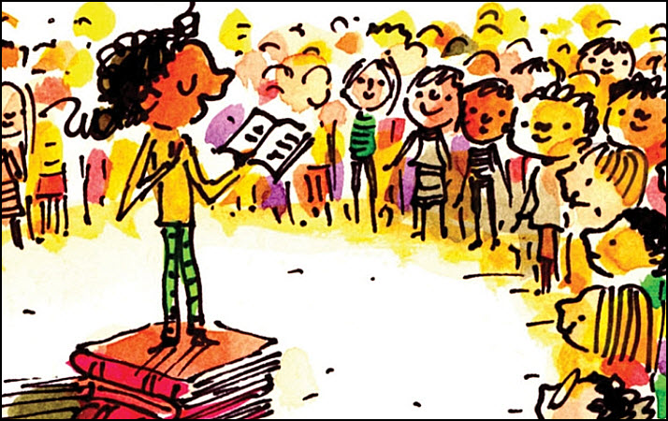
Share and feedback
Share your work
What sentence are your proud of?
What does the class think of the work?
How could we make it even better?

