Slide 1
Year 3
L.I - Can I order fractions?
Steps to success
I can identify the numerator and denominator.
I can compare the fractions.
I can identify the order of the fractions.
Challenge: True or false?
Year 4
L.I - Can I subtract fractions from whole amounts?
Steps to success
I can identify the numerator and denominator.
I can subtract the fractions by looking at the numerators.
I can use different representations.
Challenge: True or false?

Slide 2
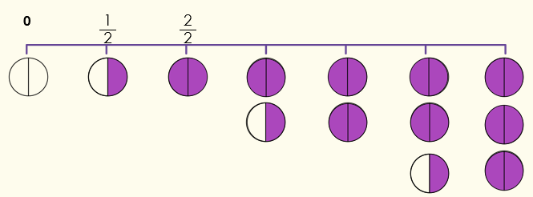
In Focus Task
Complete this number line.

Slide 3
New Learning
Year 3
Year 4
Which statement describes these fractions?
3 – $\frac{\text{3}}{\text{11}}$ =
$\frac{\text{2}}{ \text{6} }$ $\frac{\text{3}}{ \text{6 }}$ $\frac{\text{5}}{ \text{6 }}$ $\frac{\text{6}}{ \text{6 }}$
1. This cannot be completed.
1. They are equivalent
2. They are equal to 1
3. They are in ascending order
4. They are in descending order
2. $\frac{\text{8}}{\text{11}}$
3. $\frac{\text{0}}{\text{11}}$
4. 2$\frac{\text{8}}{\text{11}}$

Slide 4
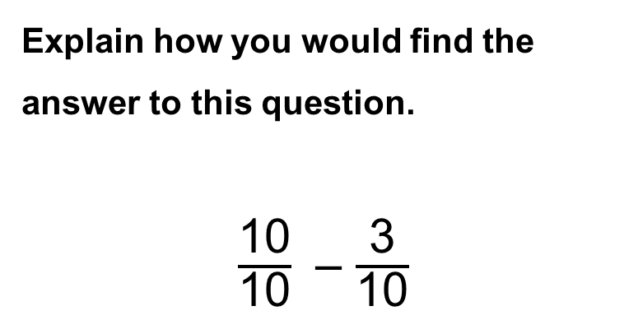
New Learning
Year 3
Year 4
< , > , or = ?
Explain how you know.
Explain how you would find the answer to this question.
$\frac{\text{10}}{\text{10}}$– $\frac{\text{3}}{\text{10}}$

Slide 5
New Learning
Stem sentences:
Y3:
When the denominators are the different and the numerator is the same, the greater the denominator, the smaller the fraction.
Y4: When subtracting fractions that have the same denominator, you only change the numerator.

Slide 6
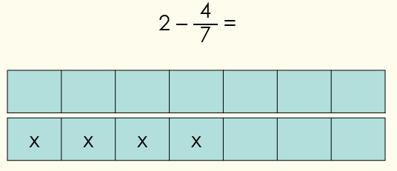
Talk Task
Year 3
Year 4
The mathstronaut takes four strips of paper. She splits one into thirds, one into half, one into eighths and one into quarters.
She colours one section of each of her strips.
Can you help her order the strips from the smallest to the largest fraction?
Use this bar model to solve the calculation.
Draw a bar model to solve this calculation:
2 – $\frac{\text{8}}{\text{10}}$ =

Slide 7
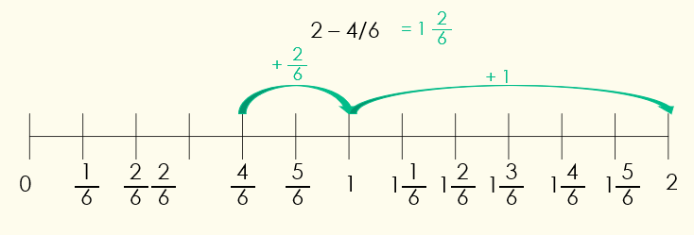
Develop Learning
Year 3
Place the fractions on the number line.
$$\frac{\text{2}}{ \text{6} }$$
$$\frac{\text{1}}{ \text{6} }$$
$$\frac{\text{3}}{ \text{6} }$$
$$\frac{\text{5}}{ \text{6} }$$
1
0
Year 4

Slide 8
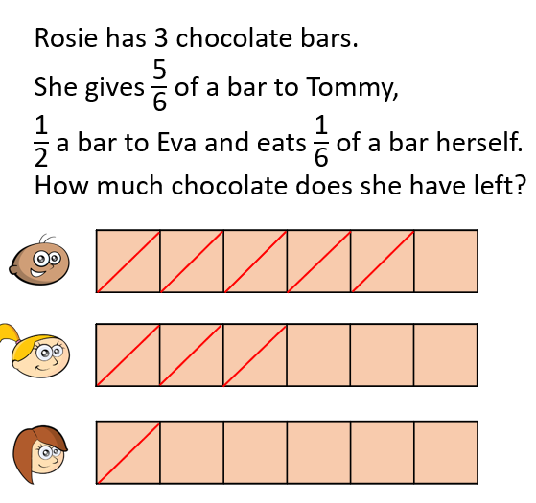
Develop Learning
Year 3
Year 4
The mathstronaut has ordered some fractions.
Is he correct? How do you know?
Has he ordered the fractions in ascending order or descending order? How do you know?
$\frac{\text{1}}{ \text{9} }$, $\frac{\text{3}}{ \text{9} }$, $\frac{\text{4}}{ \text{9} }$, $\frac{\text{8}}{ \text{9} }$, $\frac{\text{9}}{ \text{9} }$

Slide 9
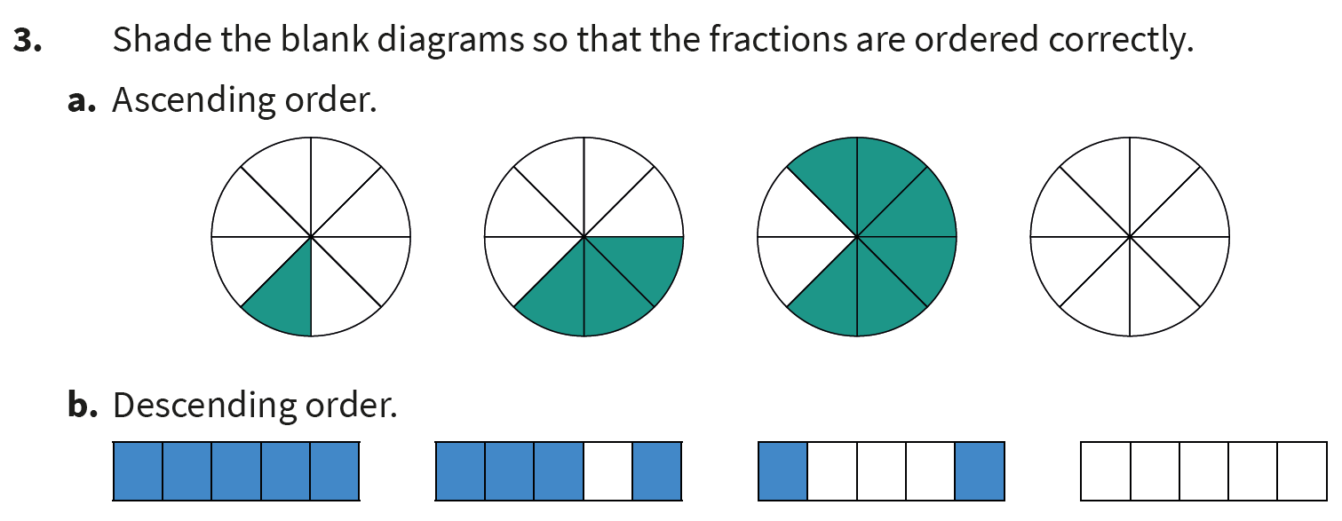
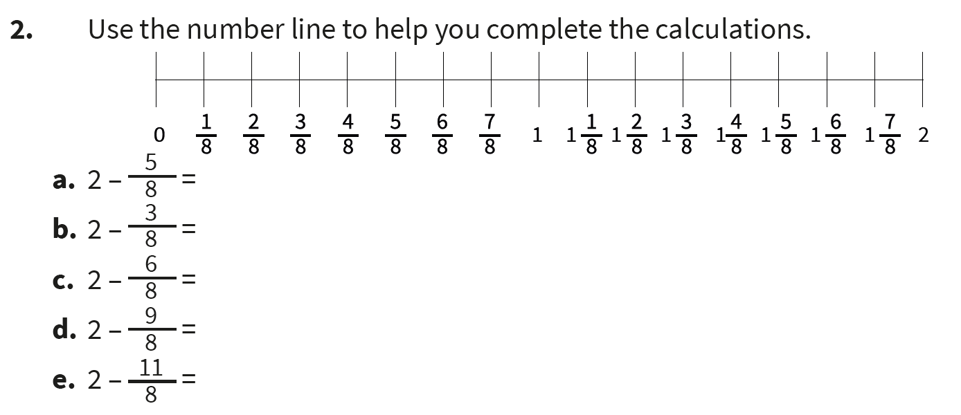
Independent Task
Year 3
Year 4

Slide 10
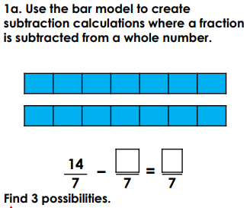
Plenary
Year 3
Year 4

