Slide 1
Explanation text
Tuesday 8th December 2020

Slide 2
Can I plan my writing by discussing writing that is similar?
Today we will focus on ‘Diagrams’.
Today we will use:
Technical vocabulary
A ruler to draw straight lines
Neat handwriting, joining letters.

Slide 3
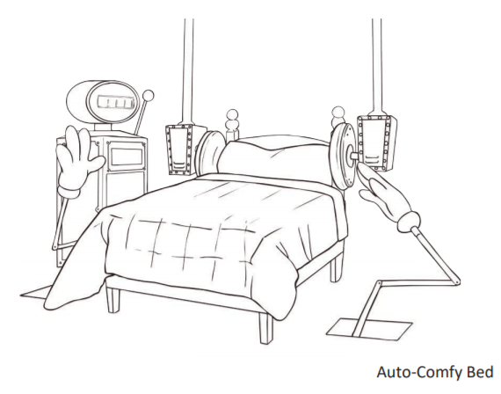
Diagrams
https://www.youtube.com/watch?v=d54yH2sNpw4
Looking at the diagram, explain to your partner how the ‘Snoozetron’ works.

Slide 4
Diagrams
Diagrams help people to quickly see the main functions
Chotting
List all the made up technical vocabulary and iRobot Dog special functions.

Slide 5
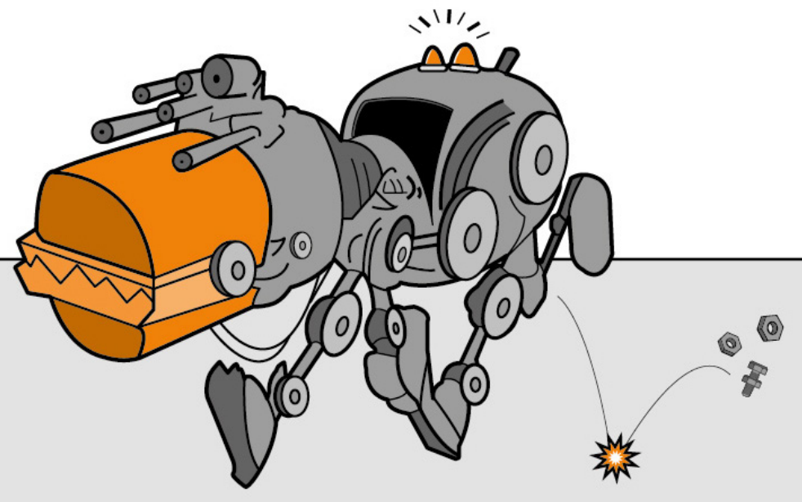
Diagrams
Using a ruler, label the main functions and features of the iRobot Dog.
Dynamo wagger
Mechanical chomp
Caption to describe the picture

Slide 6
Diagrams
Diagrams help people to quickly see the main functions
Independent task
For your independent write you will write an explanation about the digestive system.
Label the diagram using the scientific vocabulary.
You will use the diagram for your published piece.

