Slide 1
Y3 LI: Can I explore multiplying by 8? - Share into equal groups of 8 - Group into 8’s - Use concrete and pictorial representations. - Check my answers by using the inverse operation Challenge: Reasoning and problem-solving. Y4 LI: Can I explore multiplying by 7? - Apply knowledge of the 7 times table when multiplying and dividing - Check my answers by using the inverse operation. - Know that multiplication is commutative. - Challenge: Reasoning and problem-solving.

Slide 2
Focus task
Year 3
Count in 8s to 96.
How many 8s are in 16?
How many 8s are in 32?
How many 8s are in 64?
How can you draw this in an array?
Year 4
Count in 7s to 84.
How many 7s are in 21?
How many 7s are in 35?
How many 7s are in 70?
Now, count in 7s to 84.
Can you do it?
What happens?

Slide 3
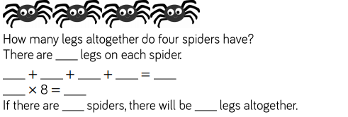
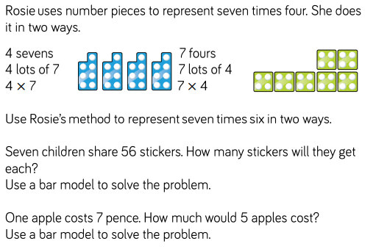
Year 3 in books
Year 4 in books

Slide 4
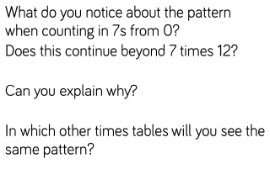
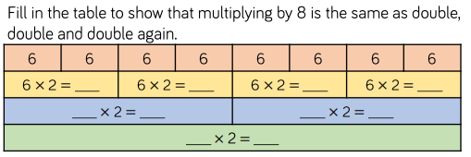
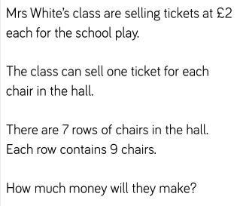
Year 3 in books
Year 4 in books
.

Slide 5
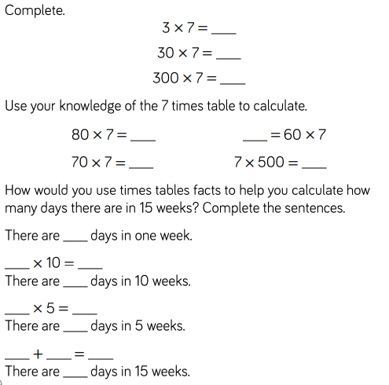
Year 3 in books
Year 4 in books
0 7 14 21 28 35 42 49 56 63 70

Slide 6
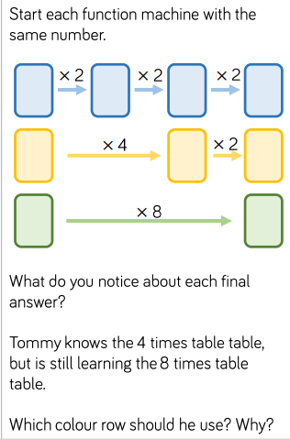
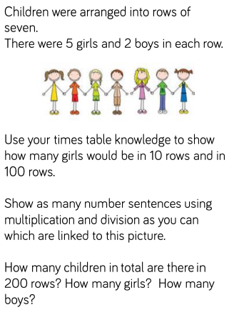
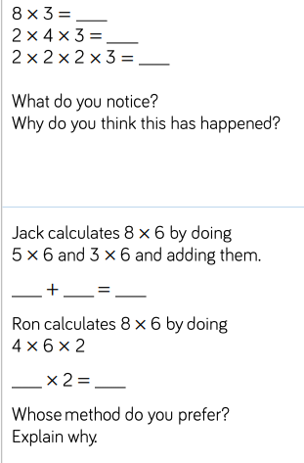
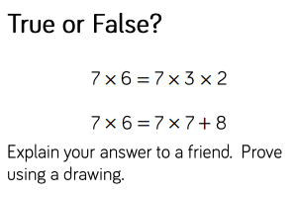
Lightbulb challenge Year 3 in books
Lightbulb challenge
Year 4 in books

