Slide 1
Y3 LI: Can I divide by 5? Y4 LI: Can I divide by 100?

Slide 2
Focus task
Year 3
Count in 5s to 50.
How many 5s are in 10?
How many 5s are in 15?
How many 5s are in 35?
Year 4
Count in 100s to 1000.
How many 100s are in 400?
How many 100s are in 600?
How many 100s are in 1000?

Slide 3
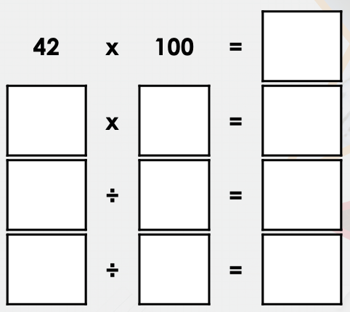
Year 3 on a whiteboard
Year 4 on a whiteboard
Divide the 55 flowers into groups of 5 and complete the number sentence.
___ divided by 5 equals ___.
Solve the equation below and write the fact families.

Slide 4
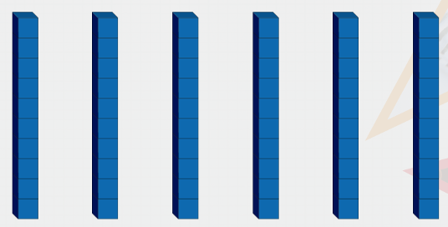
Year 3 on a whiteboard
Year 4 on a whiteboard
True or false?
60 divided by 5 equals 11.
What is 6,200 divided by 100?

Slide 5
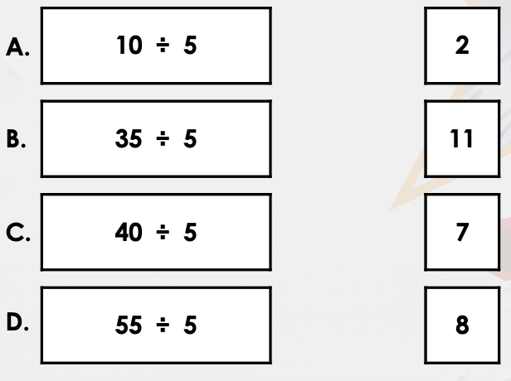
Year 3 on a whiteboard
Year 4 on a whiteboard
Match the number sentence to the correct answer.
Complete the calculation.
_____ divided by 100 = 37

Slide 6
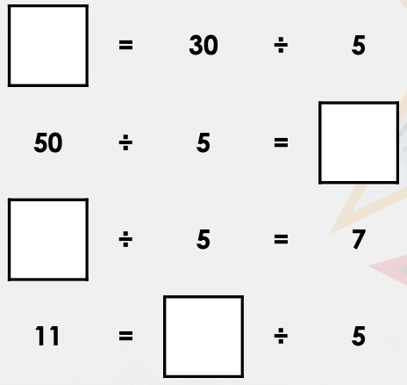
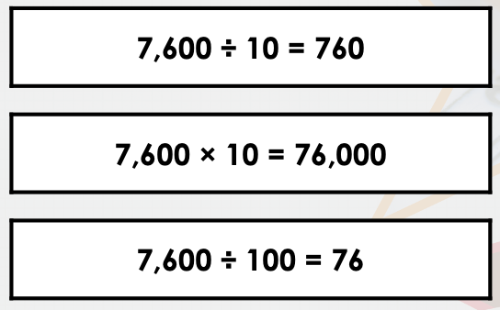
Year 3 on a whiteboard
Year 4 on a whiteboard
Complete the calculations.
Thor is converting measurements from cm to m.
Tick the correct calculation.

Slide 7
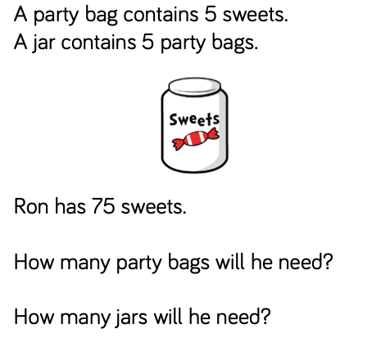
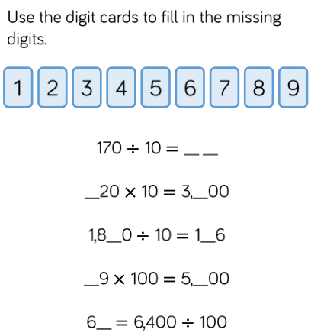
Lightbulb challenge
Year 3
Year 4

