Slide 1
Can I solve addition and subtraction problems?

Slide 2
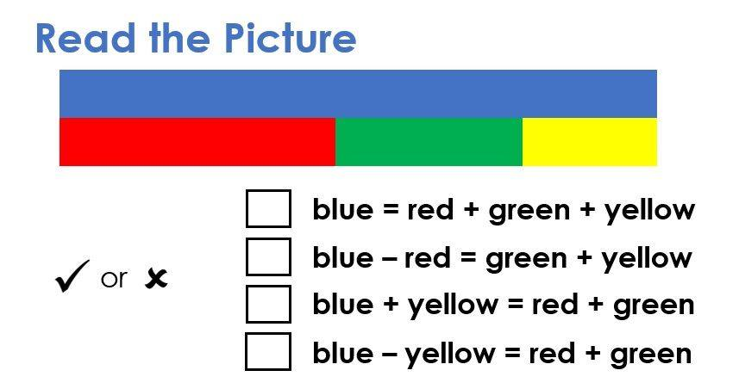
Focus task

Slide 3
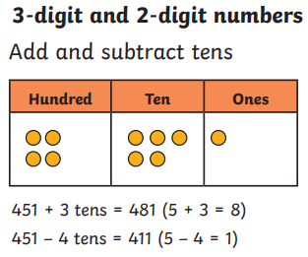
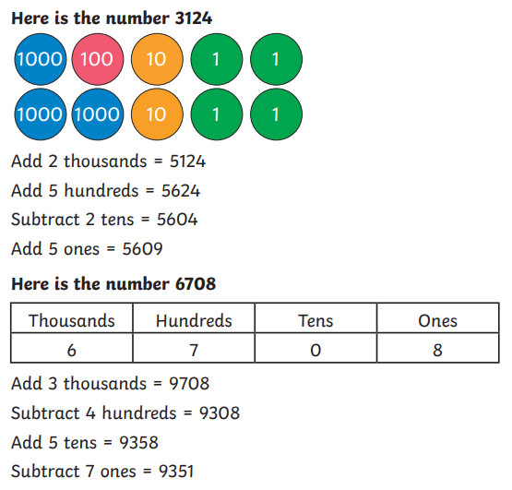
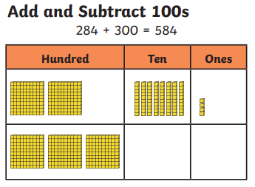
Let’s recap: concrete and pictorial

Slide 4
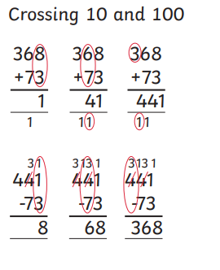
Let’s recap – column methods
Column methods, with and without regrouping.
When do we need to regroup?
Start on the right to get it right.

Slide 5
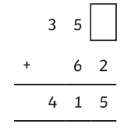
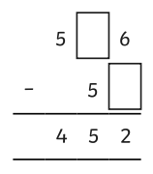
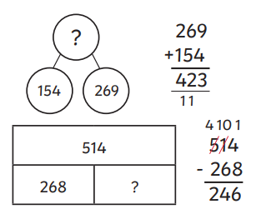
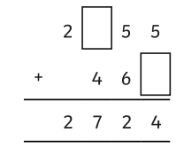
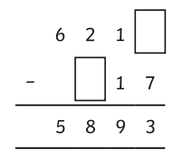
Let’s recap – missing numbers
Year 3
Year 4

Slide 6
Your task
Most of you
Year 3: Use your knowledge to solve the challenges while organising a party for the ancient Egyptian pharaoh, Tutankhamun.
Year 4: Use your knowledge to solve challenges while going on a space mission.
Some of you
may want stick with me to have a go at some extra practise of things you found a bit tricky.

Slide 7
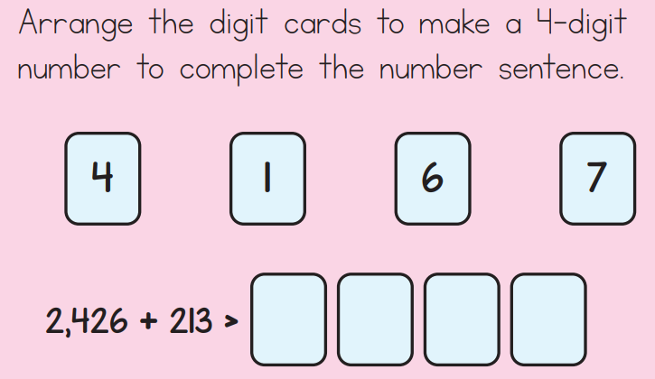
Lightbulb challenge
Year 3 Explain the mistake Year 4:

