Slide 1
Can I explain what import and export is?
- I can name some foods that are produced in Britain
- I can name some food that are produced overseas
- I can explain why we need to import food from other countries

Slide 2
What are your favourite foods?

Slide 3
Where do you think it comes from?

Slide 4
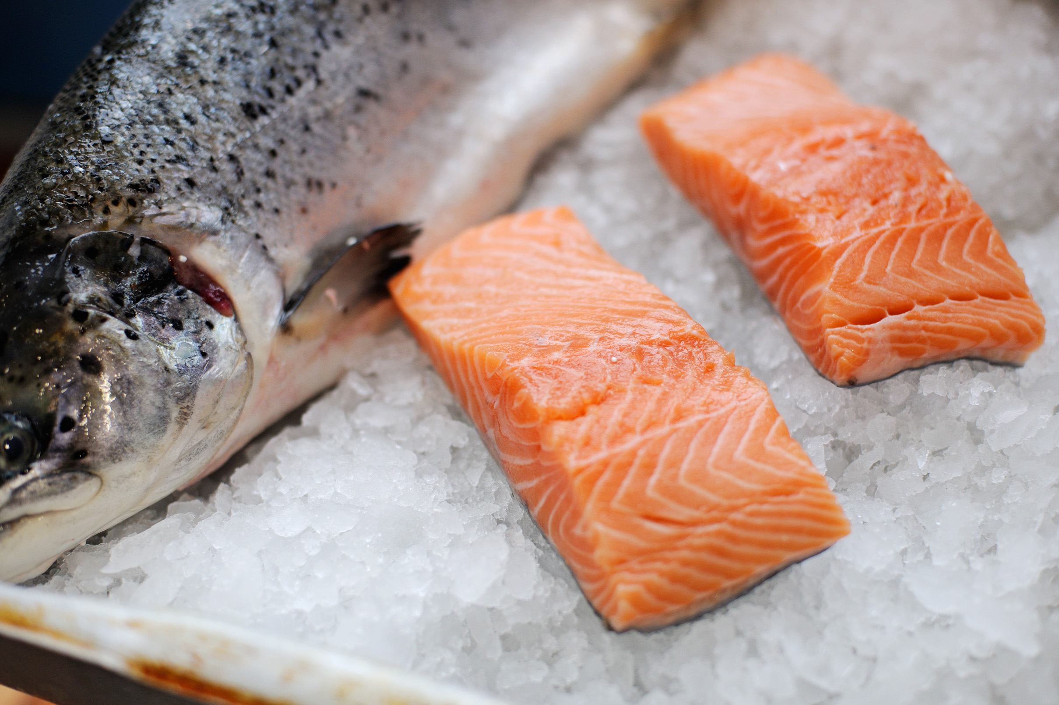
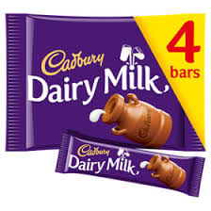
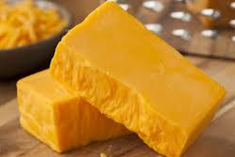
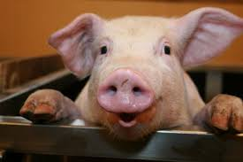
Export
Some of the foods we grow and produce in England are sold to other countries.
We call that export.
Which foods do you think we grow and produce here?
salmon
chocolate
cheese
pork

Slide 5
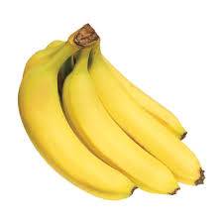
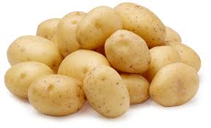
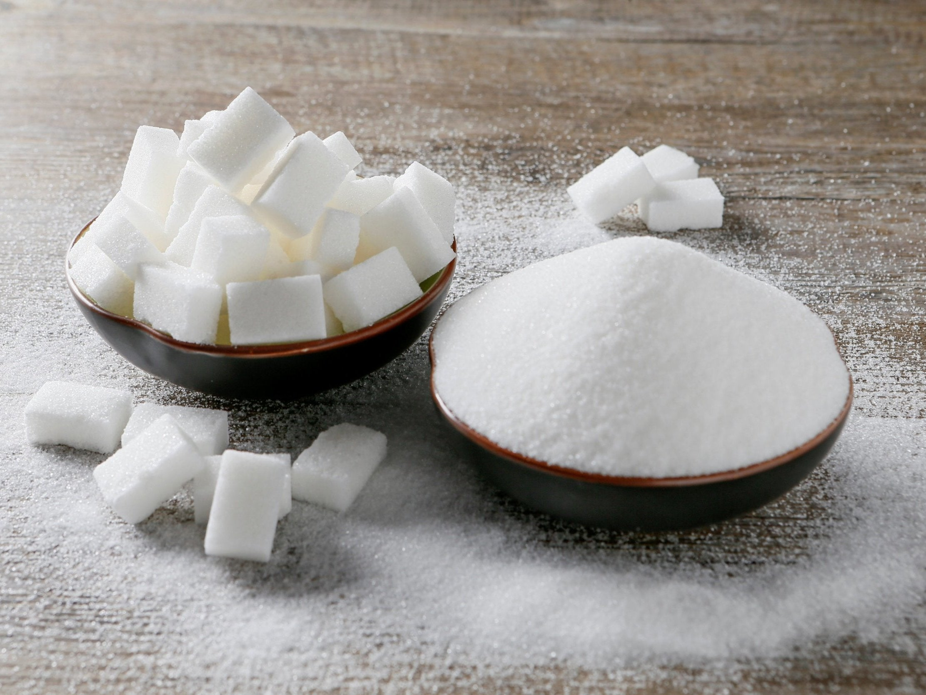
Import
Some of the food we eat comes from different countries. We call that import.
What foods do you think we import from other countries?
Did you know we import more than half of all the foods we eat and drink?
bananas
oranges
potatoes
sugar

Slide 6
What countries do we import from?

Slide 7
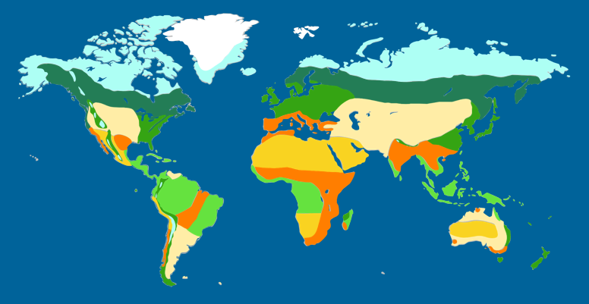
Why do you think we import food?
Our climate is moderate. This means we cannot grow certain foods. We buy those foods from other countries.
Some foods we do not produce enough of.
Some products we need as ingredients to make other products.
Some foods are cheaper to import than to produce here.

Slide 8
What are food miles?
https://www.youtube.com/watch?v=9Opt06QF9WY

Slide 9
Where in the world does your favourite meal come from?

