Slide 1
Year 3 – Spring Block 2 – Prepositions
Can I use prepositions to express place?
© Classroom Secrets Limited 2019

Slide 2
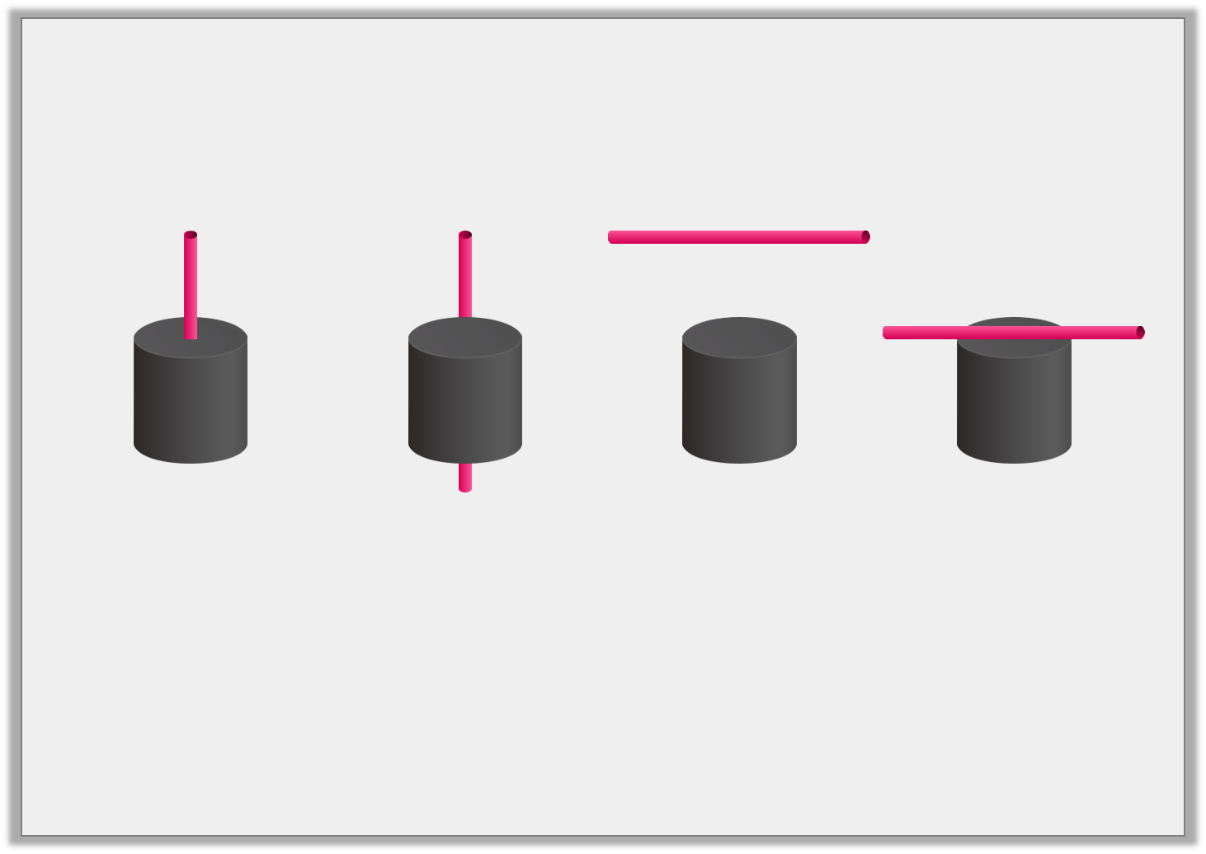
Match each sentence to the picture it describes.
The straw is above the cylinder.
The straw is on the cylinder.
The straw is in the cylinder.
The straw is behind the cylinder.
© Classroom Secrets Limited 2019

Slide 3
Varied Fluency 1
Circle the prepositions of place below.
sponge
ago
near
high
around
© Classroom Secrets Limited 2019

Slide 4
Varied Fluency 2
Underline the preposition expressing place in the sentences below.
The tree branches rested on the palace wall.
The eagle flew gracefully in the sky.
The bin bag goes inside the bin.
The dog hid underneath the table.
I managed to swiftly hide behind the fence.
The winding river flowed lazily around the island.
Y4 challenge: Underline the prepositional phrase in the sentences below:
Beyond the mountain range, lies a green valley.
Tamara put her book on the shelf.
Thor put his hammer into the cupboard.
© Classroom Secrets Limited 2019

