Slide 1
Our topic this term is... Burps, Bottoms and Bile and our text this term is... Demon Dentist
Monday 2nd November 2020

Slide 2
Can I participate in discussion about books, taking turns and listening to what others say? Reasoned discussion (Y4).

Slide 3
Front cover
Look at the front cover of the book.
Roll the dice with a learning buddy and answer the question.
Challenge: Explain why!
1) Does this book look interesting?
2) What do you like about the cover?
3) What do you dislike about the cover?
4) What do you think this book could be about?
5) How does the cover make you feel?
6) What do you think this book could be about?

Slide 4
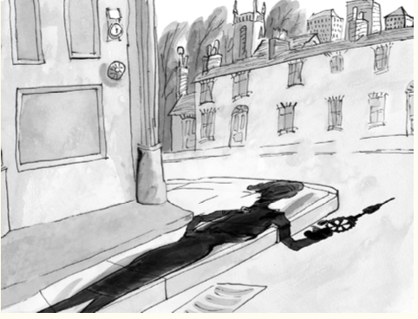
Introduction
You are introduced to a menacing first picture.
Why do you think all of the doors and shutters are closed?
What effect does the shadow have on you?

Slide 5
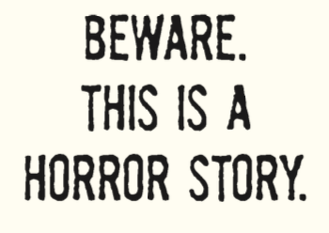
This warning follows...
How does it make you feel?
Does this tell you more about the book we are going to be reading?

Slide 6
Prologue/blurb
From reading the blurb/prologue, what kind of book do you think we will be reading together? Why?
Darkness had come to the town. Strange things were happening in the dead of night. Children would put a tooth under their pillow for the tooth fairy, but in the morning they would wake up to find...
a dead slug; a live spider; hundreds of earwigs creeping and crawling beneath their pillow.
Evil was at work. But who or what was behind it?

Slide 7
Prologue/blurb
We read in the prologue:
‘Strange things are happening’
‘They ... find something unspeakable’
‘Someone or something had come into their bedrooms’
Why do these particular phrases add more mystery to what is happening in the town?
Task: Think about this early build up to the story you are about to read.
Then, write at least three sentences predicting what you think may happen in this story.

Slide 8
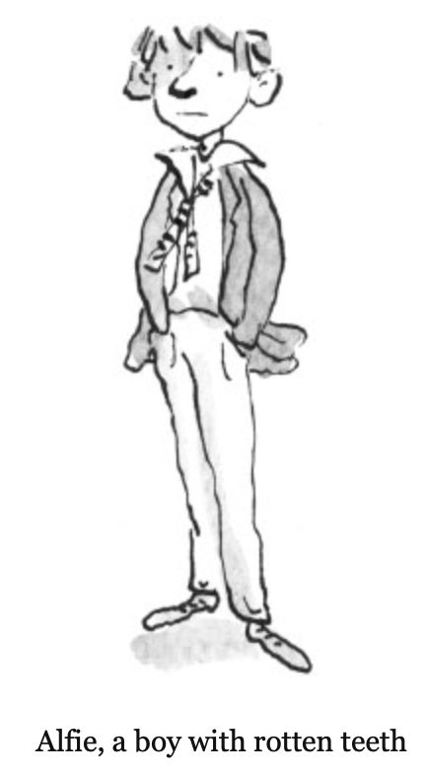
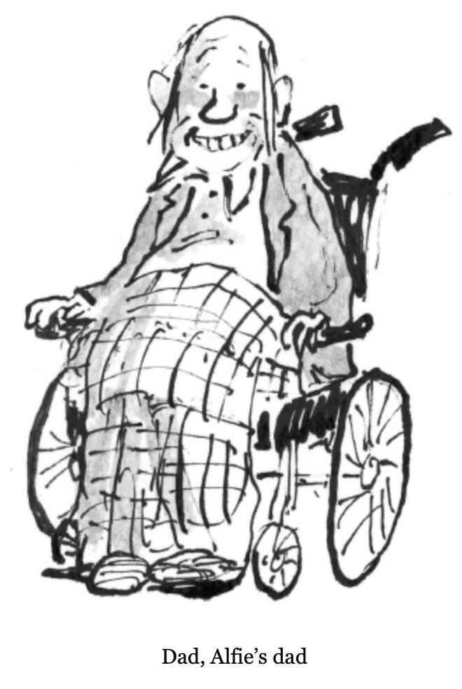
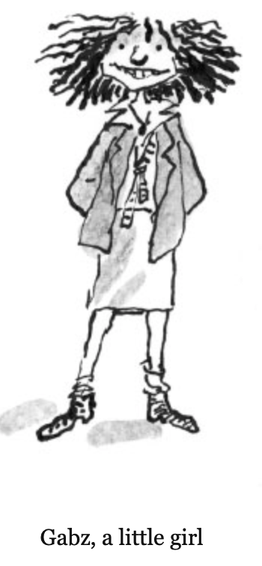
Meet the characters Who do you think is the main character? Who do you think looks interesting? What do you notice about them?

Slide 9
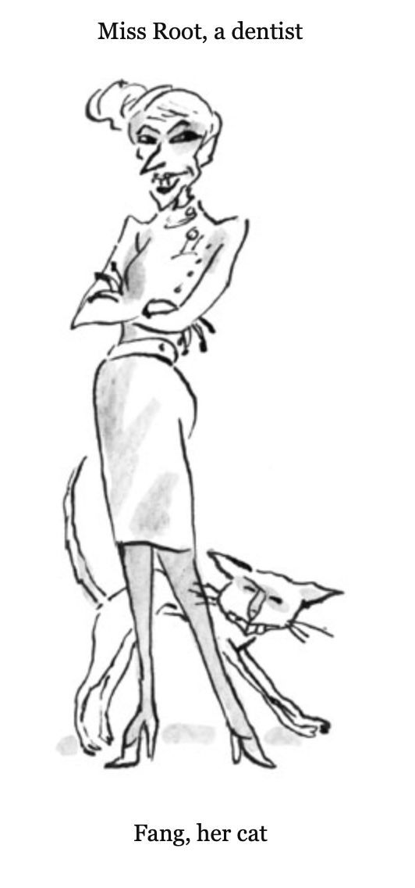
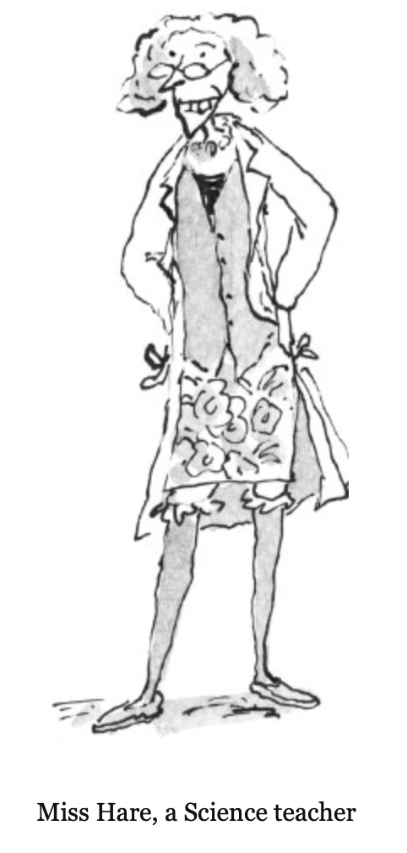
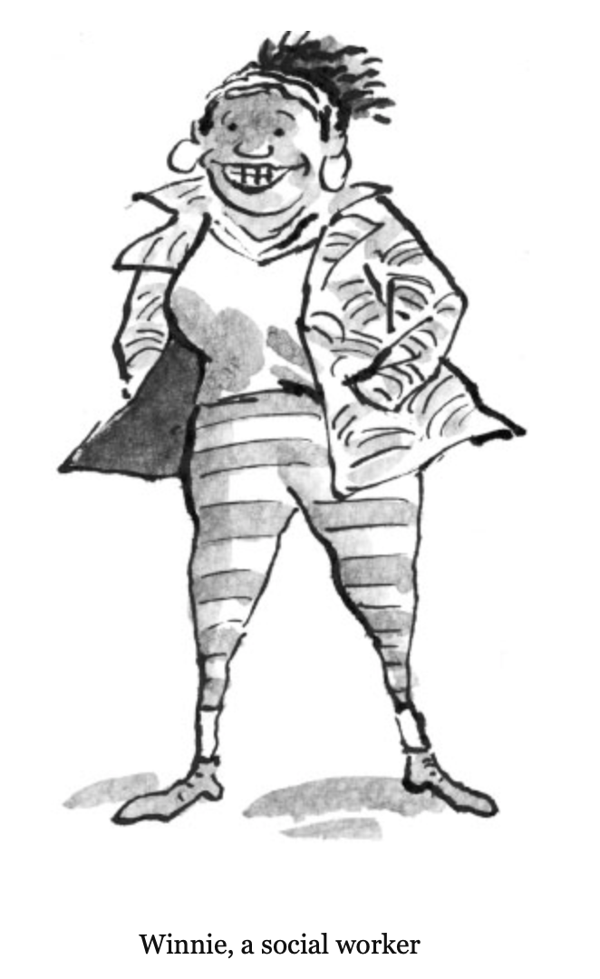
Meet the characters Who do you think is the main character? Who do you think looks interesting? What do you notice about them?

Slide 10
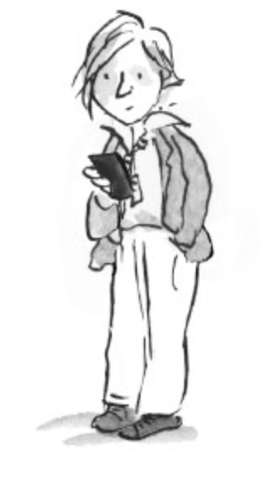
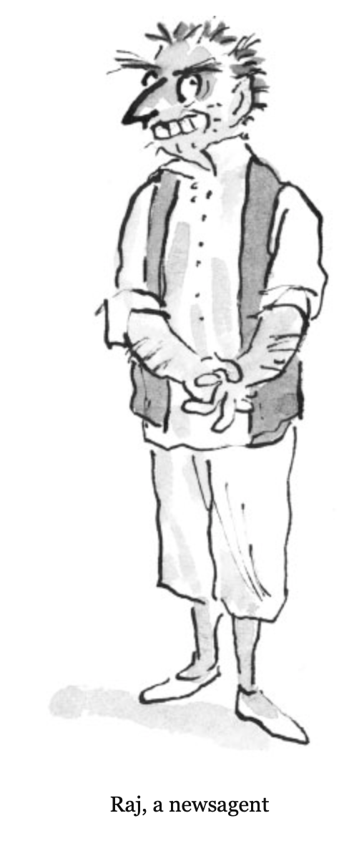
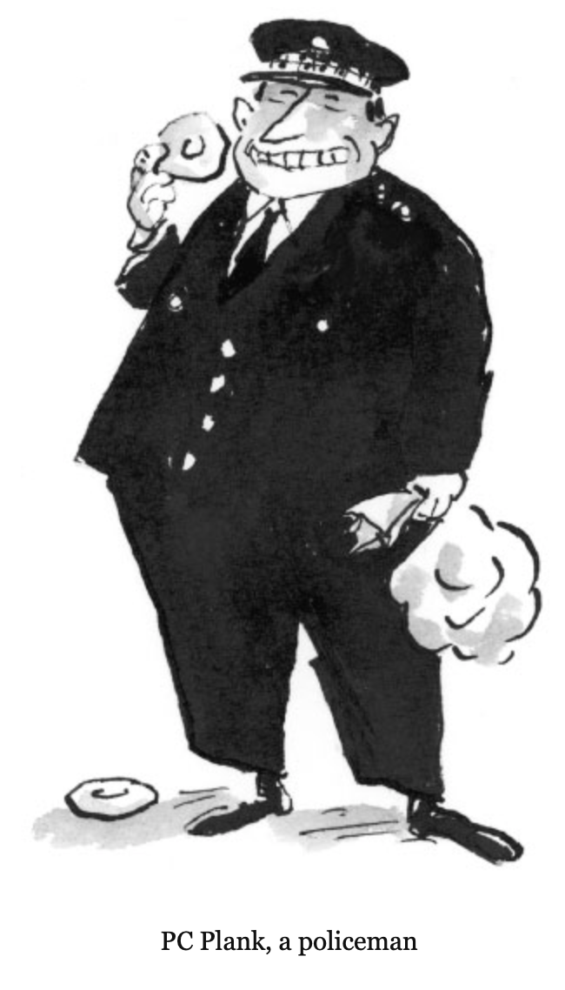
Meet the characters Who do you think is the main character? Who do you think looks interesting? What do you notice about them?

Slide 11
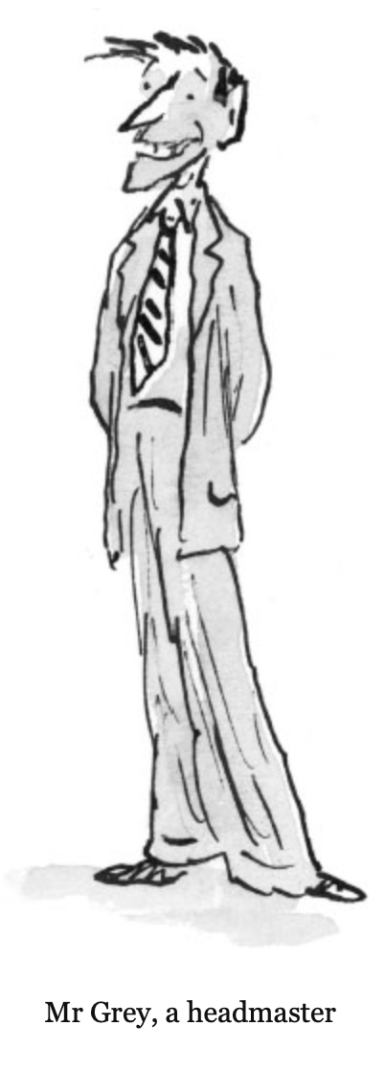
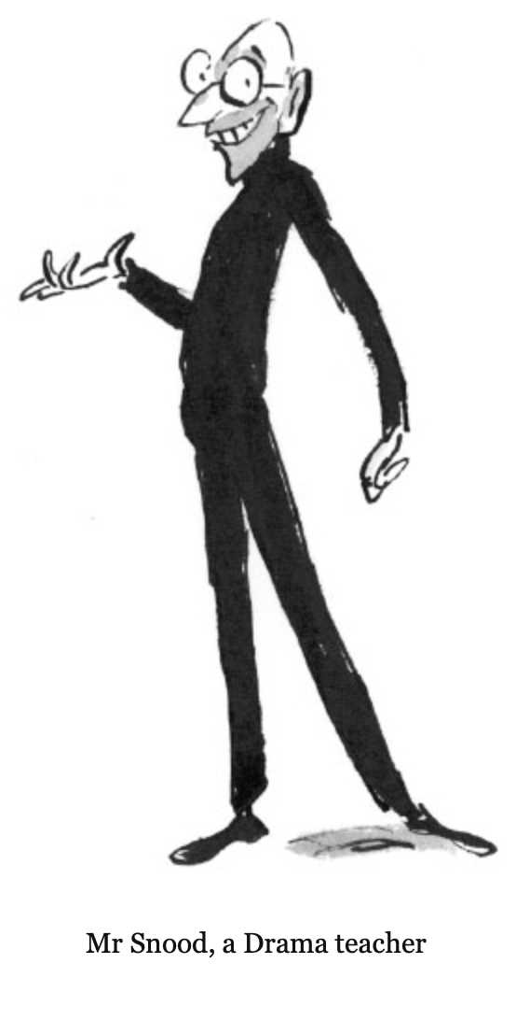
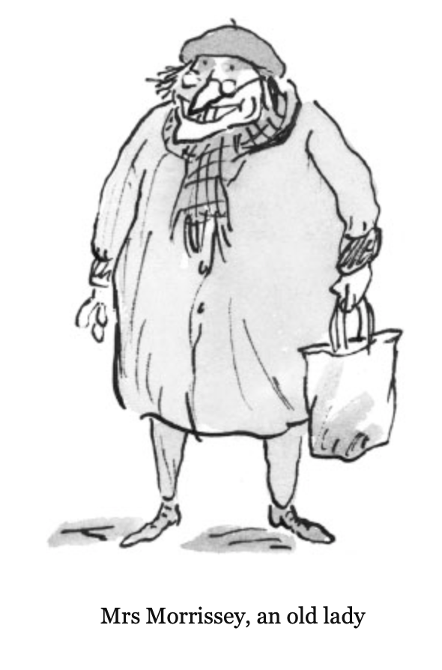
Meet the characters Who do you think is the main character? Who do you think looks interesting? What do you notice about them?

Slide 12
Read chapter 1. Discuss in your groups: Do you remember your last visit to the dentist? What did the dentist look like? Were they kind to you? How did you feel before, during and after your visit to the dentist? Task: Write down what happened in your last visit to the dentist.

Slide 13
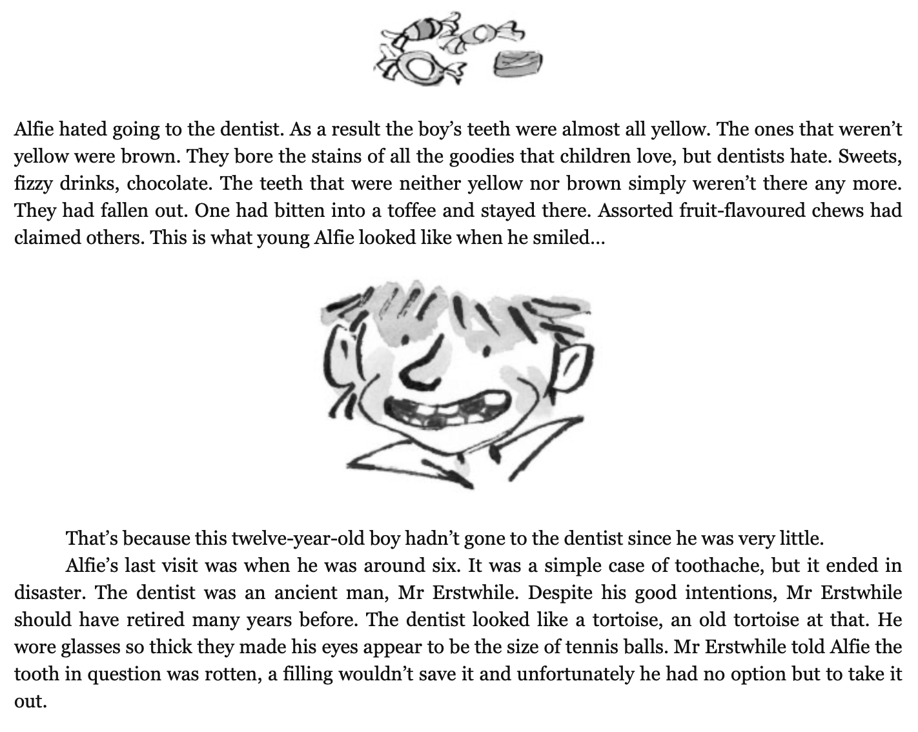
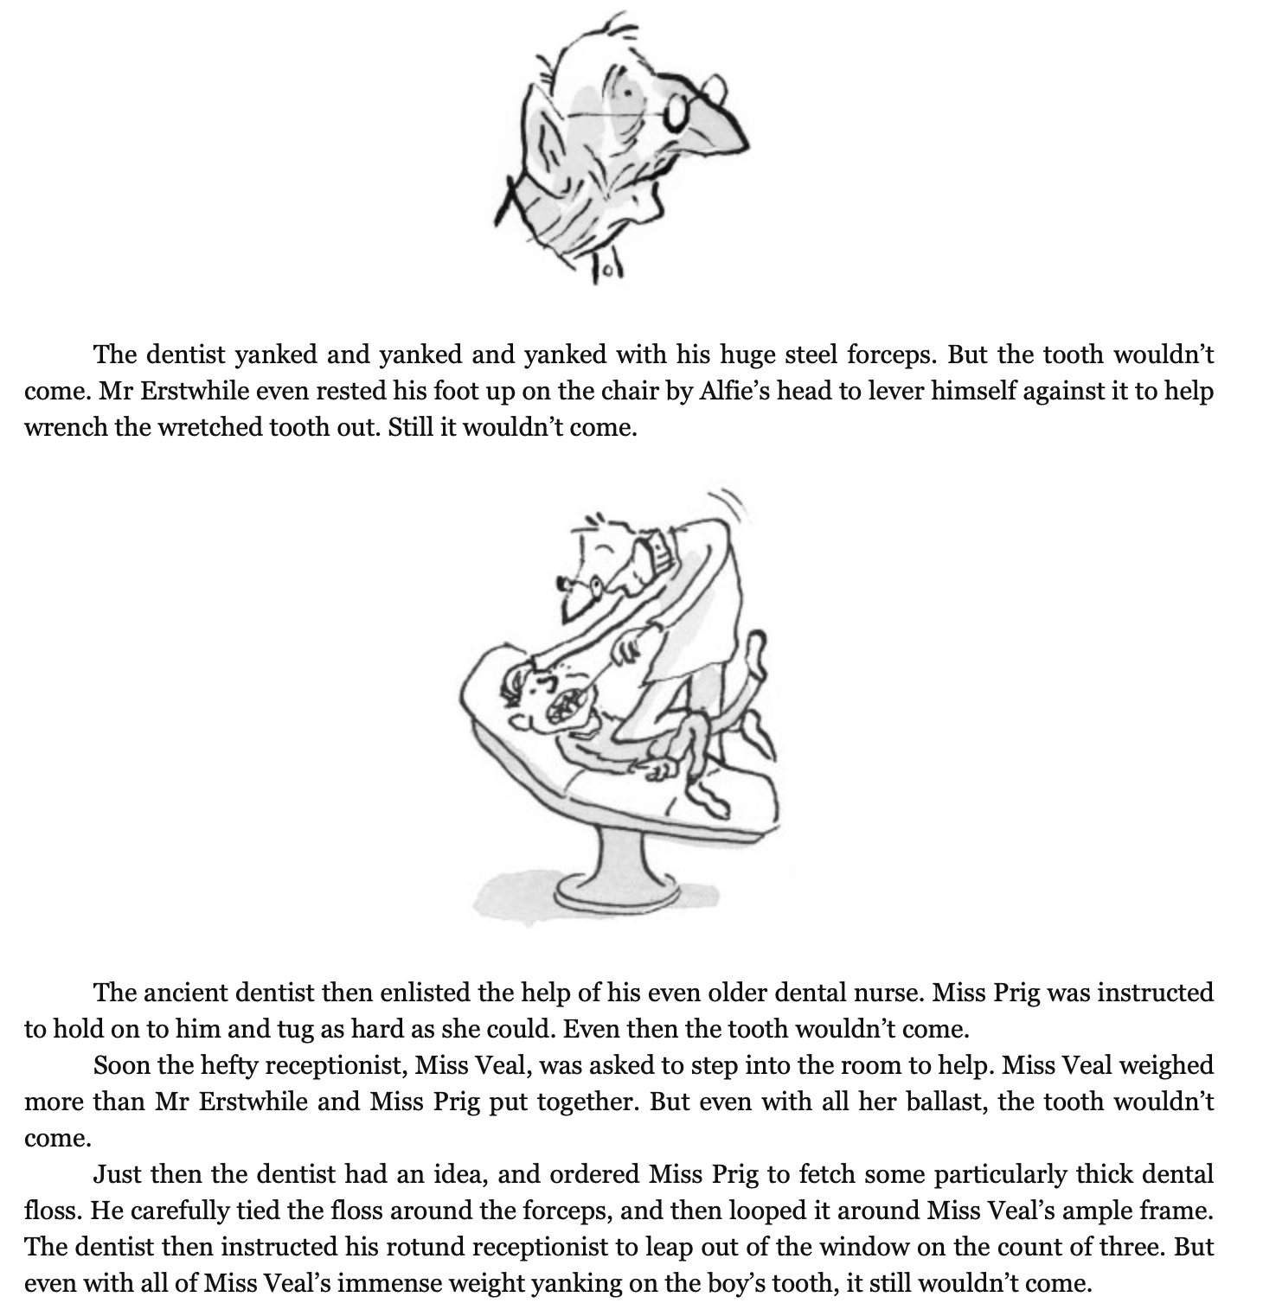
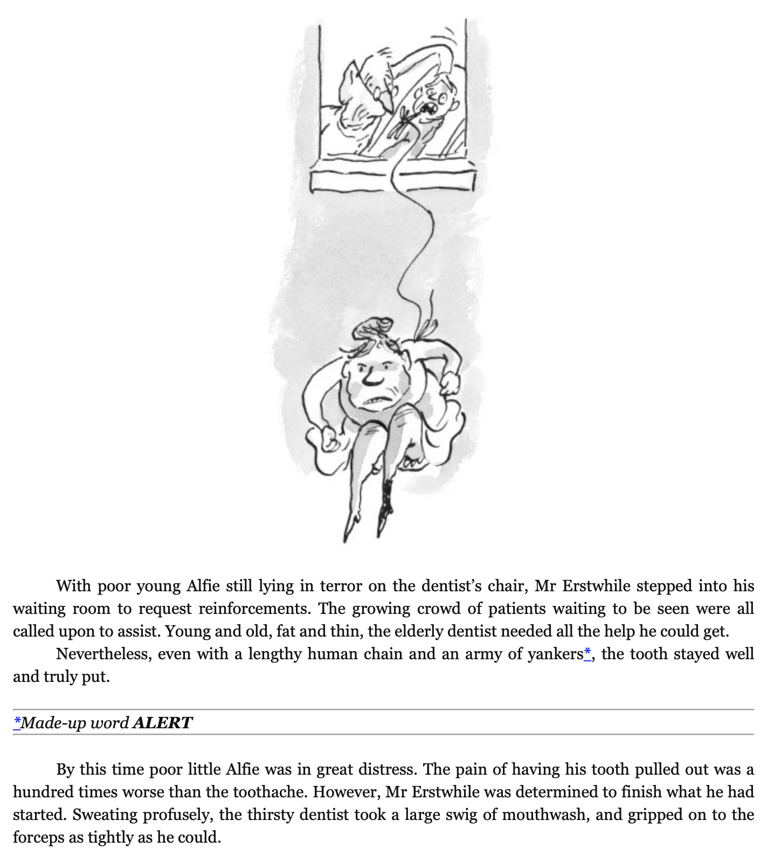
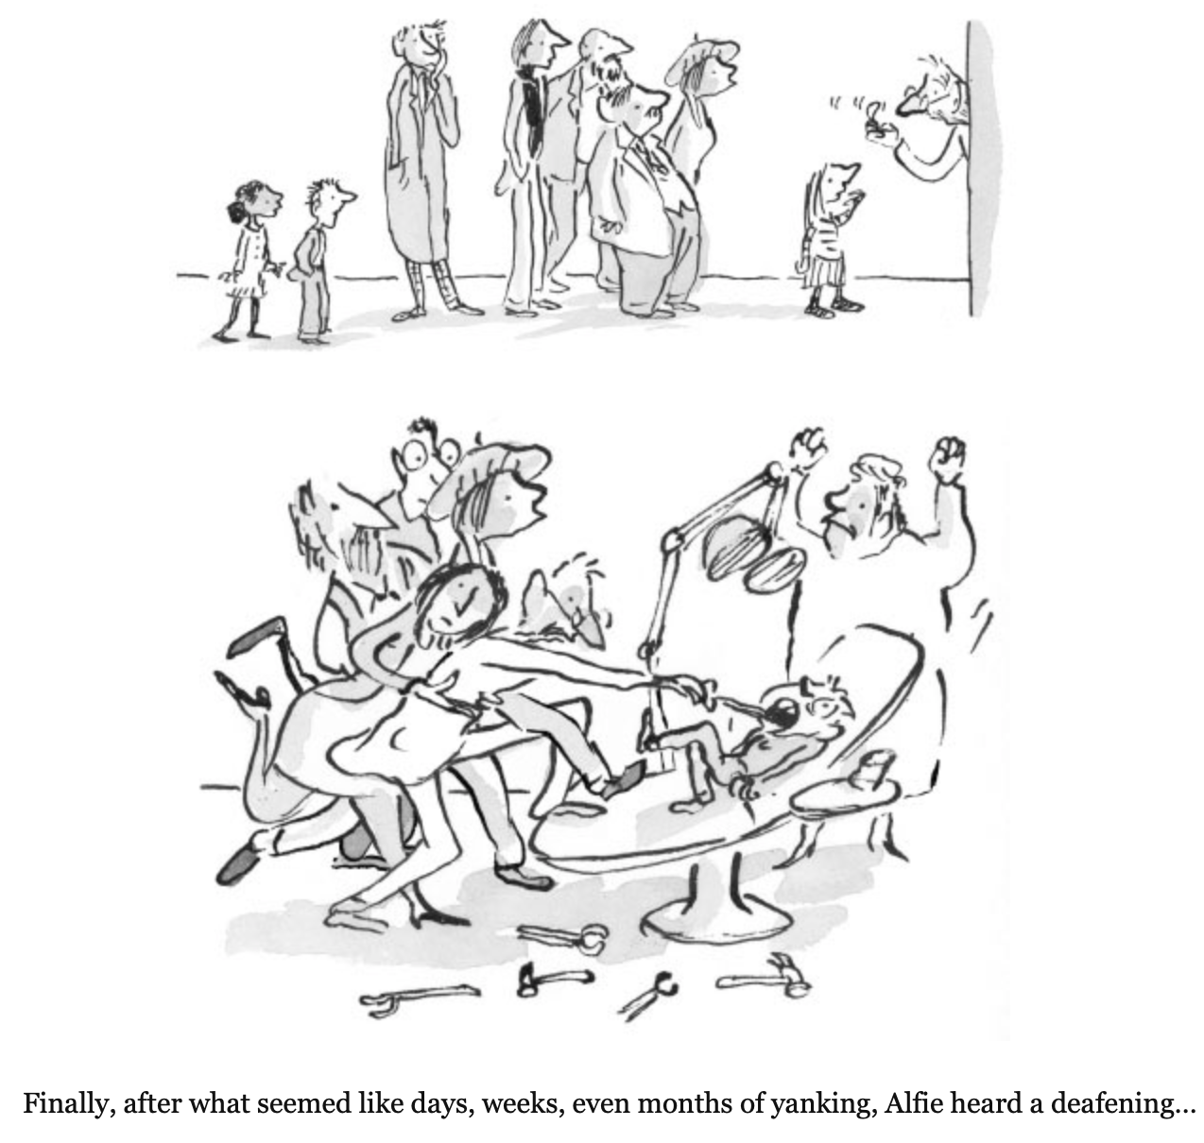
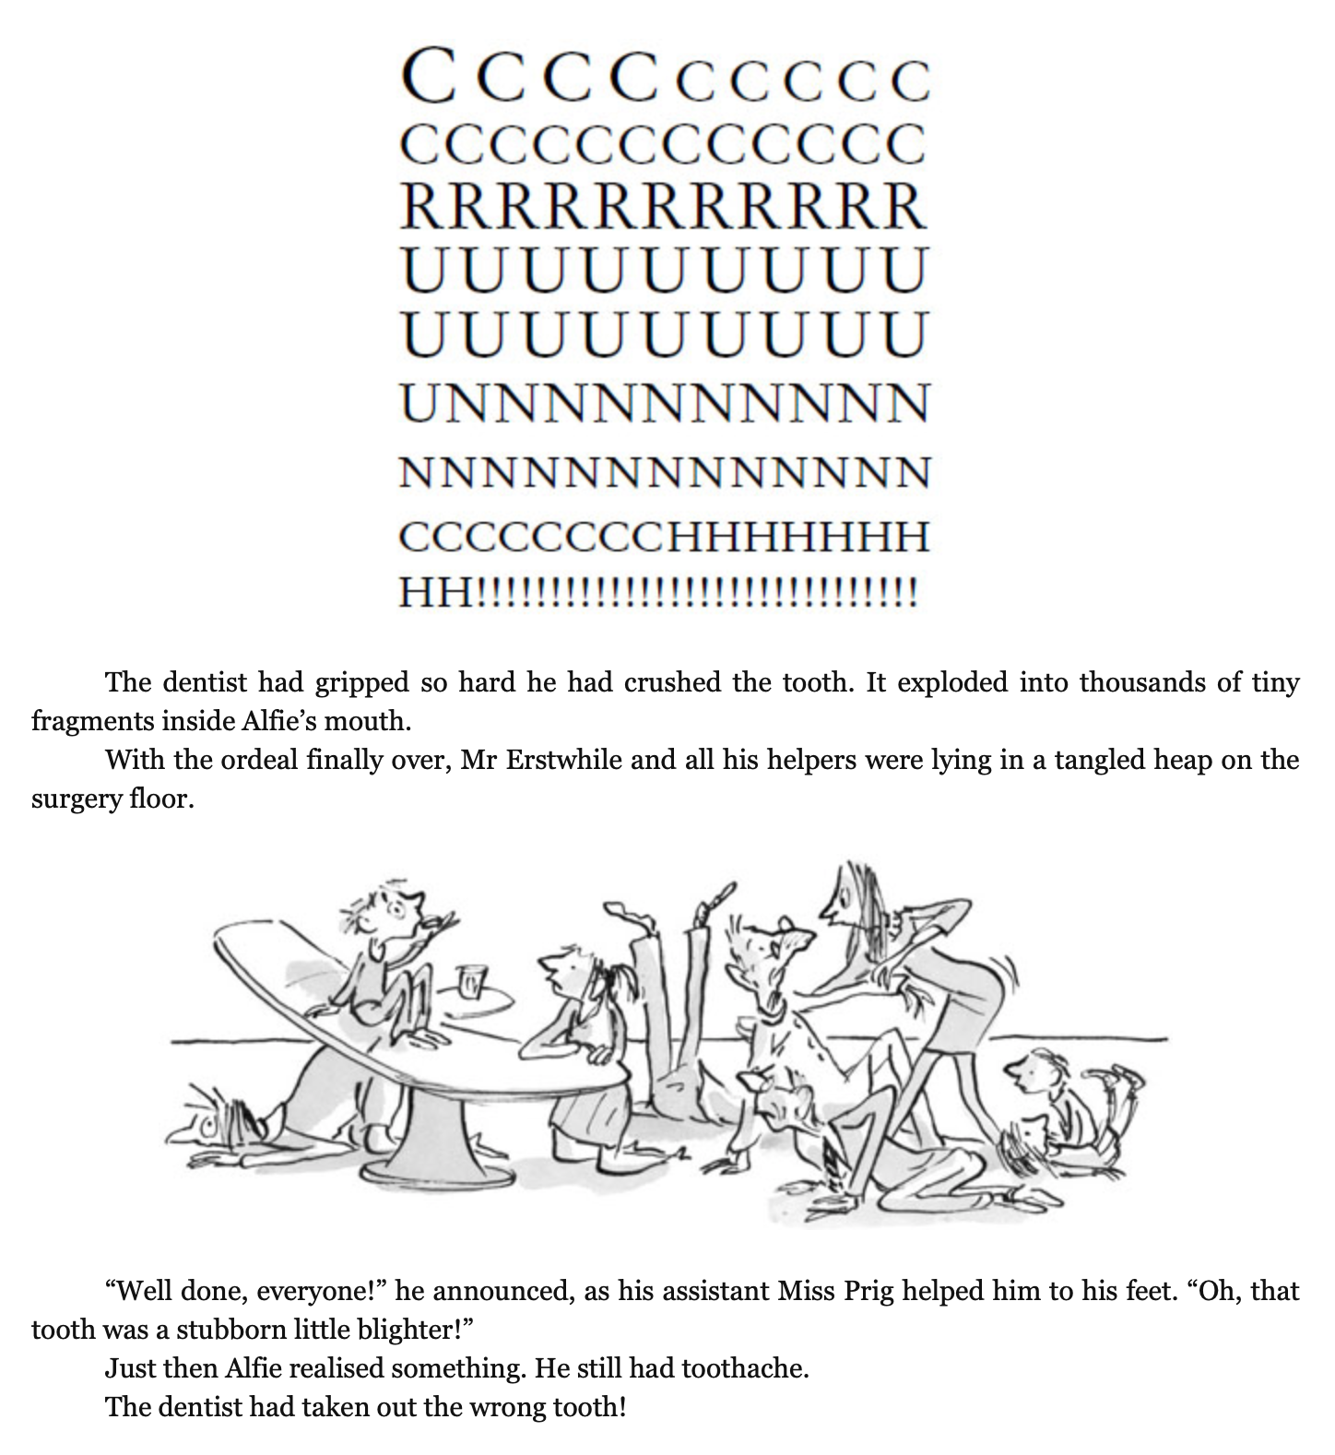
Chapter 1.

