Slide 1
Biographies
Monday 12th October 2020

Slide 2
Today we will be
Looking at using powerful similes
Florence’s positive and negative school experiences
Doing some thesaurus thinking using the noticing lens.

Slide 3
Simile
From a young age, Florence was running fast as lightning.
Let’s do some thesaurus thinking to find a better simile.
First, we are going to gather a vocabulary list of things that are fast (e.g. shooting star).
Then, we are going to gather a vocabulary list of appropriate verbs (e.g. hurtling).

Slide 4
Simile
Learning Chunk 1
Model
From a young age, Florence was running fast as lightning.
Write your own speed simile using a powerful ‘ing’ verb and adding extra detail to heighten the pace.
Deepen the moment:
Your turn

Slide 5
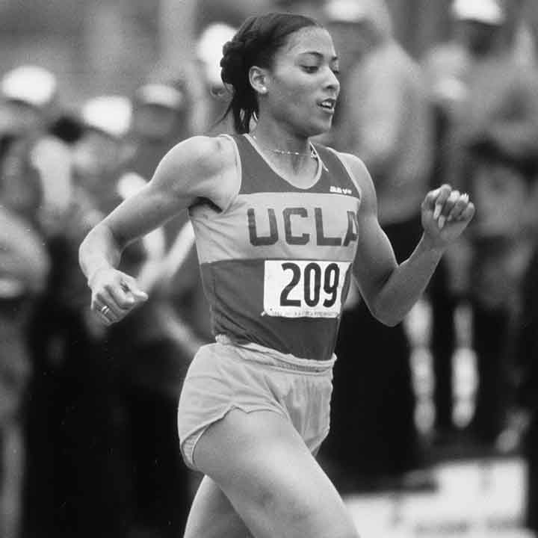
Positive and negative feelings
I want to win an Olympic medal.
Bullies:
You’re not good enough
I want to break a world record.
You’re too poor
I want to the fastest sprinter in the world.
It will never happen

Slide 6
Positive and negative feelings
Pretend you are Florence.
Let’s gather some positive words to show how she is feeling (e.g. hopeful)
Now, gather some negative words how the bullies are making her feel (e.g crushed)

Slide 7
Positive and negative feelings
Learning Chunk 2
Model
In school, Florence was mocked for her big dreams. This made her feel sad.
By the age of seven she was already winning many athletic events. This made her feel happy.
Write a negative and positive sentence. Think carefully about your vocabulary.
Your turn

Slide 8
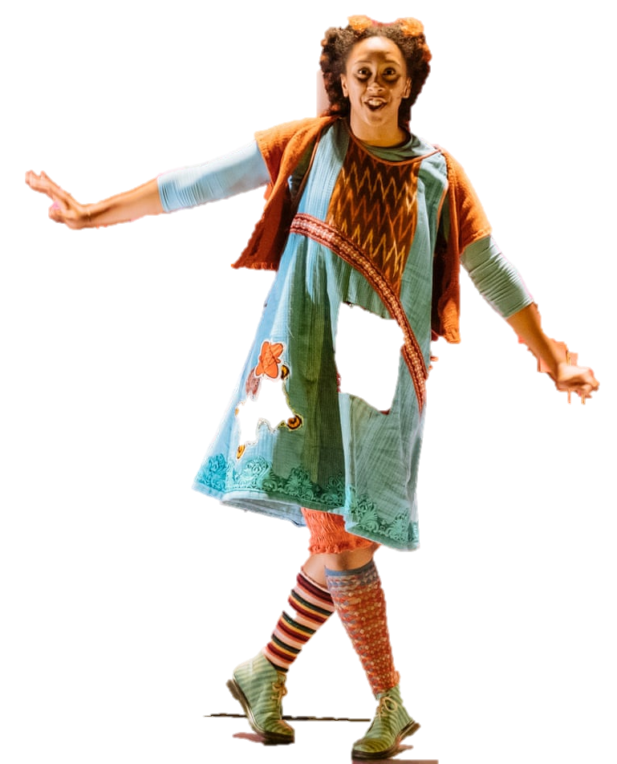
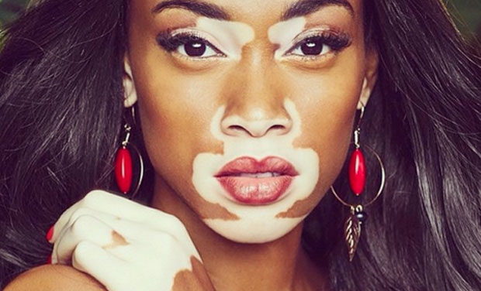
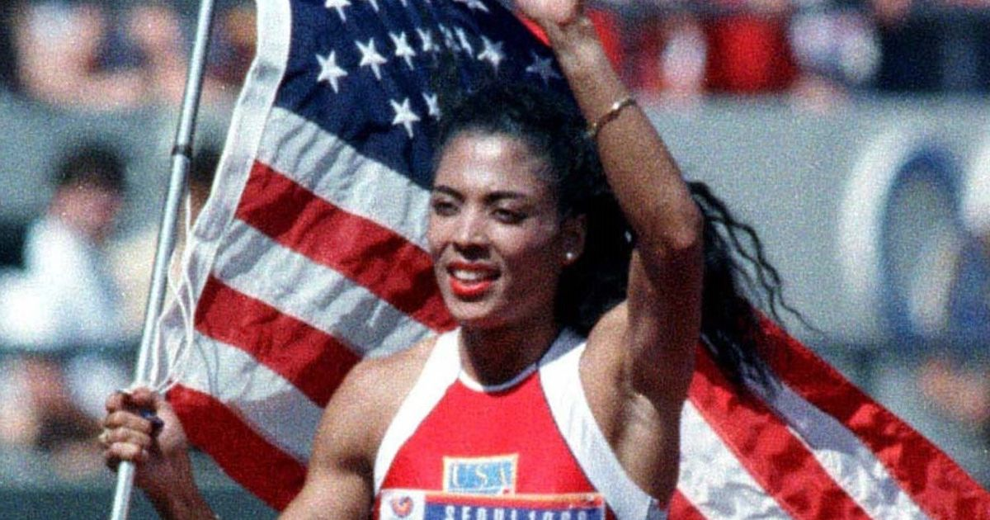
Being different
These people stand out for looking different. Let’s do some thesaurus thinking about the word different.
Notes:
Unique, outstanding, special, individual, etc

Slide 9
Being different
During school Florence was noticed for her unusual hairstyles and …
Write a sentence about how Florence stood out.
Learning Chunk 2
Model
Your turn

