Slide 1
Biography
Wednesday 7th October 2020
Experience session

Slide 2
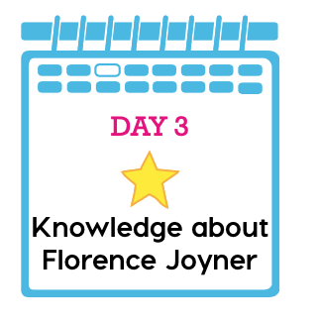
https://www.youtube.com/watch?v=S8r3nHXcEMM
Watch the first 3 minutes

