Slide 1
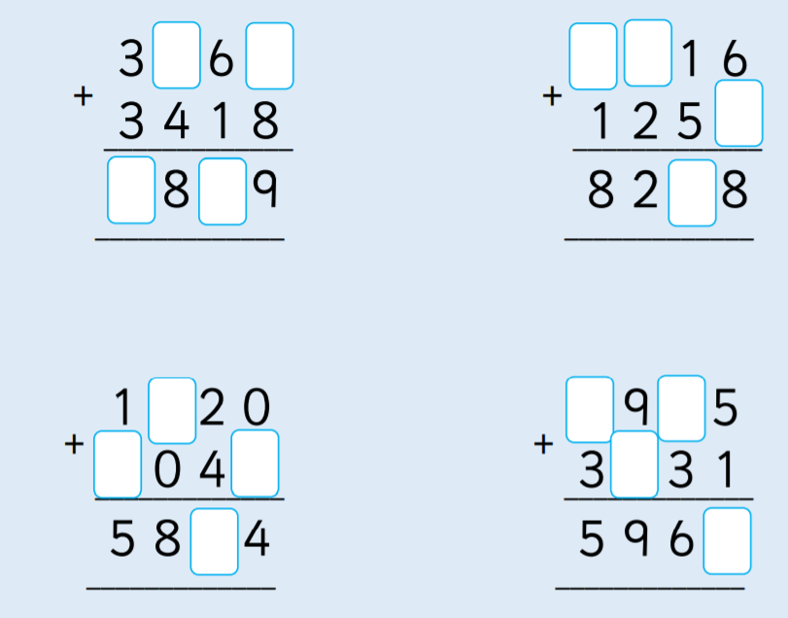
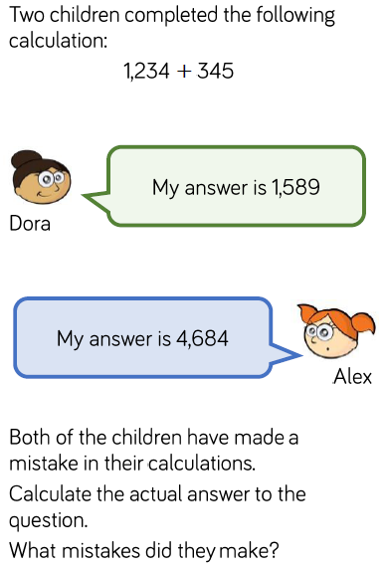
Year 4 reasoning
Year 4 fluency
Copy in your book and complete the missing numbers.
Write this as a calculation. Careful how you set out the columns.
Now work out the answer.
Set out these sums carefully in your book, using columns.
Remember to start on the right to get it right.
1,354 + 4,245
3,207 + 3,681
5,213 + 2,684

