Slide 1
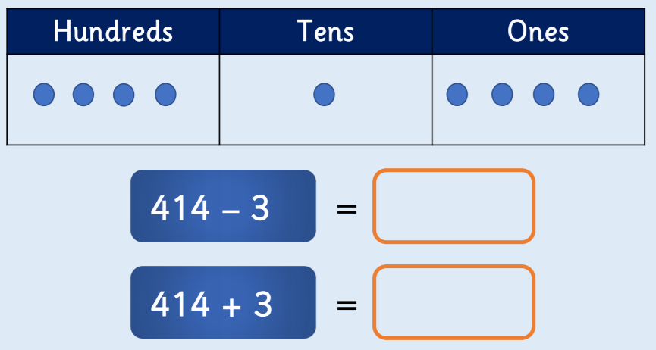
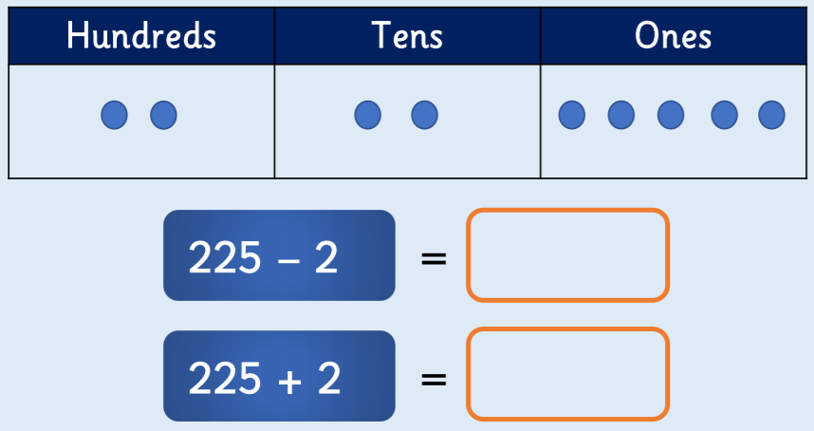
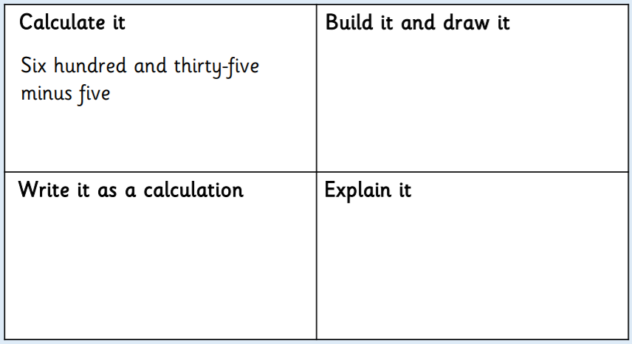
Year 3 - fluency
Year 3 - reasoning
Complete the number sentences in your book
1
2
3
What does the picture show?
___ - 3 = ____
___ + 2 = ____
4. Complete the table, cut it out and glue it in your book.

