Slide 1
Year 3: Can I place numbers on a number line? Year 4: Can I round to the nearest 10?

Slide 2
Monday 28.9.20

Slide 3
Focus task complete these in your books
Year 3
Identify the multiples of 10.
8
10
5
20
100
85
90
0
Year 4
Identify the multiples of 10.
18
32
65
700
702
832
154
280

Slide 4
Year 4 – do and talk
Year 3s – Colour in the multiples of 10 in a 150 square.
What does rounding mean?
Which multiples of 10 does 15 sit between?
21?
36?
48?
52?
164?

Slide 5
Year 4 – do and talk Which multiples of 10 do the numbers sit between?
18
33
159
Say whether each number on the number line is closer to 160 or 170.

Slide 6
Year 3 – fluency: do and talk
Draw an arrow to show the number 560.

Slide 7
Year 3 – fluency: do and talk
Which number is each arrow pointing to?
800
How do you know?
If you made a mistake, how did you get there?
What is the value of each interval?
What value can the first arrow definitely not be?

Slide 8
Year 4 – fluency: do and talk
Complete the table.
How do you know?
If you made a mistake, how did you get there?
Which number is being represented?
Will we round it up or not? Why?

Slide 9
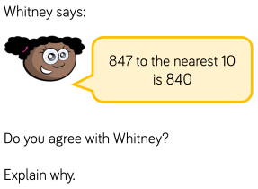
Lightbulb challenge
Year 3
What could the start and end numbers be on the number line?
Find three different ways and explain your reasoning.
Year 4
Year 3
780

