Slide 1
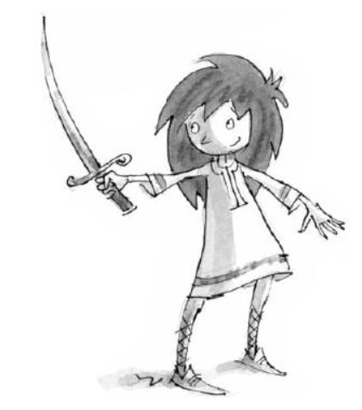
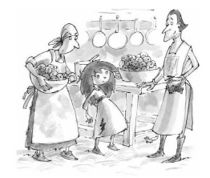
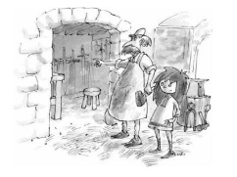
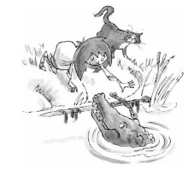
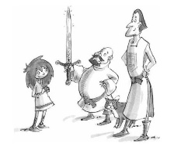
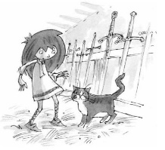
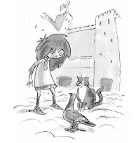
We wrote a story with seven paragraphs. The story journey looked like this.
x
x
x
x
x
x
x
x
You are going to plan your own story featuring Tommy and need to write six paragraphs.

Slide 2
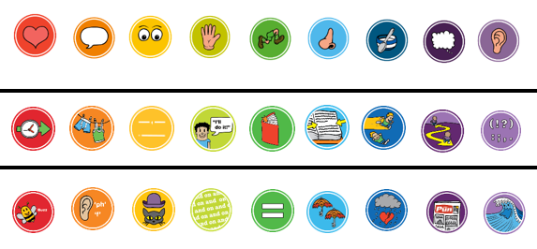
Choose the lenses
You need six lenses, one for each paragraph. These are your steps to success.
You have to choose two lenses from each tier. Draw them in your book.

Slide 3
What will happen to Tommy next?
Draw your story plot points on the story map.
Remember your character is brave and wants to be a squire.

Slide 4
LI: Can I plan a story?
Steps to success:
I can choose six lenses
I have drawn / written about my plot points.
Challenge: word collecting

