Slide 1
What things use electricity and where does it come from?

Slide 2
brainstorm
Imagine you are at home. What things in your house use electricity?

Slide 3
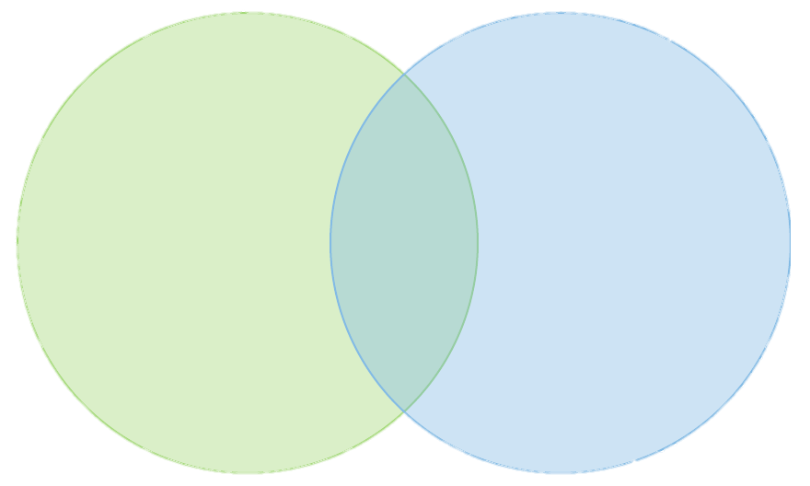
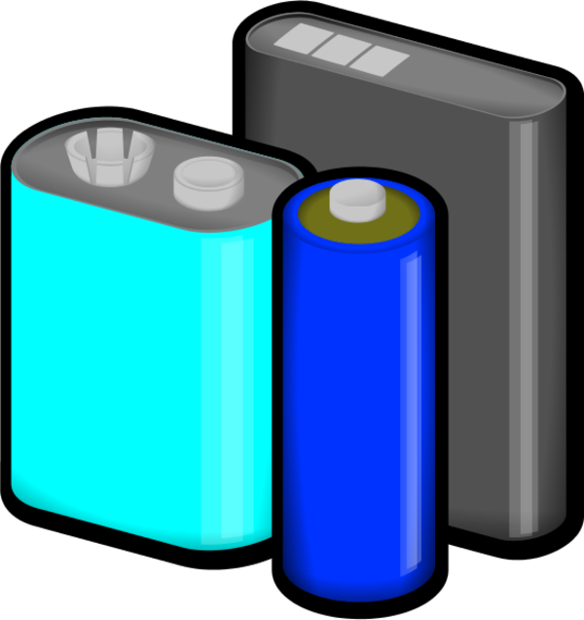
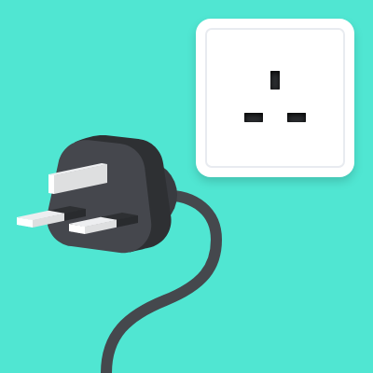
Battery or plugged in?
Plugged in the socket
Batteries

Slide 4
What is electricity?
Electricity can create light, movement and heat. https://www.bbc.co.uk/bitesize/topics/z2882hv/articles/zcwnv9q
Use three different colours and underline the items in your Venn diagram that create light, movement and heat. One colour for each.

Slide 5
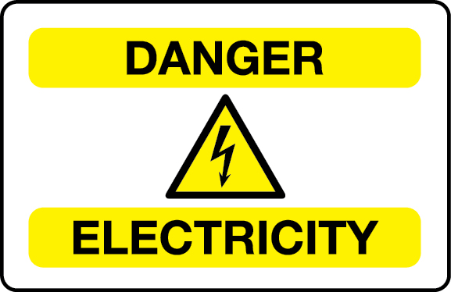
Where does electricity come from?
Renewable and non renewable sources
https://www.youtube.com/watch?v=20Vb6hlLQSg

Slide 6
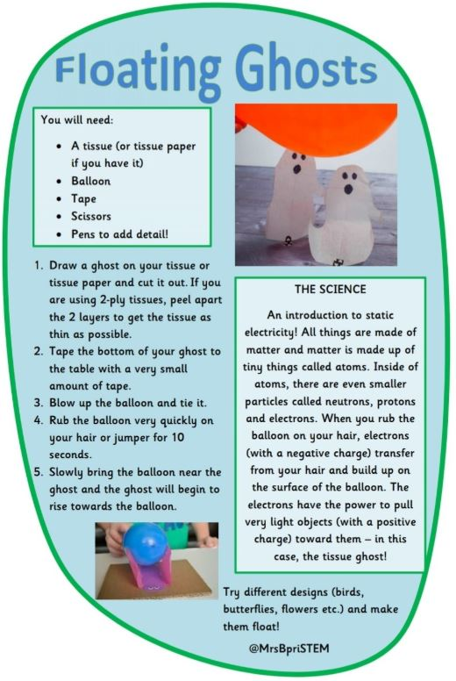
Static electricity
Static electricity is electricity that doesn’t move. Lightning for example.

