Slide 1
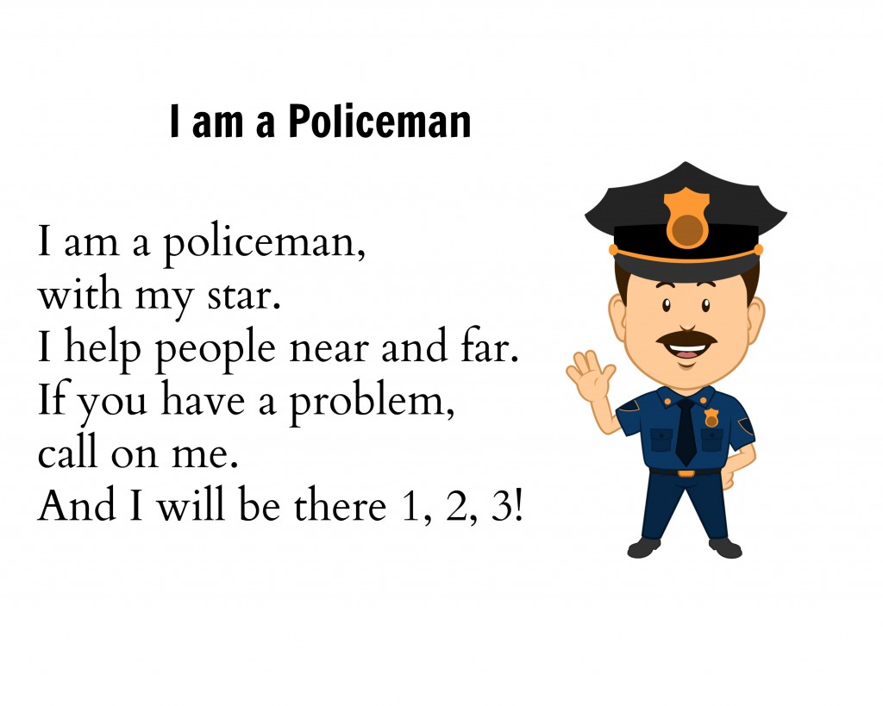

Slide 2
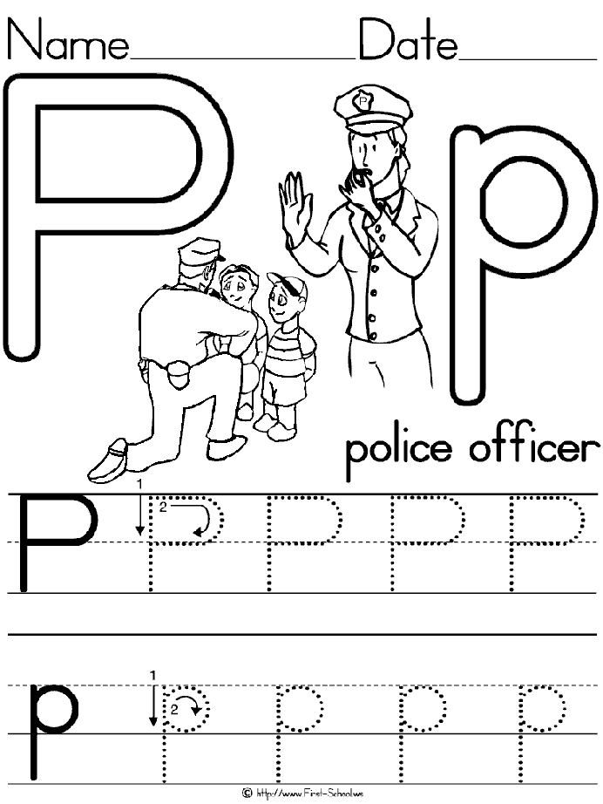

Slide 3
Policeman song
https://www.youtube.com/watch?v=uM8dBgkqJGc

Slide 4
Can you colour the items that a police officer would have? Look carefully, some might be trying to trick you!

