Slide 1
Monday 14th June 2021 LI: To use an adjective.

Slide 2
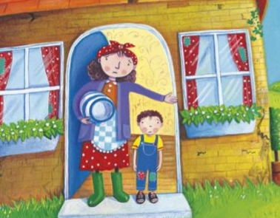
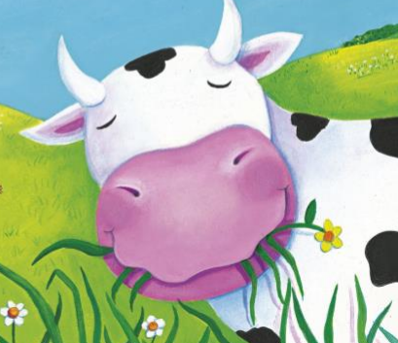
https://www.youtube.com/watch?v=8wC3Y7MuRts

Slide 3
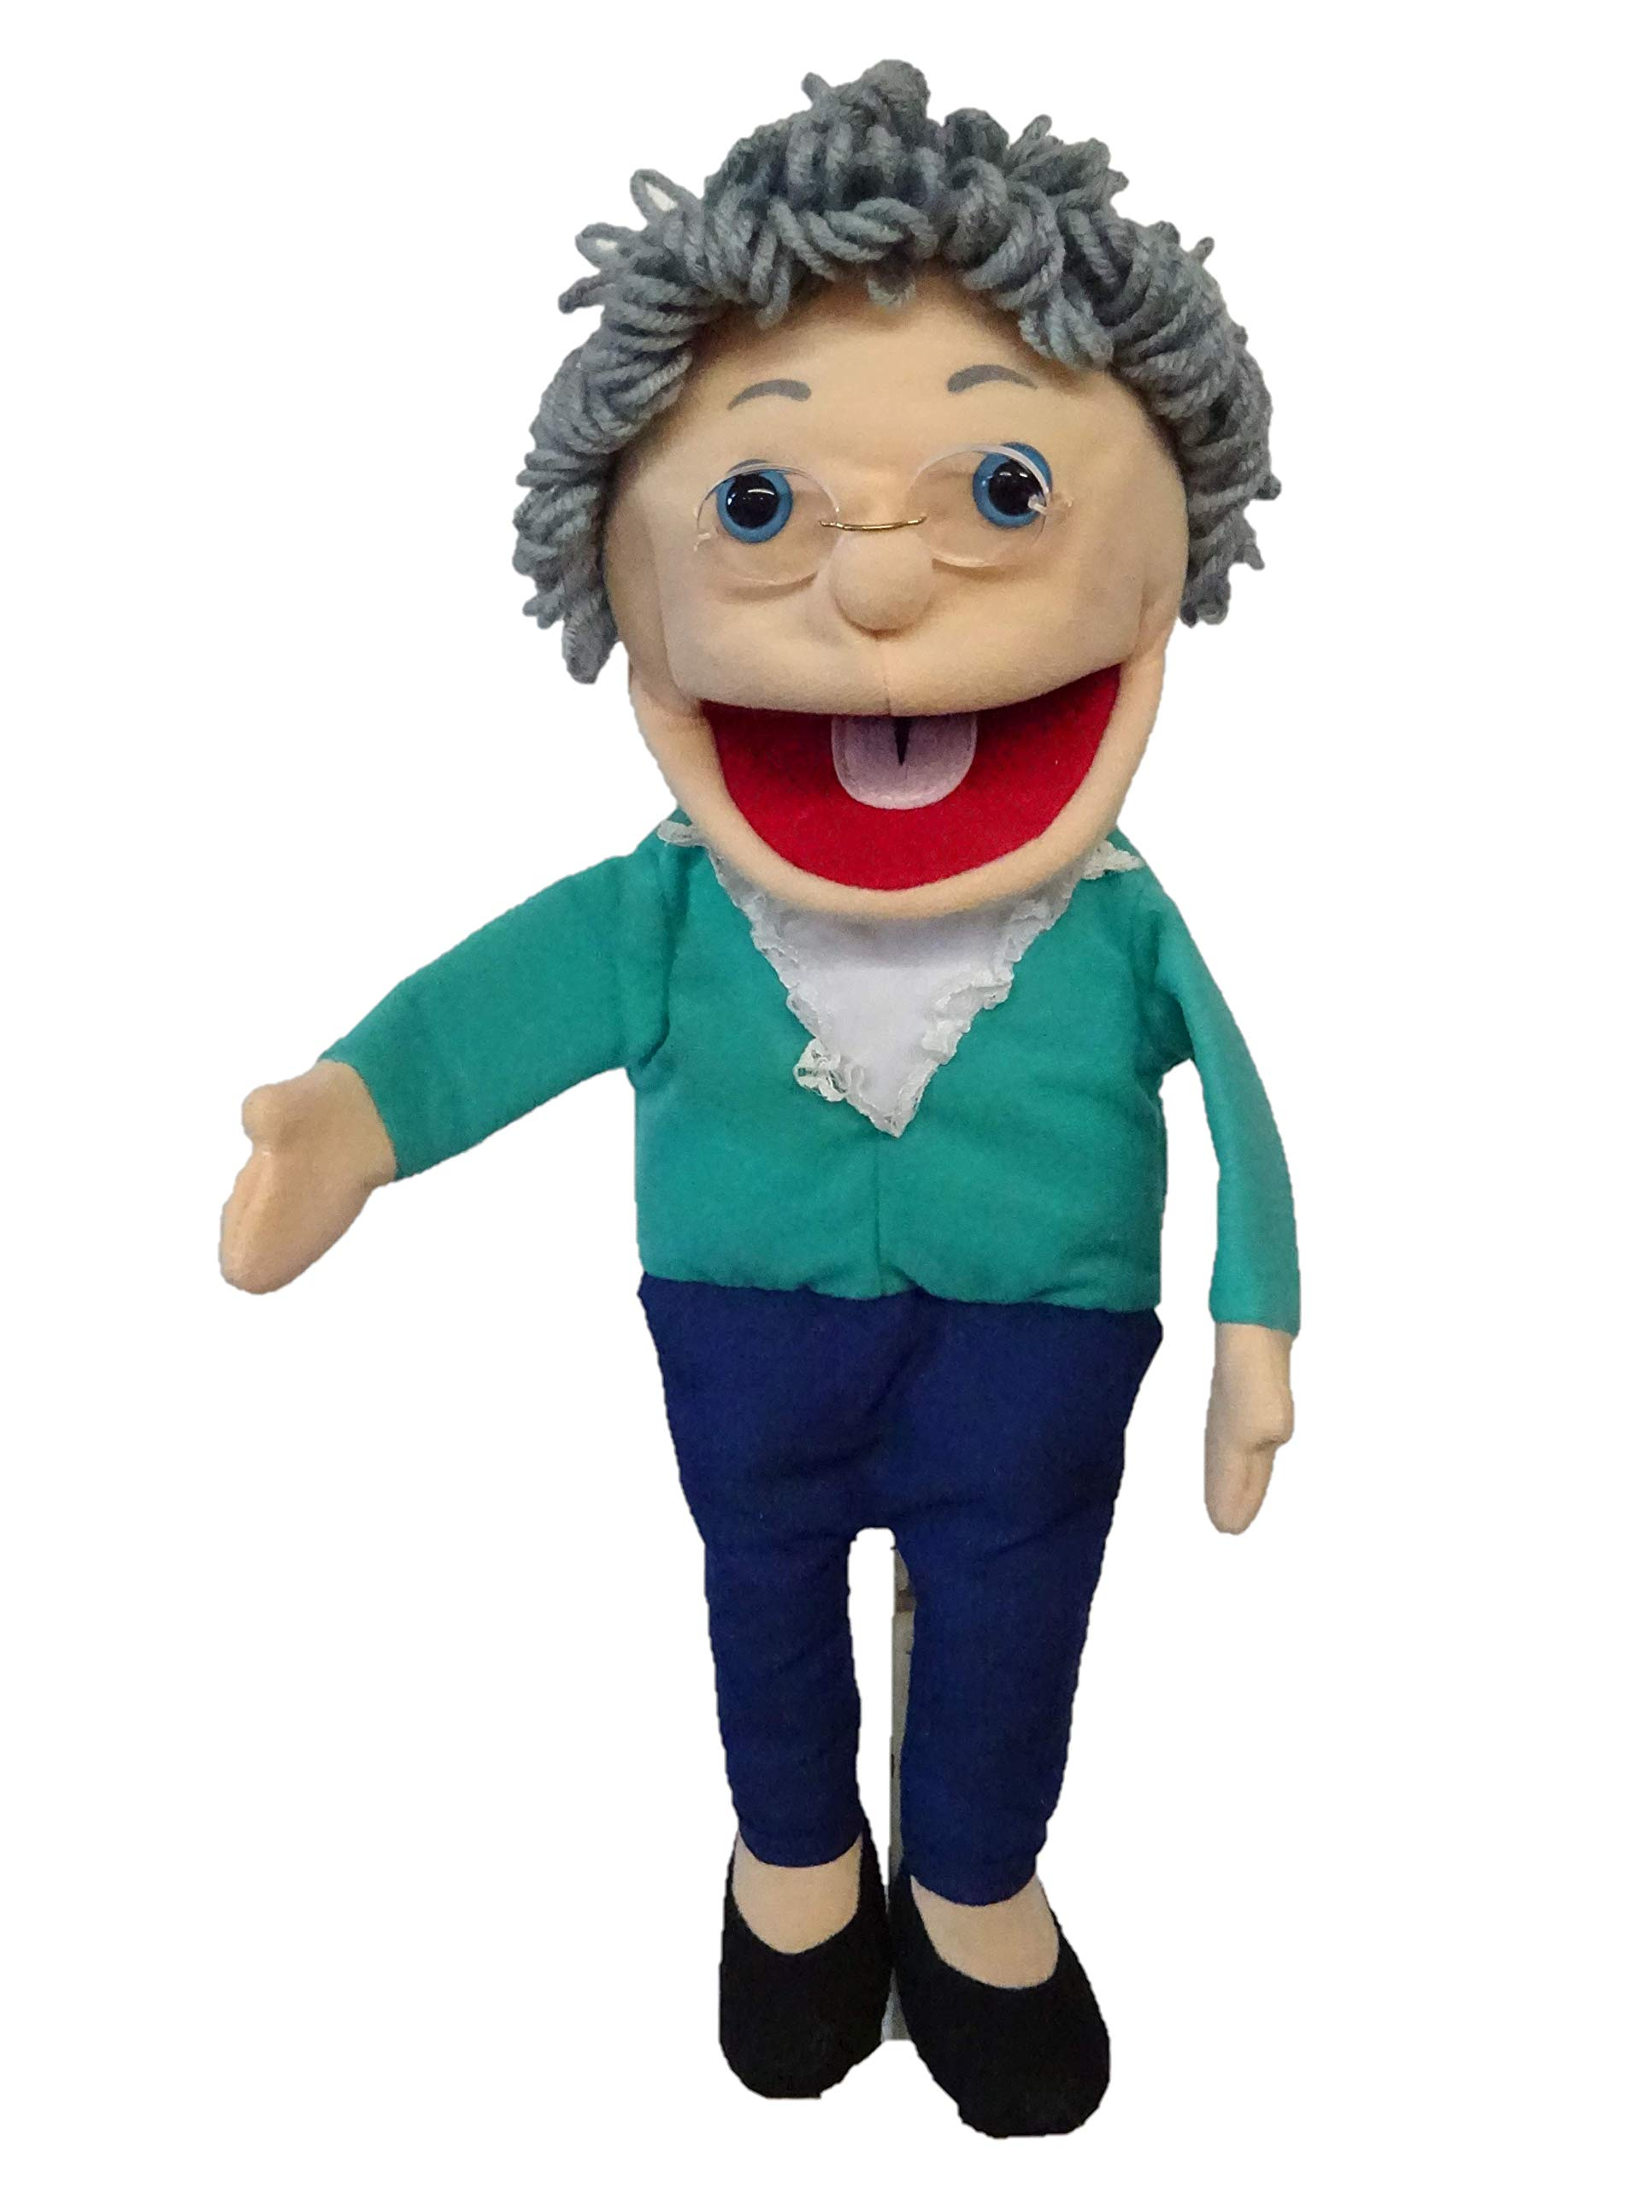
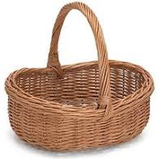
Grandma Fantastic what is in your basket?
brokenhearted
crushed
devestated
distraught
gloomy
troubled

Slide 4
unhappy
sad
upset
miserable

Slide 5
Jack was brokenhearted that he had to sell his beloved cow.

Slide 6
Jack was brokenhearted that he had to sell his beloved cow.

Slide 7
Monday 14th June 2021 LI: To use an adjective.
Jack was that he had to sell his beloved cow.

Slide 8
Monday 14th June 2021 LI: To use an adjective.
Jack was that he had to sell his beloved cow.

Slide 9
Tuesday 15th June 2021 LI: To use an adjective.

Slide 10
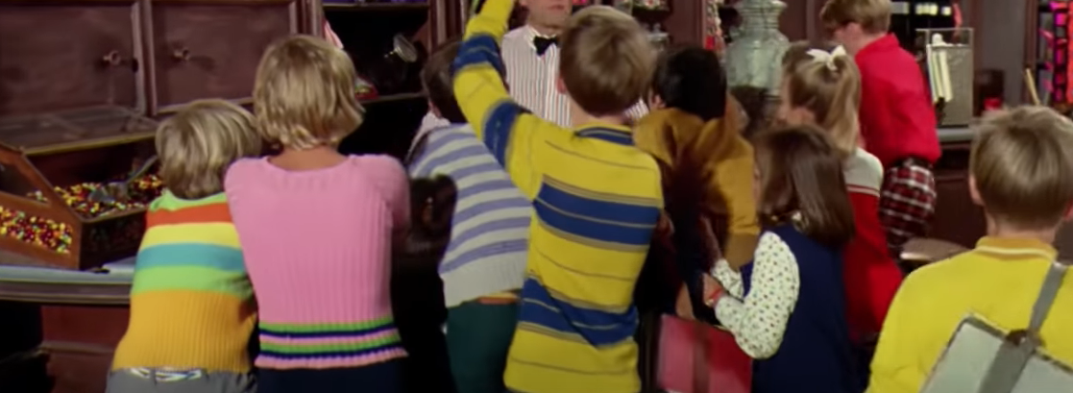
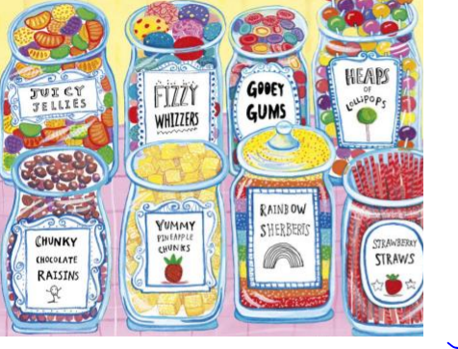
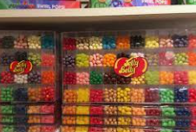
Charlie and the chocolate factory
https://www.youtube.com/watch?v=HcpDdWIaAuE

Slide 11
Grandma Fantastic what is in your basket?
canary
crimson
emerald
lemon
fruity
citrus

Slide 12
pink
sugary
red
sweet
yellow
yummy
green

Slide 13
In Jack’s bag were mouthwatering, citrus yellow jellybeans.

Slide 14
Tuesday 15th June 2021 LI: To use an adjective.
In Jack’s bag were mouthwatering, citrus yellow jellybeans.

Slide 15
Tuesday 15th June 2021 LI: To use an adjective.
In Jack’s bag were mouthwatering, citrus yellow jellybeans.

Slide 16
Tuesday 15th June 2021 LI: To use an adjective.
In Jack’s bag were mouthwatering, citrus yellow jellybeans.

Slide 17
Wednesday 16th June 2021 LI: To use a verb.

Slide 19
Grandma Fantastic what is in your basket?
scramble
scrabble
launch
scale
drag
clamber
heave

Slide 20
Push
Pull
Climb
Step
lift

Slide 21
Wednesday 16th June 2021 LI: To use a verb.
Jack scaled the towering beanstalk.

Slide 22
Wednesday 16th June 2021 LI: To use a verb.
Jack scaled the towering beanstalk.

Slide 23
Wednesday 16th June 2021 LI: To use a verb.
Jack scaled the towering beanstalk.

Slide 24
Thursday 17th June 2021 LI: To use an adjective.

Slide 25
Watch video clip:
World’s tallest people

Slide 26
Grandma Fantastic what is in your basket?
puny
skimpy
slight
Colossal
wee
humongous
monstrous
petite
gigantic

Slide 27
enormous
giant
big
huge
little
small
tiny

Slide 28
Jack took a step back as he saw the monstrous giant step towards him.

Slide 29
Thursday 17th June 2021 LI: To use an adjective.
Jack took a step back as he saw the monstrous giant step towards him.

Slide 30
Thursday 17th June 2021 LI: To use an adjective.
Jack took a step back as he saw the monstrous giant step towards him.

Slide 31
Friday 18th June 2021 LI: To use an adverb.

Slide 32
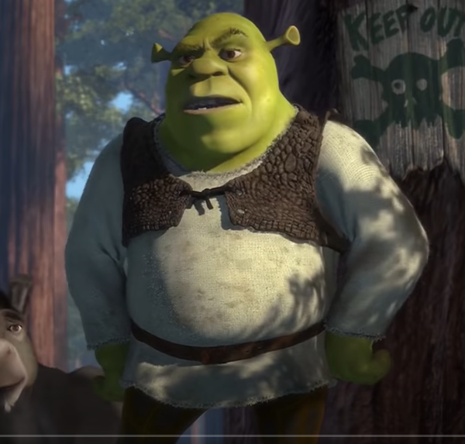
https://www.youtube.com/watch?v=70ujn7Gz_6A

Slide 33
Grandma Fantastic what is in your basket?
incensed
fuming
furious
furious
thundered
hollered
outraged
shrieked
howled
screeched
roared

Slide 34
cross
shouted
cried
annoyed
yelled
sad
screamed
angry

Slide 35
“Come back right now!” bellowed the angry giant.

Slide 36
Friday 18th June 2021 LI: To use an adverb.
“Come back right now!” bellowed the angry giant.

Slide 37
Friday 18th June 2021 LI: To use an adverb.
“Come back right now!” bellowed the angry giant.

