Slide 1
Monday 26th April 2021 LI: To describe a character

Slide 2
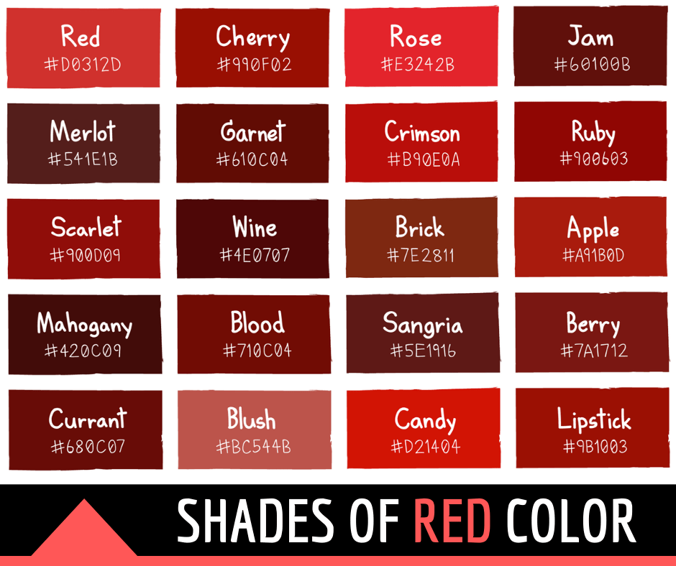
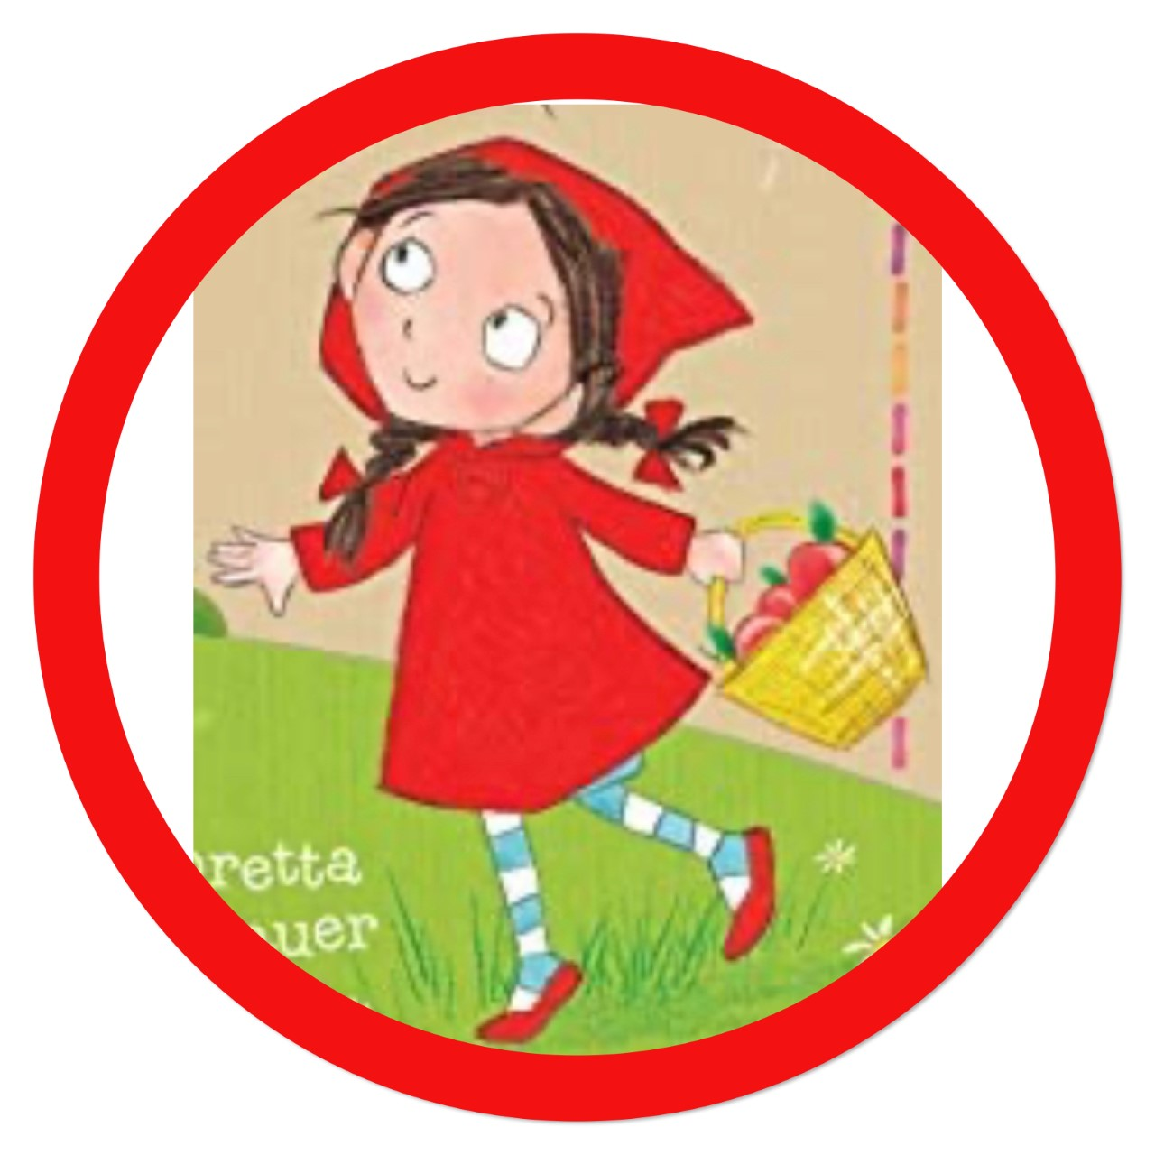
https://www.youtube.com/watch?v=zU4huNOiV0I

Slide 3
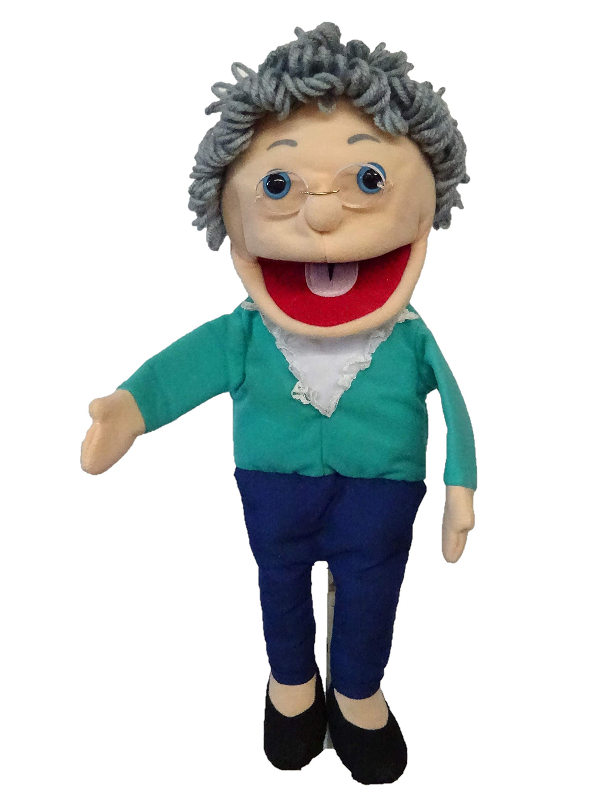
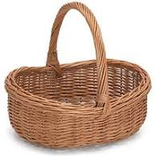
Grandma Fantastic what is in your basket?
bright red
huge eyes
friendly face
auburn

Slide 4
little
kind
brown hair
red

Slide 5
Little Red Riding Hood had a fabulous bright red cloak.

Slide 6
Little Red Riding Hood had a fabulous bright red cloak.

Slide 7
Tuesday 27th April 2021 LI: To use verbs

Slide 8
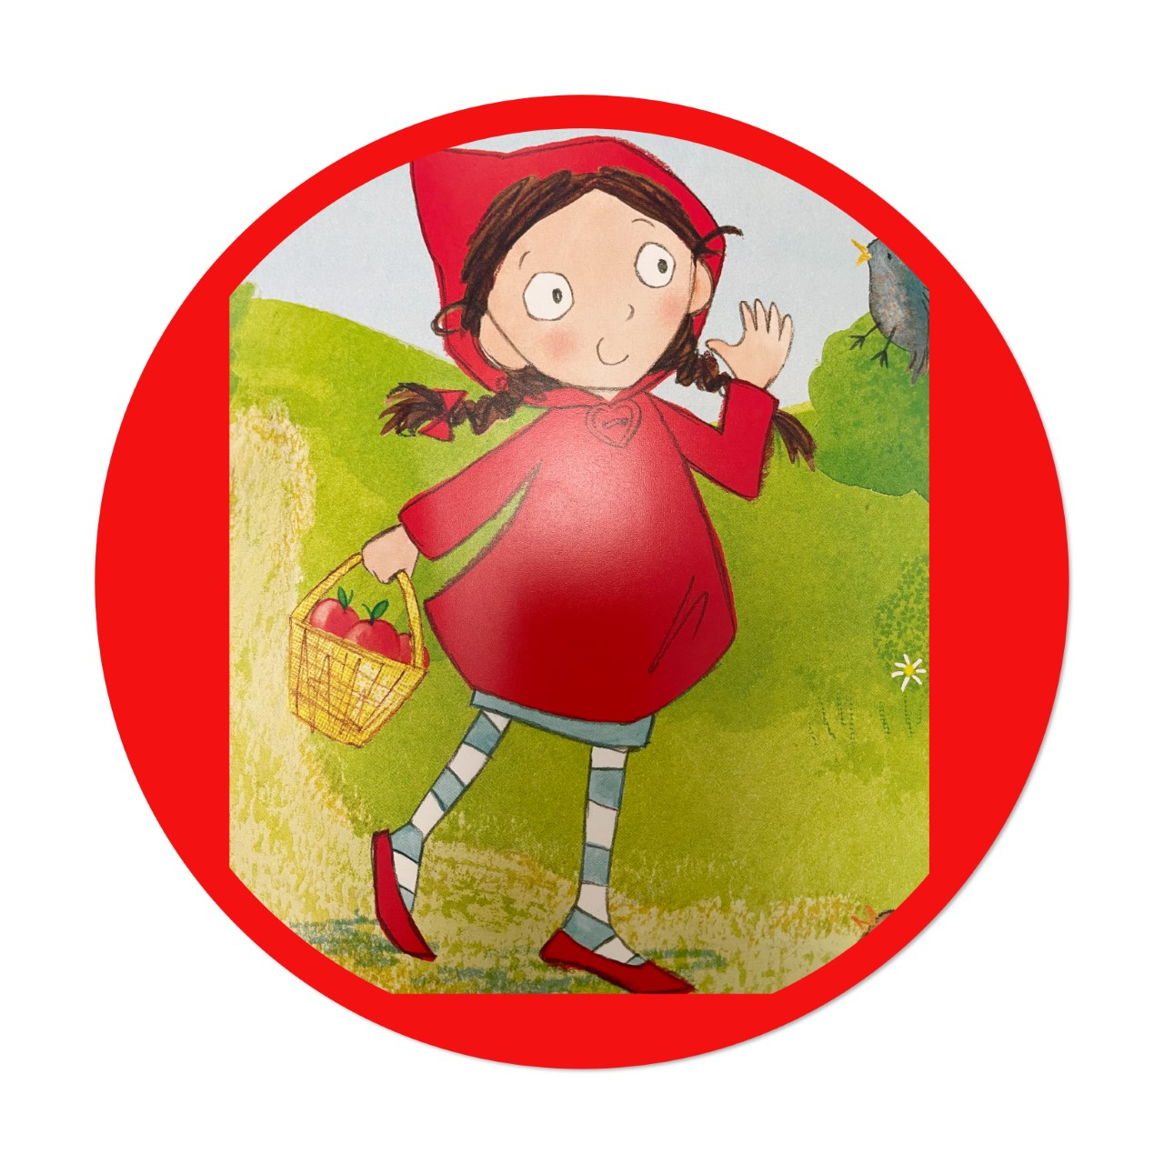
Listen to a walk in the woods: https://www.youtube.com/watch?v=ifqItKqr93w
Watch a walk in the woods https://www.youtube.com/watch?v=Q8Yv7weBq-E

Slide 9
Grandma Fantastic what is in your basket?
dashed
strolled
set off
skipped
meandered

Slide 10
walked
ran
tiptoed
hopped
crept

Slide 11
It was a bright, sunny day, and Little Red skipped through the woods.

Slide 12
It was a bright, sunny day, and Little Red skipped through the woods.

Slide 13
Wednesday 28st April 2021 LI: To use adjectives

Slide 16
Grandma Fantastic what is in your basket?
scent
perfume
fragrant
pungent

Slide 17
stinky
smelly
sweet

Slide 18
The wolf said, “Why not pick Granny some lovely flowers?”

Slide 19
The wolf said, “Why not pick Granny some lovely flowers? ”

Slide 20
Thursday 29th 2021 LI: To use adverbs

Slide 21
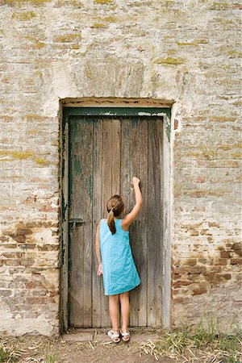
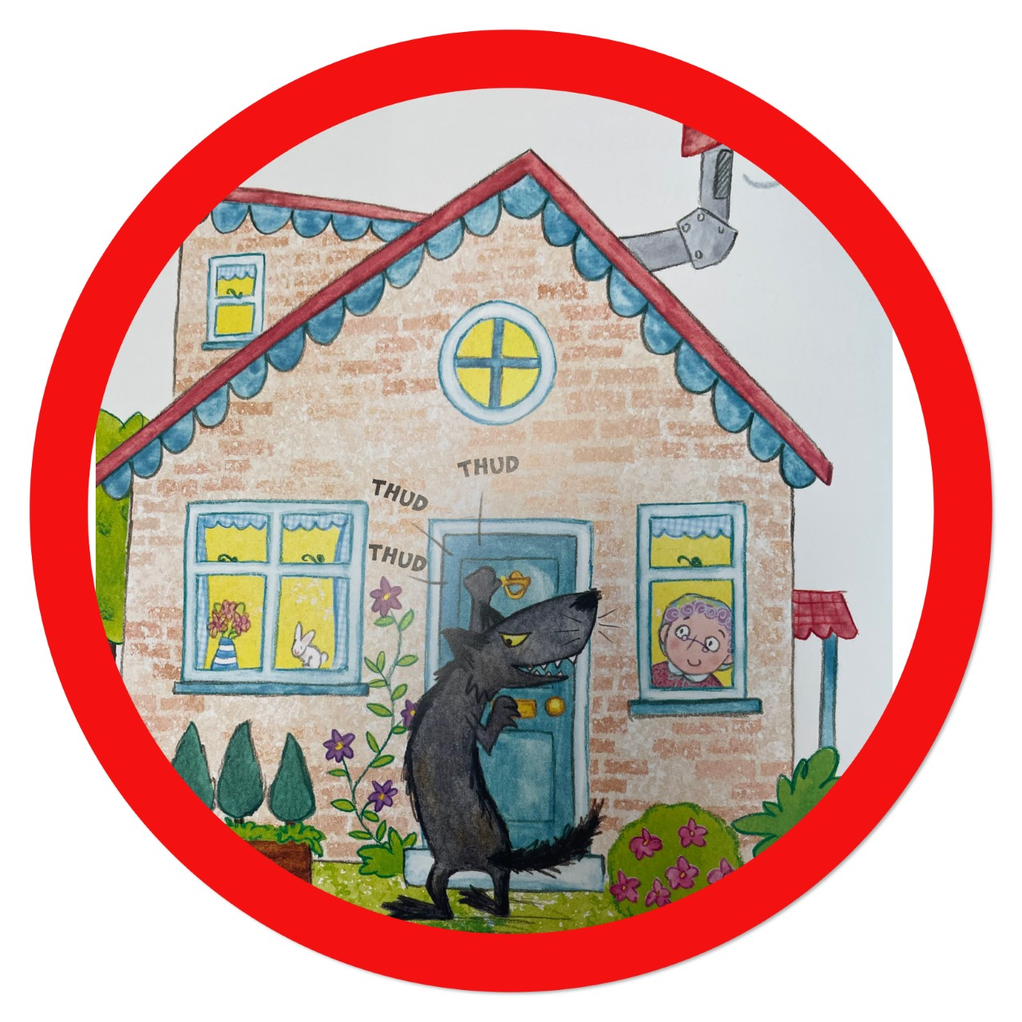
https://www.youtube.com/watch?v=deJDIfS0Psk

Slide 22
Grandma Fantastic what is in your basket?
rat-tat-tat
thud
hammered
pounded
rap

Slide 23
bang
knock
tap
hit

Slide 24
The wolf knocked on Granny’s door with a thud! Thud! Thud!

Slide 25
The wolf knocked on Granny’s door with a thud! Thud! Thud!

Slide 26
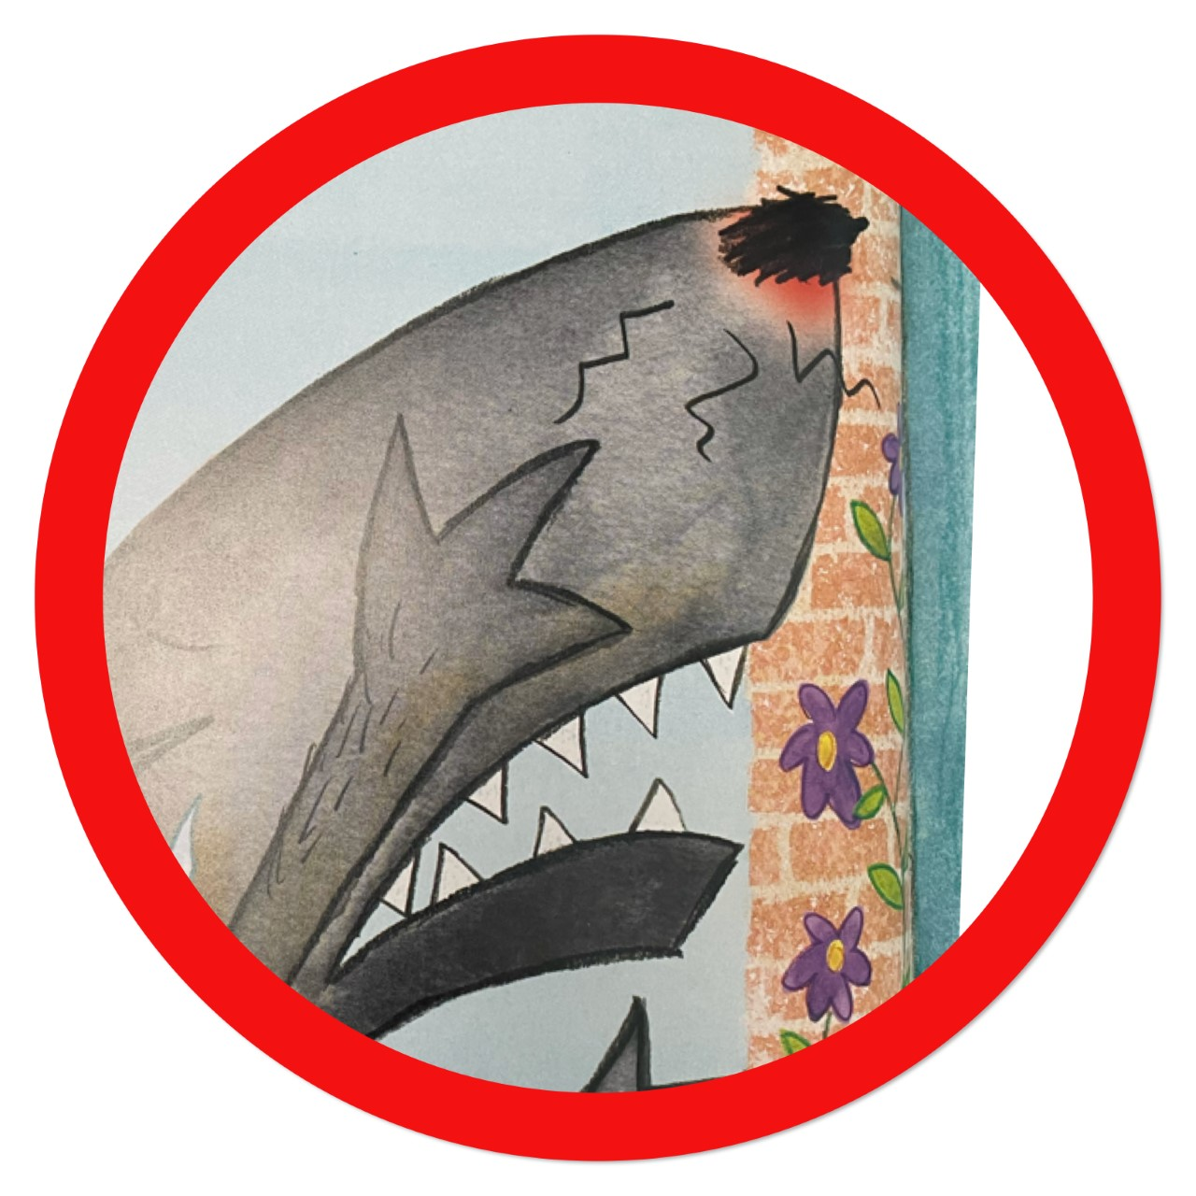
Friday 30th April 2021 LI: To write a sentence

Slide 27
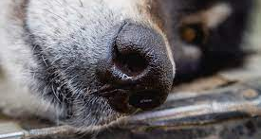
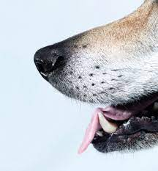
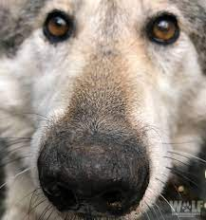
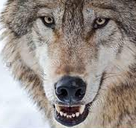

Slide 28
Grandma Fantastic what is in your basket?
large
soggy
fuzzy
long
snoot
snout
muzzle

Slide 29
furry
big
pointy
wet
nose

Slide 30
“You’re not Little Red!” yelled Granny and she slammed the door, right on his big, furry nose.

Slide 31
“You’re not Little Red!” yelled Granny and she slammed the door, right on his big, furry nose.

Slide 32
“You’re not Little Red!” yelled Granny and she slammed the door, right on his big, furry nose.

