Slide 1
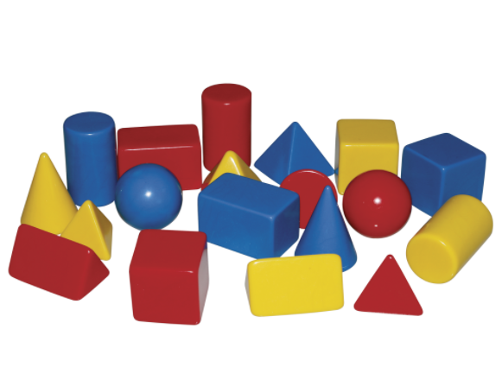
Monday Term 5 Week 1
Number and Shape Assessment

Slide 2
L.I. Number and Place Value – complete number square assessment
PKS – Read and write numbers in numerals from 0-9.
Count to 20, demonstrating that the next number in the count is one more and the previous number is one less.
Band 1 – Count and write numbers to 100 in numerals.
Band 2 – Read and write numbers to at least 100 in numerals.

Slide 3
L.I. Shape – complete White Rose End of Block assessment
PKS – Begin to identify some 2D and 3D shapes and name some of them.
Band 1 – Recognise and name common 2D shapes e.g. rectangles (including squares), circles and triangles.
Recognise and name common 3D shapes e.g. cuboids (including cubes), pyramids and spheres

Slide 4
Band 2 – Identify and describe the properties of 2D shapes, including the number of sides and line symmetry in a vertical line.
Identify and describe the properties of 3D shapes, including the number of edges, vertices and faces.
Name some common 2D and 3D shapes from a group of shapes or from pictures of the shapes and describe some of their properties (e.g. triangles, rectangles, squares, circles, cuboids, cubes, pyramids and spheres).
Identify 2D shapes on the surface of 3D shapes e.g. a circle on a cylinder and a triangle on a pyramid.
Compare and sort common 2D and 3D shapes and everyday objects describing similarities and differences e.g. find 2 different 2D shapes that only have one line of symmetry; that a cube and a cuboid have the same number of edges, faces and vertices and describe what is different about them.

