Slide 1
Term 3 Week 2
History
The Great Fire of London and Samuel Pepys

Slide 2
Learning Objectives
L.I: I can explain the events of the Great Fire of London.
Activity: To answer questions about the Great Fire of London and Samuel Pepys.

Slide 3
Please watch The Great Fire of London story on Youtube the link is below.
The Great Fire of London #greatfireoflondon #thegreatfireoflondon #Londonfire1666 - YouTube

Slide 4
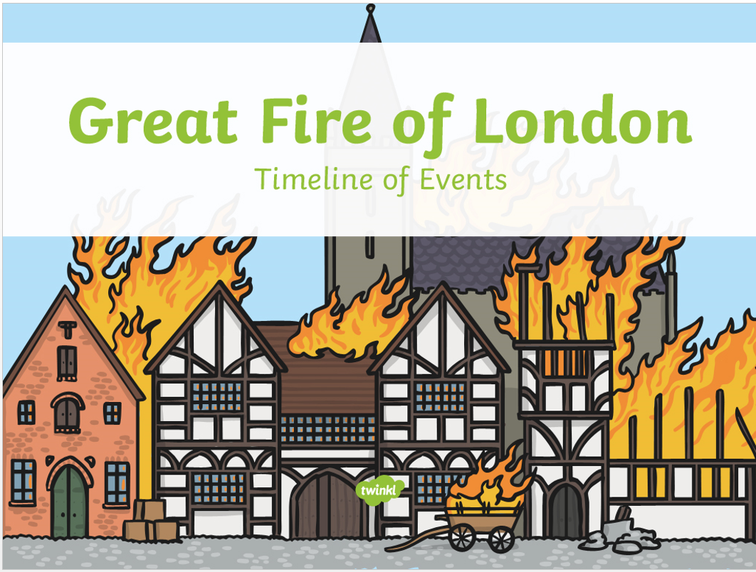

Slide 15
Samuel Pepys
Samuel Pepys was born a very long time ago on 23rd February 1633.
It is thanks to Samuel’s diaries that we know lots about important events from the past.

Slide 18
Task To answer the following questions about the Great Fire of London.
Where did the fire start?
Where did the fire spread to?
How much of London was affected by the fire?
When did the fire end?
What did Samuel Pepys see?
How would Samuel Pepys of felt when he saw the fire?

