Slide 1
Key Stage 1 Maths
Term 3 Week 2 WEDNESDAY
Addition and Subtraction

Slide 2
13.01.2021 LI: To find the difference.
Steps to Success
I can find the difference by solving problems using numbers up to 10. (Level 1)
I can find the difference by solving problems using 1 and 2 digit numbers. (Level 2)
I can find the difference by solving problems using the most efficient method to help me. (Level 3)

Slide 3
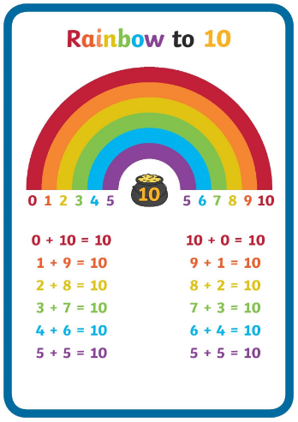
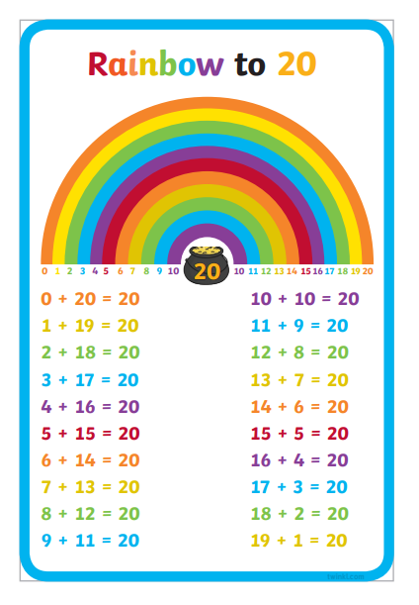
Warm up
Practise your number bonds to 10 or 20.
Say a number – how many more make 10 or 20?
What patterns do you notice?

Slide 4
What do you know about finding the difference?
Think back to the work that you did yesterday.
When you find the difference you can use counting back and counting on to help you. Use the method that is easiest for you and think about which way is the most efficient.

Slide 5
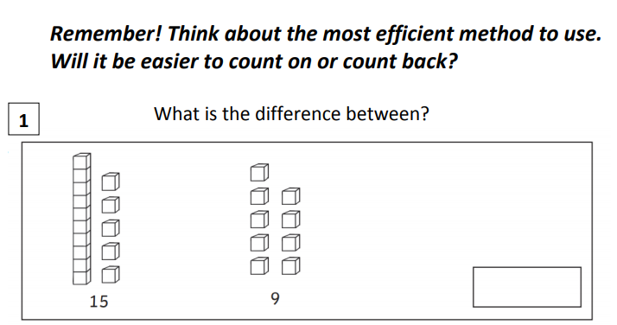
Today’s activities

Slide 6
Today’s activities

Slide 7
Today’s activities

Slide 8
Today’s activities
9
15

Slide 9
Today’s activities

Slide 10
Choose the level sheet appropriate for your child. Level 1 mainly uses numbers up to 10. Level 2 uses numbers up to 30, and greater explanation is needed. Level 3 uses larger numbers. They should be secure with place value and counting to 100.
Activity Time!
The activities are problem solving based so will require discussion.

