Slide 1
Key Stage 1 Maths
Term 3 Week 2
Addition and Subtraction

Slide 2
Key Teaching points to help you!
Addition can be done in any order.
With subtraction you must start with the biggest number.
Addition + count forwards
Subtraction – count backwards
Common misconceptions!! Children often include the starting number when they count.
E.g. for 5 – 3
They might go 5, 4, 3 – therefore giving the wrong answer. It is vital to model how to count backwards by ‘ putting the start number in our head and counting backwards.’

Slide 3
The use of zero is important so children know that when nothing is taken away, the start number remains the same or when the whole group is taken away, there will be nothing left.
One of the most difficult concepts for children is finding the difference where they subtract to calculate how many more.

Slide 4
TUESDAY

Slide 5
12.01.2021 LI: To find the difference.
Steps to Success
I can find the difference by solving problems using numbers up to 10. (Level 1)
I can find the difference by solving problems using 1 and 2 digit numbers. (Level 2)
I can find the difference by solving problems using the most efficient method to help me. (Level 3)

Slide 6
Warm up
Practise counting forwards and backwards in 2’s, 5’s and 10’s from different numbers on the number square. (On next slide).
What patterns do you notice?
Extra challenge! Try counting in 3’s.

Slide 7
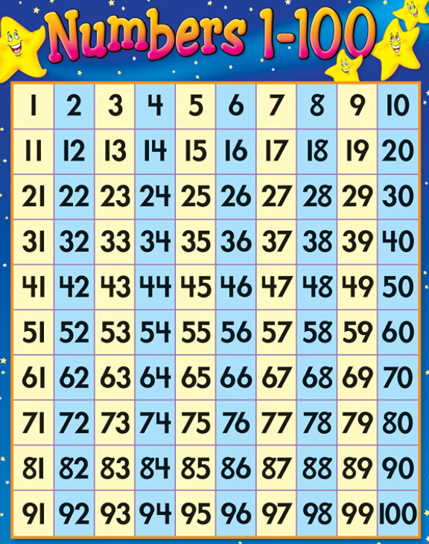
Number Square

Slide 8
What do you think difference means?
Think back to the work that you did yesterday.
When you find the difference you can use counting back and counting on to help you. Use the method that is easiest for you and think about which way is the most efficient.

Slide 9
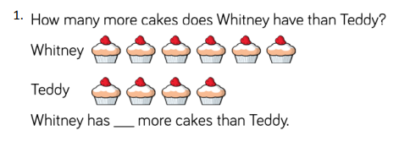
Choose the level sheet appropriate for your child. Level 1 mainly uses numbers up to 10. Level 2 uses numbers up to 30, and greater explanation is needed. Level 3 uses larger numbers. They should be secure with place value and counting to 100.

Slide 10
Choose the level sheet appropriate for your child. Level 1 mainly uses numbers up to 10. Level 2 uses numbers up to 30, and greater explanation is needed. Level 3 uses larger numbers. They should be secure with place value and counting to 100.

Slide 11
Choose the level sheet appropriate for your child. Level 1 mainly uses numbers up to 10. Level 2 uses numbers up to 30, and greater explanation is needed. Level 3 uses larger numbers. They should be secure with place value and counting to 100.

Slide 12
Choose the level sheet appropriate for your child. Level 1 mainly uses numbers up to 10. Level 2 uses numbers up to 30, and greater explanation is needed. Level 3 uses larger numbers. They should be secure with place value and counting to 100.
Activity Time!
The activities are problem solving based so will require discussion.

