Slide 1
Lesson 2: Adding and removing text
Save a copy
Year 1 – Creating Media – Digital writing
Notes:
Last updated: 01-07-20
This resource is available online at ncce.io/cm1w-2-s. Resources are updated regularly — please check that you are using the latest version.
This resource is licensed under the Open Government Licence, version 3. For more information on this licence, see ncce.io/ogl.

Slide 2
Lesson 2: Adding and removing text
Objectives
Lesson objective: To add and remove text on a computer
I can enter text into a computer
I can use letter, number, and space keys
I can use backspace to remove text

Slide 3
Key vocabulary
Lesson 2: Adding and removing text
Key vocabulary
Word processor
Keyboard
Keys
Letters
Numbers
Space
Backspace
Text cursor
Google Docs
Microsoft Word

Slide 4
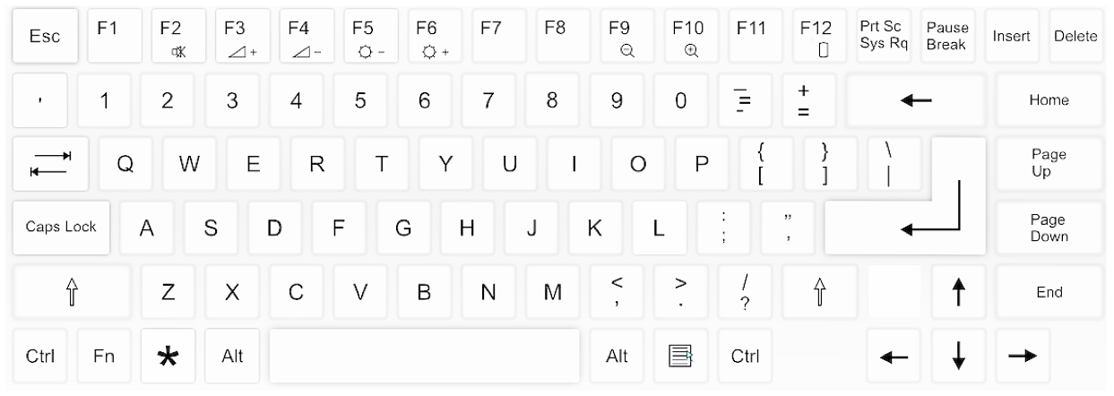
Activity 1
c
a
t
d
o
g
Notes:
Note: If the board that you are using is interactive, the correct letters will highlight when the screen is touched, e.g. ‘c’ will highlight on the first touch (regardless of where the screen is touched). The letters in the words will appear at the bottom of the screen with each click/touch.
Using the letters in the printout, demonstrate with the learners how the letters will be added to their page. This includes identifying the text cursor to understand where their text will appear when a key is pressed. In order to do this, the learner with the text cursor page will have to fold and unfold page to make the line appear to flash.
If the learners do not identify that a space is needed between the word ‘cat’ and ‘dog’, prompt them to think about whether they would write these words like this on paper.
In order to demonstrate that the text cursor can be moved around the page, model moving the learner with the text cursor. Explain that you are the mouse and ensure that the learners are aware that you have clicked when you place the text cursor in the correct space.
Image source: https://pixabay.com/vectors/computer-keyboard-home-computer-158770/

Slide 5
Think, pair, share
Is this how you would write these two words on paper?
What have you missed out?
Activity 1

Slide 6
Does anyone know how to write spaces on a computer?
Activity 1
Colour in the space key
Notes:
Click to animate the space bar after the learners have given their answers.
Image source: https://pixabay.com/vectors/computer-keyboard-home-computer-158770/

Slide 7
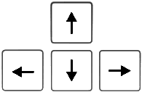
Text cursor
Activity 1
This tells you where your writing will appear.
To move it, you can:
Use the arrow keys or
Move the mouse and click where you want it
h
i
Notes:
When you click the slide, the animation of the word ‘hi’ will begin. Click after this has finished to display the arrow and the mouse pointer images.
Image sources:
https://pixabay.com/vectors/computer-keyboard-home-computer-158770/
https://pixabay.com/illustrations/mouse-pointer-arrow-ps-computer-1345874/

Slide 8
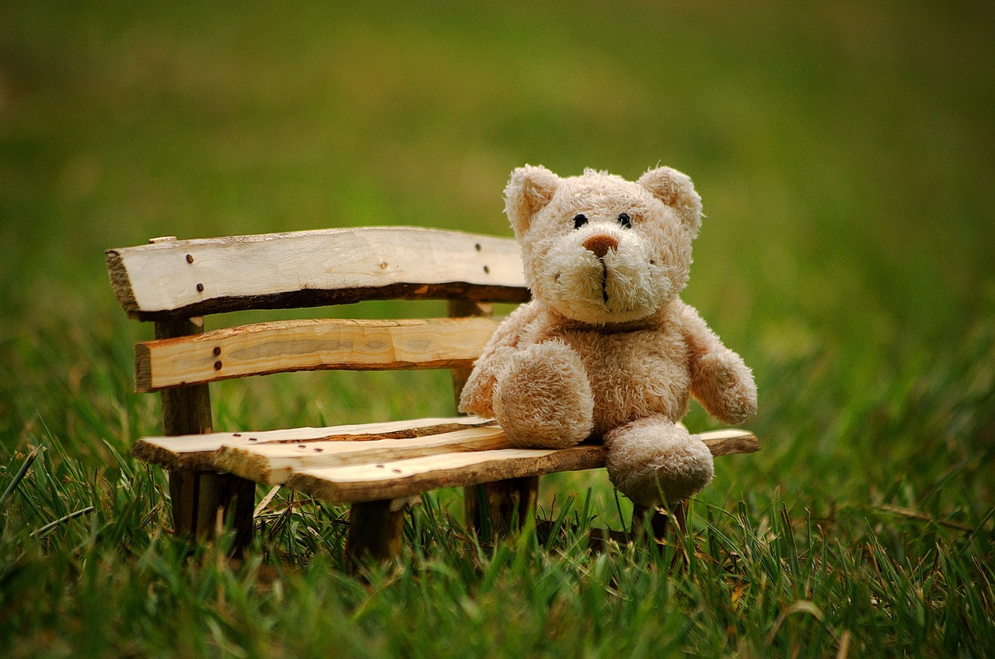
Activity 2
This is William.
This is his lost toy, Ted.
Notes:
Image sources:
https://pixabay.com/photos/kids-boy-glasses-spectacles-cute-1508121/
https://pixabay.com/photos/teddy-soft-toy-funny-teddy-bear-2977694/

Slide 9
Log in to the computer and open the word processor
Activity 2
Notes:
Note: Additional support/time may be required to facilitate this step. You may wish to ask the learners to colour in the keys that they need to use to log in to the computer, in order to reduce the amount of time spent on this task in future lessons.
Image sources:
https://pixabay.com/vectors/laptop-notebook-mobile-computer-154091/
https://pixabay.com/vectors/computer-desktop-workstation-office-158675/
https://commons.wikimedia.org/wiki/File:Microsoft_Word_2013_logo.svg
https://commons.wikimedia.org/wiki/File:Icon-doc.svg
https://commons.wikimedia.org/wiki/File:LibreOffice_6.1_Writer_Icon.svg
https://www.openoffice.org/ui/VisualDesign/OOo30MimeType.html

Slide 10
Activity 2
Ted is…
big
small
brown
soft
a nose
Ted has...
fur
ears
Notes:
Note: This slide could be shared on the screen or provided as a physical copy (printout) in order to provide the learners with easier access to the sentence starters.
Encourage the learners to think about other words that could be used to describe Ted, and ensure that they are using the space bar introduced in slide 6.
Image source: https://pixabay.com/photos/teddy-soft-toy-funny-teddy-bear-2977694/

Slide 11
Does anyone know how to move down to start writing on a new line, when using a computer?
Activity 3
Colour in the Enter key
Notes:
Click to animate the Enter key after the learners have given their answers.
Image source: https://pixabay.com/vectors/computer-keyboard-home-computer-158770/

Slide 12
Think, pair, share
What does William need to add so that people can tell him if they find Ted?
Activity 3

Slide 13
Think, pair, share
Should you ever write your own personal phone number for everyone to see?
Why not?
Activity 3

Slide 14
Phone number
Activity 3
Write a phone number at the bottom of your page:
Notes:
Note: If the keyboard that the learners are using has a number pad, this could be a tricky step to complete, without introducing the ‘number lock’. It is recommended that the learners only use the top number keys for this activity.

Slide 15
This is the backspace key — colour it in on your keyboard
Activity 4
h
i
Notes:
Click to animate the backspace key and allow the learners time to colour in their template.
When you click the slide again, the animation of taking away the letters in the word ‘hi’ will begin.
Image source: https://pixabay.com/vectors/computer-keyboard-home-computer-158770/

Slide 16
Activity 4
Think, pair, share
What changes would you make to this lost toy poster?
Notes:
Click on the poster to open the model lost toy poster.
Image source: https://pixabay.com/photos/teddy-soft-toy-funny-teddy-bear-2977694

Slide 17
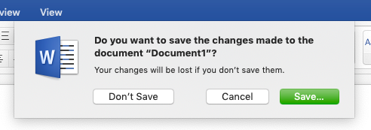
Time to finish!
Activity 5
Close your word processor using the x in the top right corner.
Click ‘Save...’ if it asks you to save!
Log off your computer.
Notes:
Note: This is likely to be highly scaffolded depending on the learners’ previous experience and the school’s setup. You may wish to add a page detailing the steps that your learners need to take to save their documents in the correct place. This could be reused in future lessons.
If the school uses a cloud-based system that allows collaboration on documents (e.g. Google Docs), the learners may not need to save their documents. This is something that should be explained to learners.

Slide 18
With a partner...
Plenary
What steps do you need to take to correct the writing?
Can you share your partner’s answers?
Notes:
Image source: https://pixabay.com/illustrations/speech-balloon-talk-bubble-1019777/

Slide 19
How confident are you? (1–3)
Assessment
I can enter text into a computer
I can use letter, number, and space keys
I can use backspace to remove text
3 - Very confident
2 - Unsure
1 - Not confident
Notes:
Image source: https://pixabay.com/vectors/thumb-up-hand-like-confirm-go-top-307176/

Slide 20
Next lesson
Summary
In this lesson, you…
Used the keyboard to write text onto the page, and used the backspace key to remove text from the page.
Next lesson, you will…
Add capital letters to text and look at some of the keys on the keyboard. You will also look at the toolbar and find out what some of the buttons do.

