Slide 1
Key Stage 1 Maths
Term 3 Week 1 Thursday
Addition and Subtraction

Slide 2
07.01.2021 LI: To add 2 numbers
Steps to Success
I can add single numbers up to 10.
I solve number problems involving the addition of single digit numbers. (Level 1)
I add 1 and 2 digit numbers to 20, including 0. (Level 2)
I can solve problems with addition, applying increasing knowledge of written methods and mental methods. (Level 3)

Slide 3
Doubling up
Say what you see...
l + l = 2 | 2 + 2 = 4 | 3 + 3 = 6 | 4 + 4 = 8 | 5 + 5 = l0
l0 + l0 = 20 | 20 + 20 = 40 | 30 + 30 = 60 | 40 + 40 = 80 | 50 + 50 = l00
Note: This warm up is about spotting patterns. There are a few, from numbers going up in 1s, the answers following the multiples of 2, numbers going up on l0s, answers rising by 20 each time, and the second row being like the first, except for it being a tens.

Slide 4
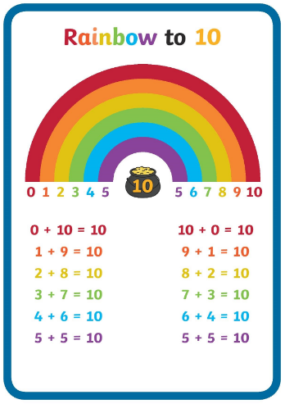
Add by making 10 first.
Tens frame
Number line
Number bonds to 10

Slide 5
Rosie has used the tens frames to work out 6 + 7
She has 6 red counters.
She has 7 blue counters. She used 4 of them to fill up 1 ten, then the other 3 were left to begin the new frame.
Note:
Partitioning is when you split a number into its number bonds.
In this case, 7 has been partitioned so the tens frame can be completed by using the number bond 6 and 4. The 3 left over begins a new frame.
When the children count, they don’t need to count each counter in the first frame because they know that there are 10. They can count on, saying “10... 11, 12, 13.

Slide 6
Mo used a number line to work out 6 + 8
6 + 8 = 14 or 6 + 4 + 4 = 14
8

Slide 7
Add by making 10.

Slide 8
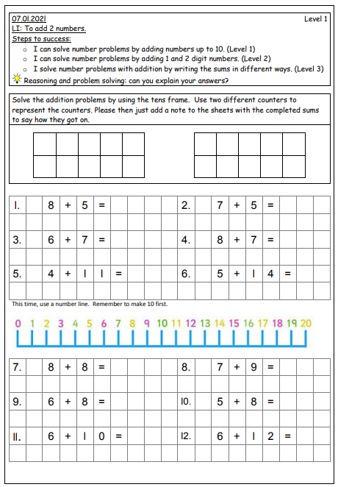
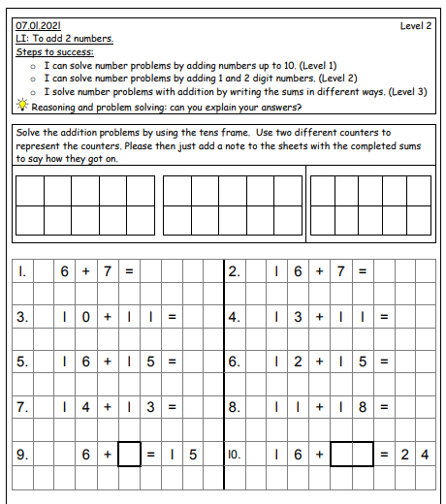
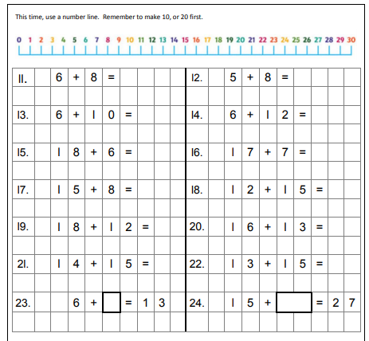
Choose the level sheet appropriate for your child. Level 1 mainly uses numbers up to 10. Level 2 uses numbers up to 20, and greater explanation is needed. Level 3 uses more mental arithmetic, application and wider written methods. They should be secure with their number bonds to 10 and 20.
Level 3, see next page.

Slide 9
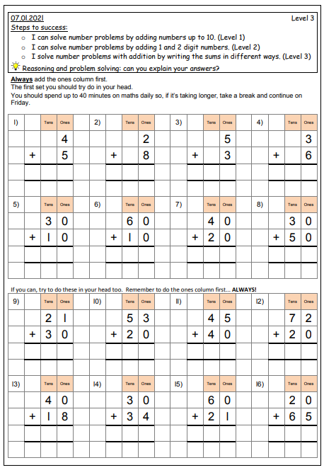
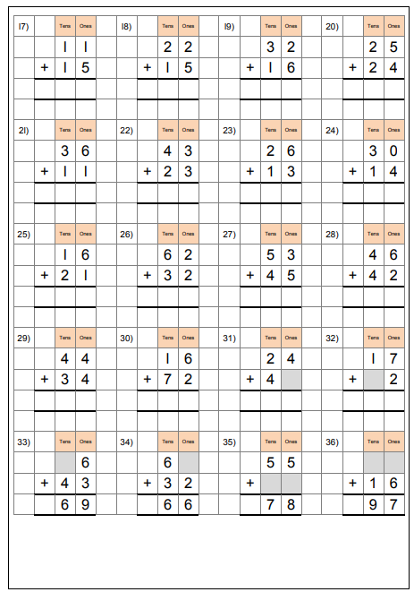
Choose the level sheet appropriate for your child. Level 1 mainly uses numbers up to 10. Level 2 uses numbers up to 20, and greater explanation is needed. Level 3 uses more mental arithmetic, application and wider written methods. They should be secure with their number bonds to 10 and 20.
Level 3: This allows the children to practise column addition that they began on Wednesday.
It works through all the different levels so that they are ready to use column addition with an exchange (carrying).
It is important that they do this step is secure before exchanging.

