Slide 1
Key Stage 1 Maths
Term 3 Week 1
Addition and Subtraction

Slide 2
05.01.2021 LI: To add 2 numbers
Steps to Success
I solve number problems involving the addition of single digit numbers. (Level 1)
I add 1 and 2 digit numbers to 20, including 0. (Level 2)
I can solve problems with addition, applying increasing knowledge of written methods and mental methods. (Level 3)

Slide 3
Say what you see...
How many did you have to begin with?
How many more were added?
How many do you have now?
What number sentence represents this?

Slide 4
Adding by counting on.
There are still 7 blue butterflies.
Do you have to count the blue butterflies again to count on?
Do you have to begin with the largest number when you count on?
Why is it simpler to begin with the biggest number?
What 2 number sentences could you write to represent this?

Slide 5
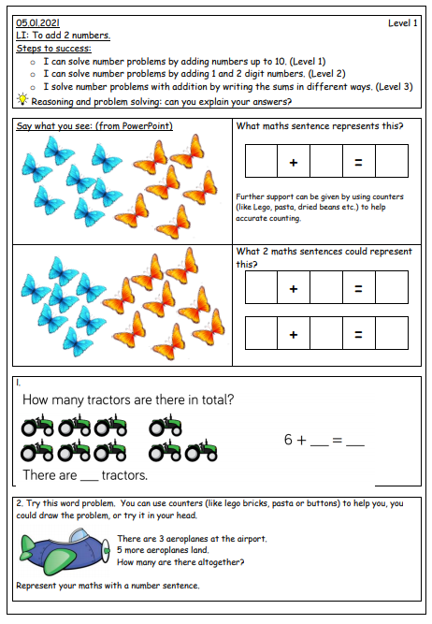
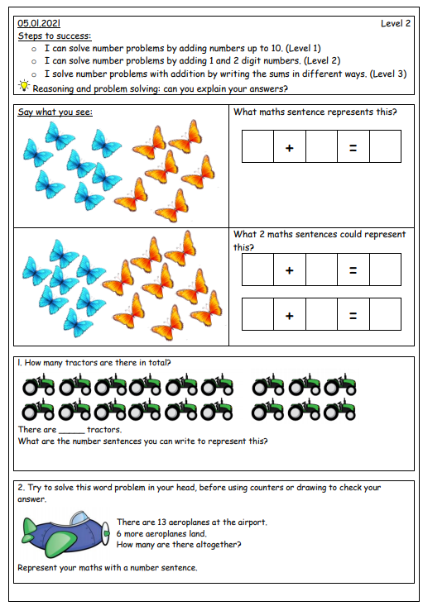
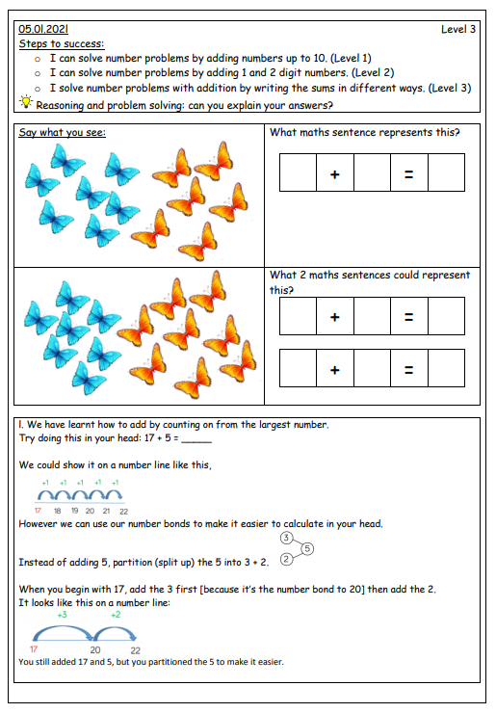
Choose the level sheet appropriate for your child. Level 1 mainly uses numbers up to 10. Level 2 uses numbers up to 20, and greater explanation is needed. Level 3 uses more mental arithmetic, application and wider written methods. They should be secure with their number bonds to 10 and 20.

