Slide 1
Creating Media — Digital writing
Save a copy
Unit introduction
Notes:
Last updated: 01-07-20
This resource is available online at ncce.io/cm1w-1-s. Resources are updated regularly — please check that you are using the latest version.
This resource is licensed under the Open Government Licence, version 3. For more information on this licence, see ncce.io/ogl.

Slide 2
During this unit, you will...
Unit introduction
Look at how to interact with a computer using a keyboard and mouse.
Change the look of the text that you enter on the computer.
Compare writing on a computer to writing on paper.
Today you are you ! That’s truer than true!
Notes:
Image source: https://pixabay.com/vectors/computer-desktop-workstation-office-158675/

Slide 3
Lesson 1: Exploring the keyboard
Year 1 – Creating Media – Digital writing

Slide 4
Lesson 1: Exploring a keyboard
Objectives
Lesson objective: To use a computer to write
I can open a word processor
I can recognise keys on a keyboard
I can identify and find keys on a keyboard

Slide 5
Key vocabulary
Making changes to text
Key vocabulary
Word processor
Keyboard
Keys
Letters
Google Docs
Microsoft Word

Slide 6
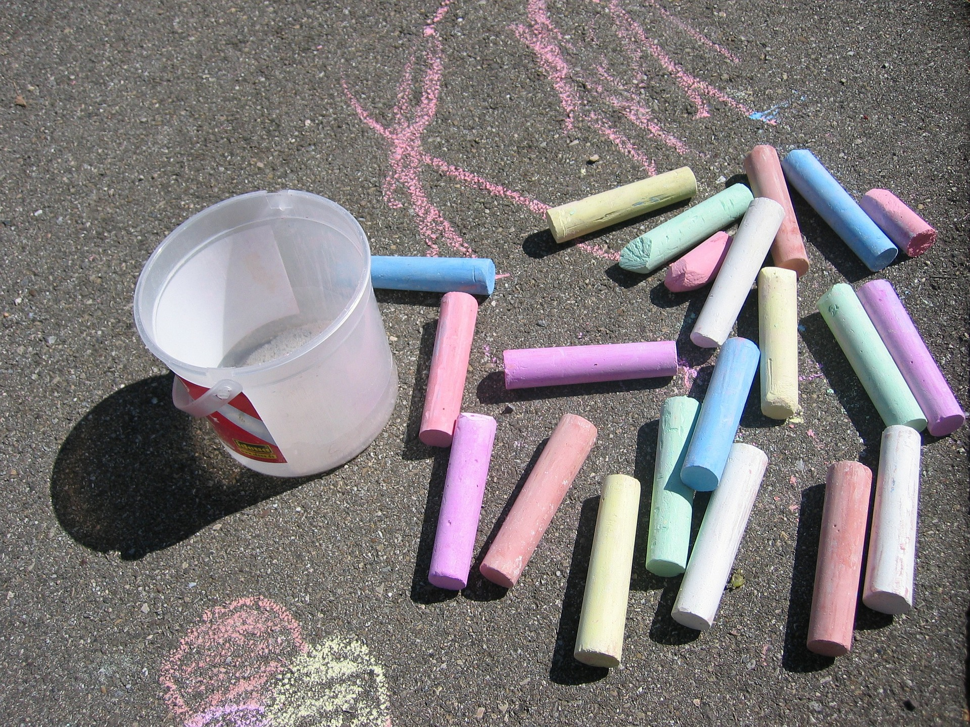
With a partner...
Introduction
Question: What can you use to create writing?
Notes:
Allow the learners time to discuss these images and to think about what can be used to create writing. Encourage the learners to think about other writing tools, e.g. fingers and paint, sand or salt, etc.
Image sources:
https://pixabay.com/photos/a4-paper-template-pencil-poetry-4279517/
https://pixabay.com/photos/street-chalk-chalk-colorful-asphalt-73583/
https://pixabay.com/vectors/ball-pen-biro-pen-black-write-154998/
https://pixabay.com/vectors/pencil-green-writing-tools-37254/

Slide 7
Think, pair, share
Activity 1
What is this?
Have you used anything like this before?
Notes:
Note: Learners may be familiar with a different type of word processor, e.g. a tablet. Encourage them to think about things that they may have used that look similar to the picture.

Slide 8
Activity 1
They are both pages that you can write on!
Notes:
Hold up a piece of plain paper to encourage the learners to relate the two ways of writing. It is important to explain that the white page is where the writing will go and the grey area is there to show us where the page ends.
Image sources:
https://pixabay.com/photos/a4-paper-template-pencil-poetry-4279517/

Slide 9
Think, pair, share
Activity 1
What could you use this for?
Notes:
When the learners are thinking about the possible uses of the word processors, ask them to think about what they could use a regular piece of paper for.
Due to the age of the learners, encourage them to think critically about this activity. They may use physical paper to draw pictures, but they wouldn’t be able to use the word processor on a computer in the same way.

Slide 10
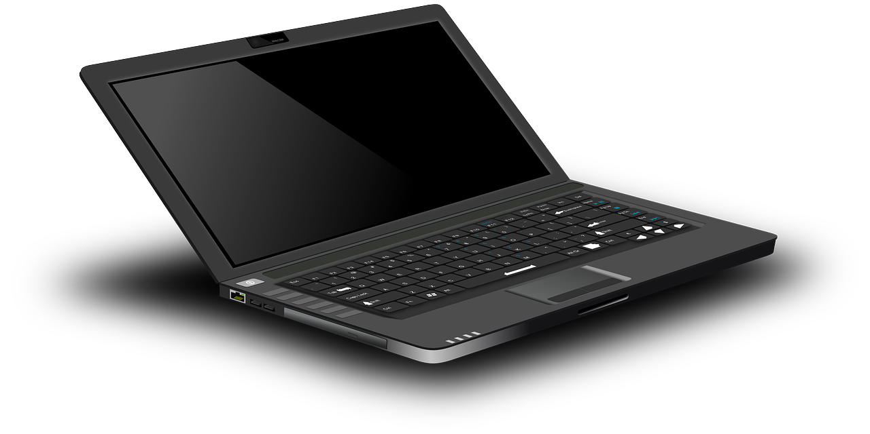
Activity 2
Think, pair, share
Which part of the computer could you use to add letters to your pages?
Notes:
Once the learners have thought about what part of the computer they could use, click to animate the illustrated keyboard.
Image sources:
https://pixabay.com/vectors/laptop-notebook-mobile-computer-154091/
https://pixabay.com/vectors/computer-desktop-workstation-office-158675/
https://pixabay.com/vectors/mouse-electronics-keyboard-computer-1412284/

Slide 11
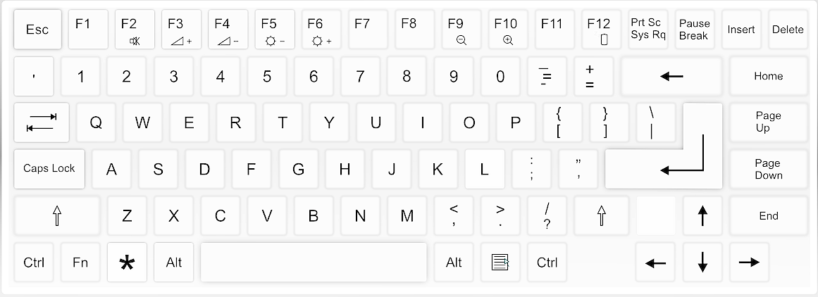
Activity 2
The buttons are called “keys”!
What do you notice about the keyboard?
Notes:
Prompt the learners to think about the letter keys for this activity, but allow them to think more generally as well. Possible answers could include:
The letters are not in alphabetical order.
The letters are all capitals.
Some of the keys have more than one thing on them.
Click to display the arrow and box explaining that we call the buttons on a keyboard ‘keys’.
Image source: https://pixabay.com/vectors/computer-keyboard-home-computer-158770/

Slide 12
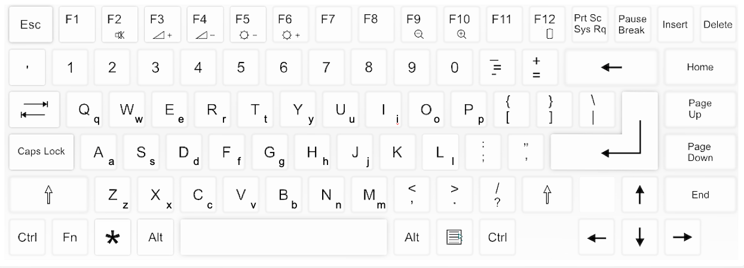
Find and colour the letters of your name
Activity 2
Notes:
Provide the learners with physical copies of the keyboard to colour. This will support them with the tasks throughout the rest of the unit and so should be kept safe for each lesson.
Image source: https://pixabay.com/vectors/computer-keyboard-home-computer-158770/

Slide 13
Log in to the computer and open the word processor
Activity 3
Notes:
Note: If this lesson is the first time that the learners will be logging in to the computer, additional support/time may be required to facilitate this step. You may wish to ask the learners to colour the keys that they need to use to log in to the computer, in order to reduce the amount of time spent on this task in future lessons.
Image sources:
https://pixabay.com/vectors/laptop-notebook-mobile-computer-154091/
https://pixabay.com/vectors/computer-desktop-workstation-office-158675/
https://commons.wikimedia.org/wiki/File:Microsoft_Word_2013_logo.svg
https://commons.wikimedia.org/wiki/File:Icon-doc.svg
https://commons.wikimedia.org/wiki/File:LibreOffice_6.1_Writer_Icon.svg
https://www.openoffice.org/ui/VisualDesign/OOo30MimeType.html

Slide 14
Can you press the keys on the keyboard to write...
Activity 3
The letters a, b, c, d, e and f?
Your name?
A friend’s name?
Notes:
Image source: https://pixabay.com/illustrations/letters-school-learn-alphabet-abc-3704026/

Slide 15
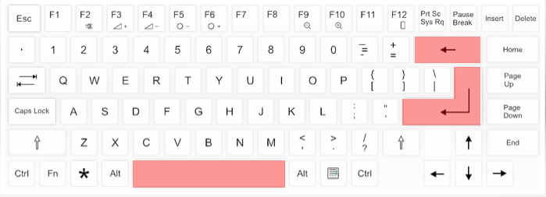
Explorer task
Activity 3
What do these keys do?
Notes:
Note: This template could be shared on the screen or provided as a physical copy (printout) if you want to keep the previous slide visible throughout the activity.
Encourage the learners to use the keys when they are writing to see what they do. Ask the learners to think about when they might need to use these keys. Ask the learners to share with the rest of their peers.
Image source: https://pixabay.com/vectors/computer-keyboard-home-computer-158770/

Slide 16
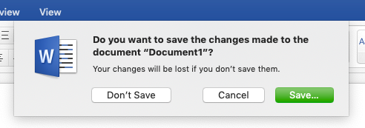
Time to finish!
Activity 3
Close your word processor using the x in the top right-hand corner.
Click ‘Don’t Save’ if it asks you to save!
Log off your computer.
Notes:
Note: Additional support/time may be required to facilitate this step. You may wish to add a slide that details the steps that the learners need to take to log off/shut down their computers.

Slide 17
With a partner...
Plenary
What did you like about using the computer to write?
Was anything tricky about using the keyboard?
Can you share your partner’s answers?
Notes:
Ask the learners to think about the two questions and discuss them with their partners. Encourage the learners to use good listening, as they will be sharing what their partner has said, and not their own ideas.
Image source: https://pixabay.com/illustrations/speech-balloon-talk-bubble-1019777/

Slide 18
How confident are you? (1–3)
Assessment
I can open a word processor
I can recognise keys on a keyboard
I can identify and find keys on a keyboard
3 - Very confident
2 - Unsure
1 - Not confident
Notes:
Image source: https://pixabay.com/vectors/thumb-up-hand-like-confirm-go-top-307176/

Slide 19
Next lesson
Summary
In this lesson, you…
Explored the way that the keyboard looks and identified some keys. You also used the keyboard to write letters and names.
Next lesson, you will…
Use the keyboard to write text onto the page and use the backspace key to remove text from the page.

