Slide 1
Term 3 Week 1
Poetry

Slide 2
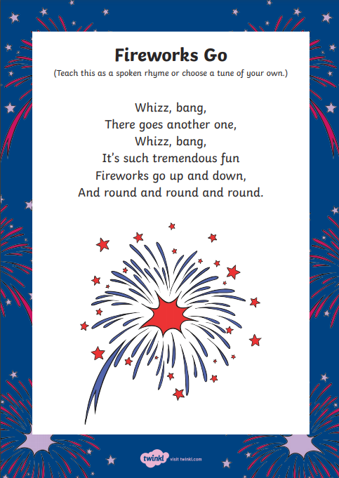
Wednesday 5th January
Can you remember yesterday's poem?
Quickly practise reciting it; using actions will help you to get it right!

Slide 3
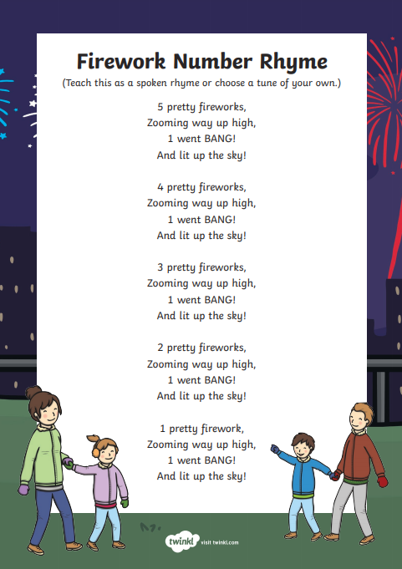
Wednesday 5th January
Here's a simple counting rhyme to learn today.
Look out for onomatopoeia. (the words that make the sounds of the fireworks)
Look out for rhyming words.
Look out for rhyming words.)
Look out for repetition.
Look out for repetition.
(If there are any words you like, be sure to add them to yesterday's word bank.)

Slide 4
Wednesday 5th January
LI To plan a poem.
Steps to Success:
I say out loud what I am going to write about. (Band 1)
I compose a sentence (poetry phrase) before writing it. (Band 1)
I think about what I am going to write before I write it. (Band 2)
I write down ideas/keywords, including new vocabulary. (Band 2)

Slide 5
Tuesday 4th January
LI To plan a poem.
Today we are going to be using these lenses in our learning.
action
onomatopoeia
alliteration
language
phonics & grammar

Slide 6
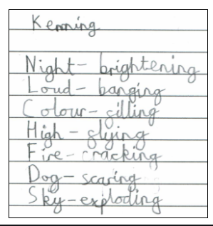
Wednesday 5th January
LI To plan a poem.
Steps to Success:
I say out loud what I am going to write about. (Band 1)
I compose a sentence (poetry phrase) before writing it. (Band 1)
I think about what I am going to write before I write it. (Band 2)
I write down ideas/keywords, including new vocabulary. (Band 2)
phonics & gammar
A kenning is a poem that gives clues to hint what it's about. This kenning is about fireworks.
What suffix has been used at the end of each line? ...That's right, -ing!

Slide 7
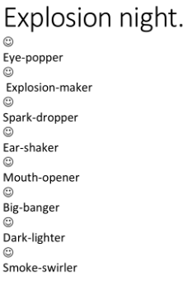
Wednesday 5th January
LI To plan a poem.
Steps to Success:
I say out loud what I am going to write about. (Band 1)
I compose a sentence (poetry phrase) before writing it. (Band 1)
I think about what I am going to write before I write it. (Band 2)
I write down ideas/keywords, including new vocabulary. (Band 2)
phonics & gammar
Here's another kenning poem about fireworks.
What suffix has been used at the end of each line? ...That's right, -er!

Slide 8
Wednesday 5th January
LI To plan a poem.
Steps to Success:
I say out loud what I am going to write about. (Band 1)
I compose a sentence (poetry phrase) before writing it. (Band 1)
I think about what I am going to write before I write it. (Band 2)
I write down ideas/keywords, including new vocabulary. (Band 2)
phonics & gammar
You're going to use your word-bank from yesterday to write a kenning poem.

Slide 9
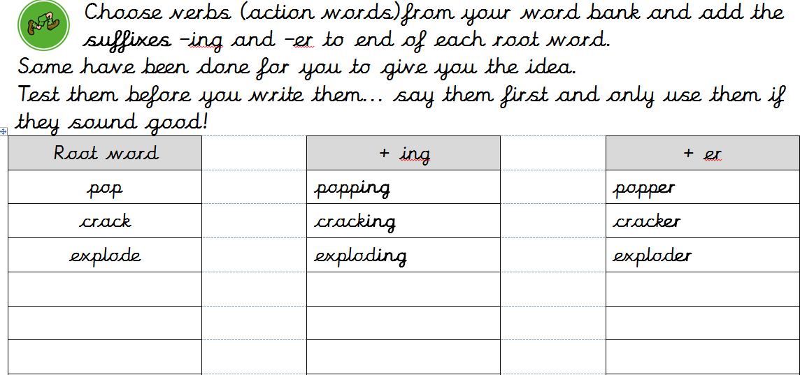
Wednesday 5th January
LI To plan a poem.
Steps to Success:
I say out loud what I am going to write about. (Band 1)
I compose a sentence (poetry phrase) before writing it. (Band 1)
I think about what I am going to write before I write it. (Band 2)
I write down ideas/keywords, including new vocabulary. (Band 2)
phonics & grammar

Slide 10
Wednesday 5th January
LI To plan a poem.
Steps to Success:
I say out loud what I am going to write about. (Band 1)
I compose a sentence (poetry phrase) before writing it. (Band 1)
I think about what I am going to write before I write it. (Band 2)
I write down ideas/keywords, including new vocabulary. (Band 2)
phonics & grammar
Which words could you match together to make a new phrase?
light
burning
colour
bursting
fire
spinning
spark
zooming

Slide 11
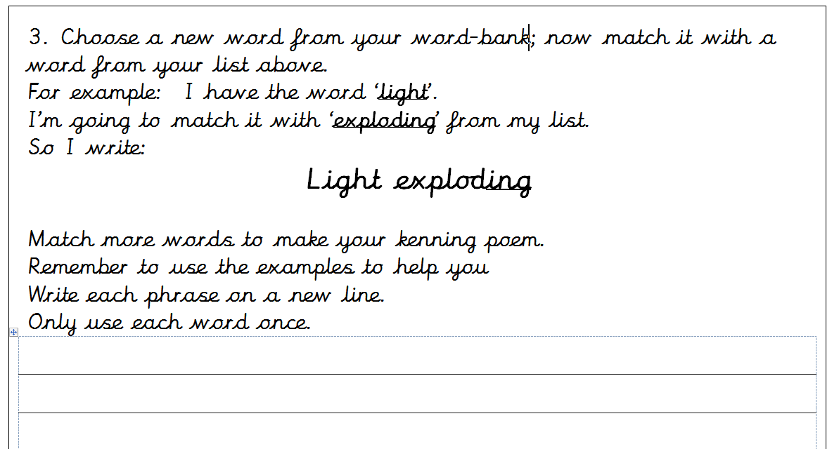
Wednesday 5th January
LI To plan a poem.
Steps to Success:
I say out loud what I am going to write about. (Band 1)
I compose a sentence (poetry phrase) before writing it. (Band 1)
I think about what I am going to write before I write it. (Band 2)
I write down ideas/keywords, including new vocabulary. (Band 2)
phonics & grammar

