Slide 1
Term 3 Week 1
Poetry

Slide 2
Tuesday 4th January
LI To explore language for poetry.
By the end of this week, you will have written a poem of your own and you will know one poem (or maybe more) off by heart!

Slide 3
Tuesday 4th January
LI To explore language for poetry.
Today is an experience lesson.
We will be using today’s learning to help us to plan and write a poem later this week.

Slide 4
Tuesday 4th January
LI To explore language for poetry.
Steps to Success:
I recite poems by heart. (Band 1 reading)
I join in with predictable phrases when being read to. (Band 1 reading)
I am beginning to build up a repertoire of poems learnt by heart. (Band 2 reading)
I recite poems with understanding and use of intonation. (Band 2 reading)
I am beginning to develop stamina by planning and writing poetry. (Band 2 writing)

Slide 5
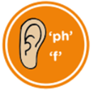
Tuesday 4th January
LI To explore language for poetry.
Today we are going to be using these lenses in our learning.
Don't worry if it looks like a lot! We'll take them as they come!
feelings
noticing
action
thinking
onomatopoeia
alliteration
rhyme
repetition
genre
Text layout
phonics
language
Personal opinions

Slide 6
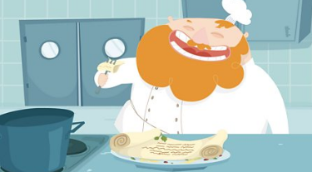
Tuesday 4th January
LI To explore language for poetry.
What is a poem?
genre
A poem can be about anything!
It uses just a few words to quickly share something...
something that happened;
something that was seen or experienced;
someone's feelings.
They can rhyme... but they don't have to.
They can be funny... or serious.
Best of all... they don't have to be whole sentences.
Only the best words are chosen for sharing.
Someone who write a poem is called a poet.
Click on the picture. Follow the link to find out more about what a poem is.

Slide 7
Tuesday 4th January
LI To explore language for poetry.
Steps to Success:
I recite poems by heart. (Band 1 reading)
I join in with predictable phrases when being read to. (Band 1 reading)
I am beginning to build up a repertoire of poems learnt by heart. (Band 2 reading)
I recite poems with understanding and use of intonation. (Band 2 reading)
Happy New Year!
Welcome to 2021!
Fireworks are used across the whole world to celebrate start of a new year.
On the next page, there is a firework poem.
Read it and use the lenses to help you learn more about it.
Join in with the parts you like best, then try to learn it off by heart.

Slide 8
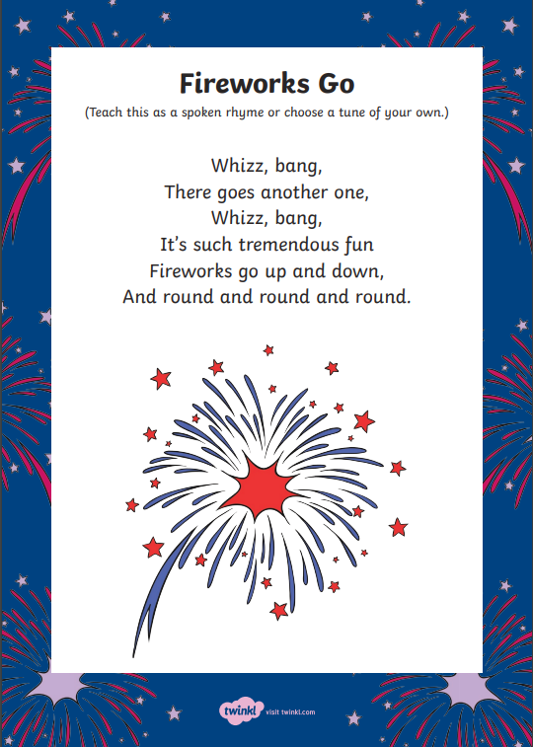
Tuesday 4th January
LI To explore language for poetry.
First listen to or read the poem. Perhaps you can make up some actions.
Can you see that the poem is written in short lines, not long lines like a story?
What is happening in the poem?
What do, or don't, you like about the poem? Can you explain why?
text layout
noticing
action
personal opinions

Slide 9
Tuesday 4th January
LI To explore language for poetry.
How does the poet feel?
Which words make the sounds of the fireworks?
Which words repeat?
Which words rhyme?
feelings
language
thinking
onomatopoeia
repetition
rhyme

Slide 10
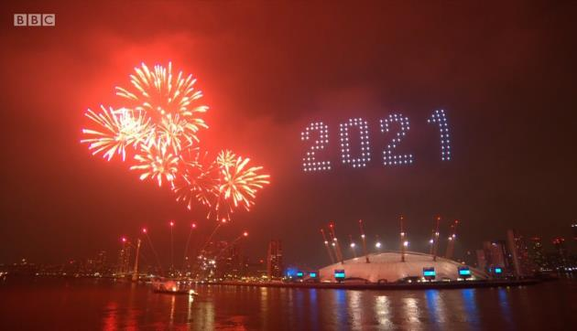
Tuesday 4th January
LI To explore language for poetry.
Steps to Success:
I am beginning to develop stamina by planning and writing poetry. (Band 2 writing)
Happy New Year!
Click on the photograph to watch this year's London firework display. It celebrates many of the amazing and special people and things that came from a really tough year.
As you watch, write down fantastic words you think of to describe the display. Think of the best words you can as this will be a word bank that you use later in the week.
The words should describe what you see and hear, or what you feel. Do not try to write sentences, just key words.
You can watch it as many times as you need to so you have some brilliant language to use.
feelings
noticing
onomatopoeia
thinking
action

Slide 11
Tuesday 4th January
LI To explore language for poetry.
Steps to Success:
I recite poems by heart. (Band 1 reading)
I join in with predictable phrases when being read to. (Band 1 reading)
I am beginning to build up a repertoire of poems learnt by heart. (Band 2 reading)
I recite poems with understanding and use of intonation. (Band 2 reading)
Finally...
How much of the poem can you remember?
Can you remember your favourite words, or even the whole poem?
Can you perform the poem, with actions, to someone in your family?

