Slide 1
2 4. 1 1 . 2 1
3&4: Can I count in tenths?
5&6: Can I convert improper fractions to mixed numbers?
I can find the improper fraction.
I can convert this to a mixed number pictorially.
I can convert this to a mixed number using my knowledge of times tables.
In focus task

Slide 2
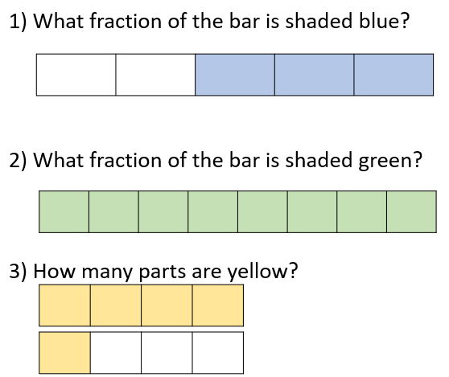
In Focus Task
Can you use our stem sentence from Monday to explain each fraction?
There are ____ equal parts to the whole.
There are ____ parts.
The fraction is ____.

Slide 3
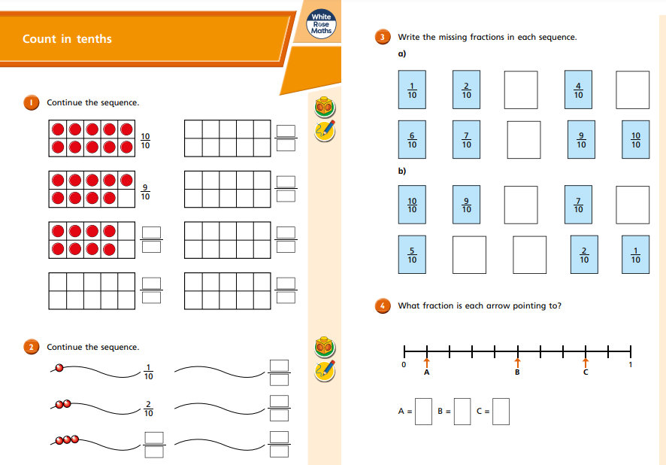
Miss L’s group:
Lola, Ella, Frankie, Bobby, Lorcan, Tiyler & Terry: Counting in tenths

Slide 4
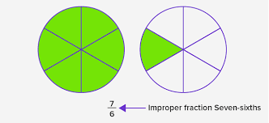
Talk Task
Today we are learning about improper fractions into mixed numbers.
An improper fraction is a fraction where the numerator is greater than or equal to the denominator.
Discuss in your groups and come up with some examples of improper fractions.
Challenge: Can you show me on a whiteboard using pictures?
Here is an example for you:

Slide 5
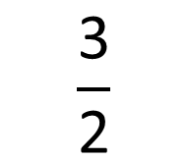
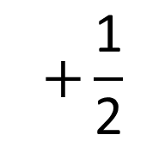
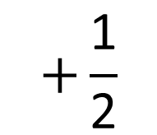
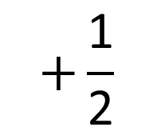
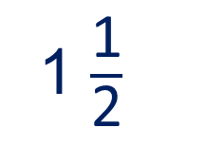
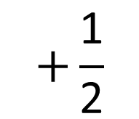
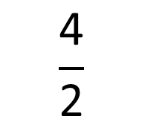
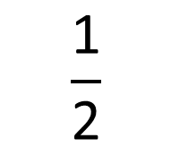
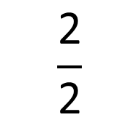
New Learning
$$+\frac{\text{1}}{\text{2}}$$
$$+\frac{\text{1}}{\text{2}}$$
$$+\frac{\text{1}}{\text{2}}$$
$$+\frac{\text{1}}{\text{2}}$$
0
$$\frac{\text{1}}{\text{2}}$$
$$\frac{\text{2}}{\text{2}}$$
$$\frac{\text{3}}{\text{2}}$$
$$\frac{\text{4}}{\text{2}}$$
1
1 $\frac{\text{1}}{\text{2}}$
2

Slide 6



New Learning
This is an improper fraction.
An improper fraction is where the numerator is greater than the denominator.
This is a mixed number.
It is a number with a whole and a fraction.
$$\frac{}{\text{2}}$$
$$\frac{\text{1}}{\text{2}}$$
$$\frac{\text{3}}{\text{2}}$$
$=$ $\text{1}$

Slide 7
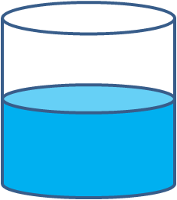
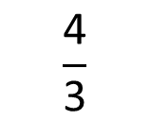
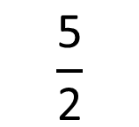
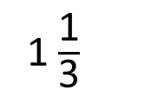
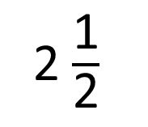
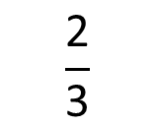
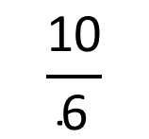
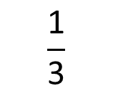
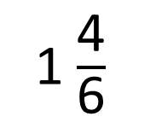
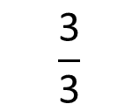
Develop Learning
How do the representations show mixed numbers and improper fractions?
$$\frac{\text{3}}{\text{3}}$$
$$\frac{\text{4}}{\text{3}}$$
0
$$\frac{\text{1}}{\text{3}}$$
$$\frac{\text{2}}{\text{3}}$$
1
1$\frac{\text{1}}{\text{3}}$
2
$$\frac{\text{10}}{\text{6}}$$
2$\frac{\text{1}}{\text{2}}$
$$\frac{\text{5}}{\text{2}}$$
1$\frac{\text{4}}{\text{6}}$

Slide 8

Develop Learning
Convert the improper fraction to a mixed number
$$\frac{\text{1}}{\text{3}}$$
$\frac{\text{7}}{\text{3}}$ $=$
2

Slide 9
Develop Learning
Convert the improper fraction to a mixed number
$=$
*CT to display for working wall

Slide 10
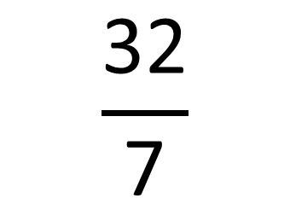

Develop Learning
Draw it pictorially on a whiteboard if you need to.
Convert the improper fractions to mixed numbers.
$$\frac{\text{32}}{\text{7}}$$
$$=$$
*CT to display for working wall
$$\frac{\text{4}}{\text{7}}$$
32 $÷$ 7 $=$ 4 r 4

Slide 11



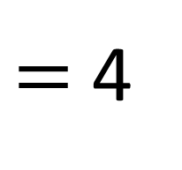
Develop Learning
Here is the example with pictures.
Convert the improper fractions to mixed numbers.
$$\frac{\text{32}}{\text{7}}$$
4 $\frac{\text{4}}{\text{7}}$
means 1 $÷$ 4
$$=$$
so
$$\frac{\text{4}}{\text{7}}$$
r 4
32 $÷$ 7
$=$ 4

Slide 12
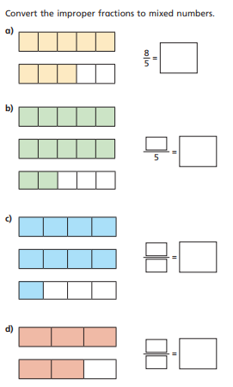
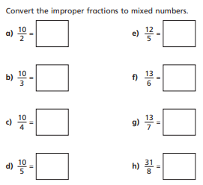
Independent Task
Once you have finished, please complete the reasoning question on the next slide and then the work on common factors

Slide 13
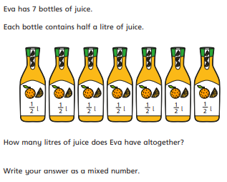
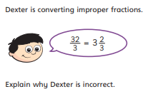
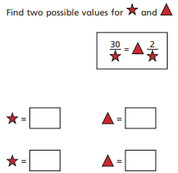
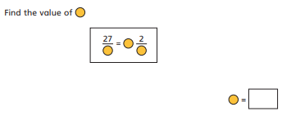
Reasoning

Slide 14
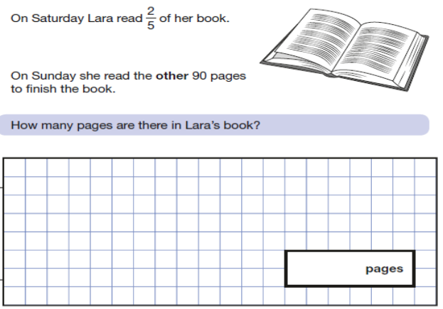
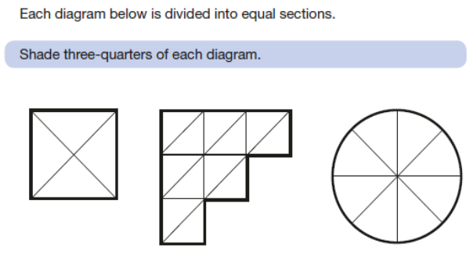
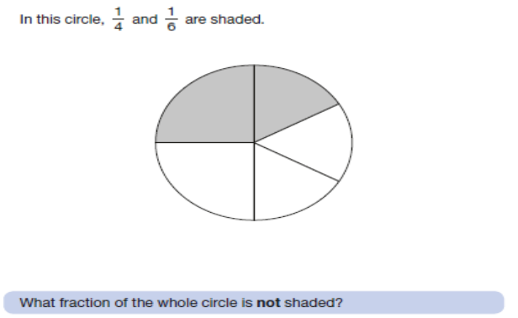
Reasoning SATs style questions based on fractions

Slide 15
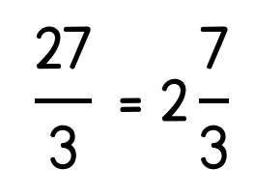
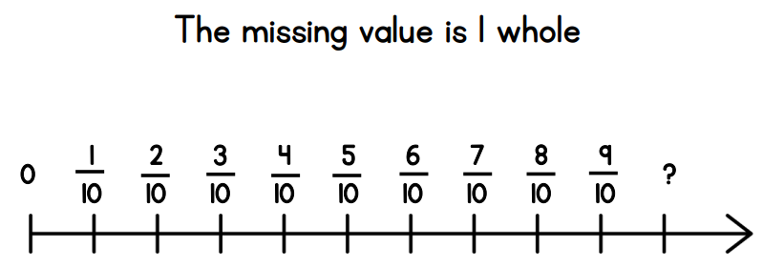
Plenary
Light Bulb Challenge
*Remember to answer in full sentences*
It is true because… or It is false because…
Alternative

