Slide 2
Aim
Can I explain day and night and the apparent movement of the sun across the sky?
Success Criteria
explain that day and night is due to rotation of the Earth.
explain using evidence how night and day occur.

Slide 3
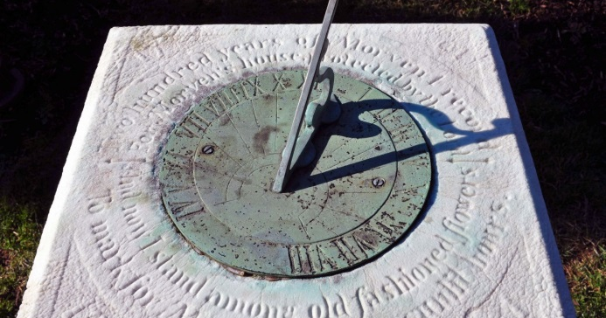
Sun and Shadows
When?
How?
What?
Why?
Where?
Photo courtesy of PMillera4 (@flickr.com)- granted under creative commons licence - attribution

Slide 4
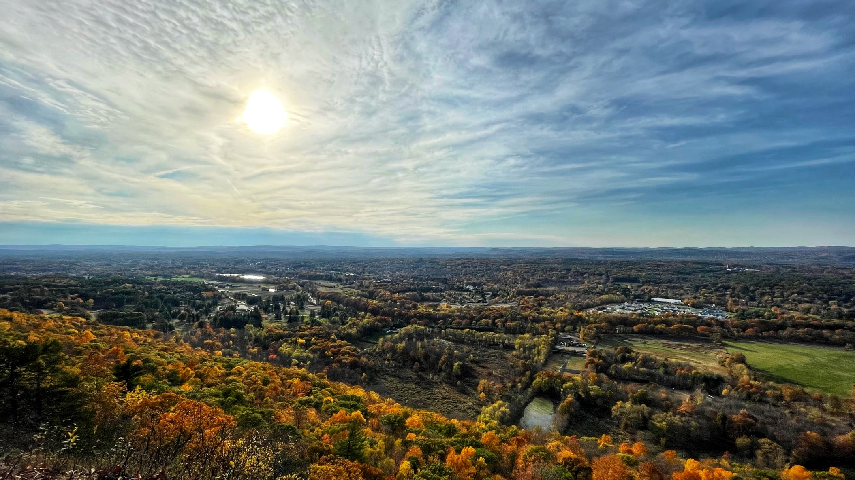
Night and Day
Does the position of the sun change over the course of the day? How do you know?
Investigating observations.
When?
What?
Why?
How?
Evidence?
Where?
Click here if the video does not work
Video courtesy of FreeSwissVideo (@youtube.com) - granted under creative commons licence - attribution

Slide 5
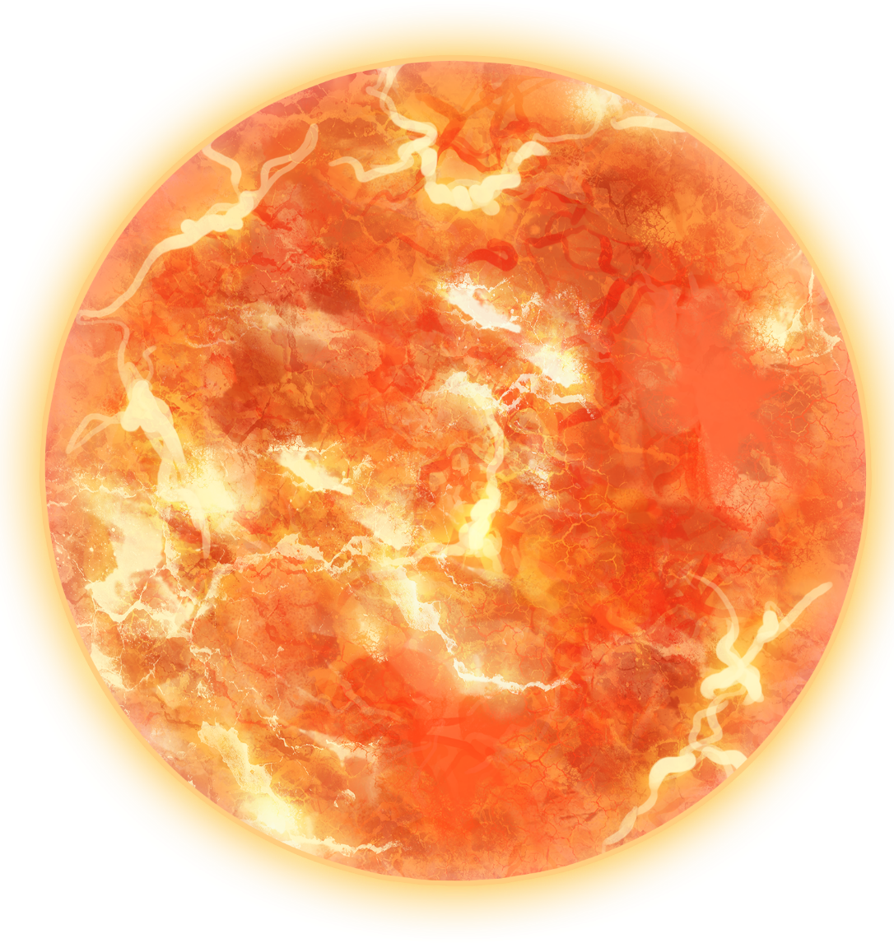
Rotating Earth
The Sun!

Slide 6
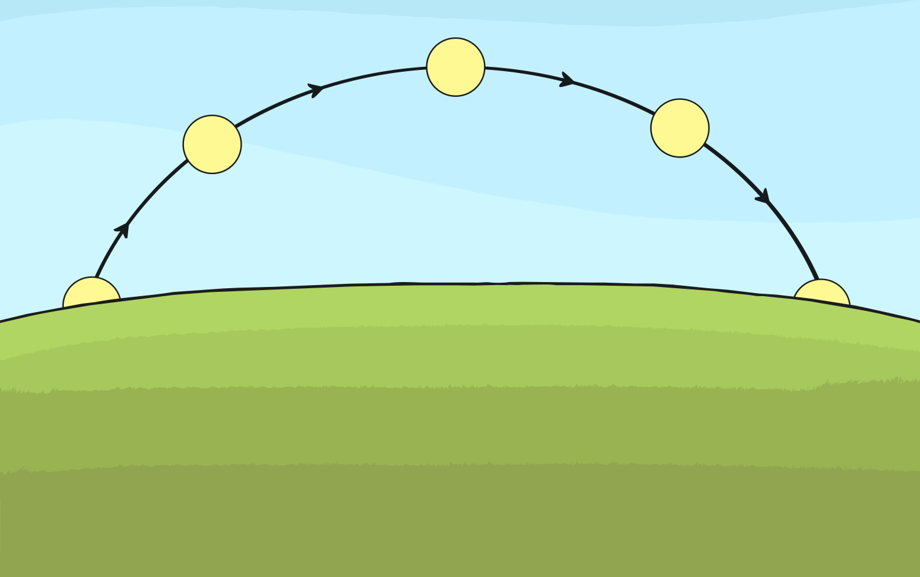
Explaining Night and Day
Watch this clip
Day and night - KS2 Science - BBC Bitesize

Slide 7
Explaining Night and Day

Slide 8
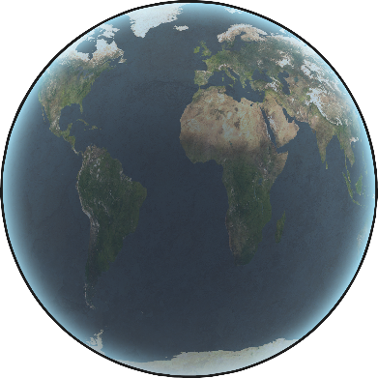
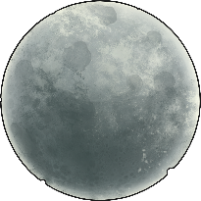
Night and Day – Explanation Text

Slide 9
Peer Assess – Explanation Text
Listen to your partner’s explanation text.
Give 2 bits of positive feedback.
Swap roles.
Give 1 next step.
After you have both given feedback, make changes to your work to show that you have understood what improvement you had to make.

