Slide 1
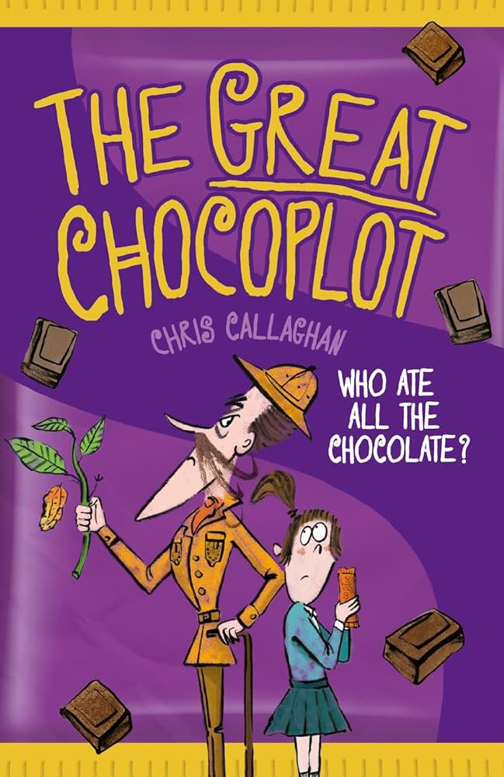
Maths - In maths the children will learn to:
Shape
compare and classify geometric shapes, including quadrilaterals and triangles, based on their properties and sizes
identify acute and obtuse angles and compare and order angles up to 2 right angles by size
identify lines of symmetry in 2-D shapes presented in different orientations
complete a simple symmetric figure with respect to a specific line of symmetry
Statistics
Interpret and present discrete and continuous data using appropriate graphical methods, including bar charts and time graphs
solve comparison, sum and difference problems using information presented in bar charts, pictograms, tables and other graphs
Position and direction
describe positions on a 2-D grid as coordinates in the first quadrant
describe movements between positions as translations of a given unit to the left/right and up/down
plot specified points and draw sides to complete a given polygon
Year 4
Orcas
Term 6
How did the achievements of the ancient Maya impact their society and beyond?
English
Core texts
The Great Chocplot – Chris Callaghan
Reading
develop positive attitudes to reading and understanding of what they read
listen to and discussing a wide range of fiction and non-fiction
reading books that are structured in different ways and reading for a range of purposes
use dictionaries to check the meaning of words that they have read
discussing words and phrases that capture the reader’s interest and imagination understand what they read, in books they can read independently
checking that the text makes sense to them, discussing their understanding and explaining the meaning of words in context
retrieve and record information from non-fiction
predicting what might happen from details stated and implied
identifying themes and conventions in a wide range of books
drawing inferences such as inferring characters’ feelings, thoughts and motives from their actions, and justifying inferences with evidence
We will also be developing our skimming and scanning skills by looking at some test-style reading questions throughout the term.
Writing:
Plan their writing by:
•discussing writing similar to that which they are planning to write in order to understand and learn from its structure, vocabulary and grammar
•discussing and recording ideas
Draft and write by:
•composing and rehearsing sentences orally (including dialogue), progressively building a varied and rich vocabulary and an increasing range of sentence structures
•organising paragraphs around a theme
•in narratives, creating settings, characters and plot
Evaluate and edit by:
Assessing the effectiveness of their own and others’ writing and suggesting improvements
proposing changes to grammar and vocabulary to improve consistency, including the accurate use of pronouns in sentences
Grammar, punctuation and spelling
•extend the range of sentences with more than one clause by using a wider range of co-ordinating conjunctions and subordinating conjunctions
•choose nouns or pronouns appropriately for clarity and cohesion and to avoid repetition
•use conjunctions, adverbs and prepositions to express time and cause
•use fronted adverbials, with commas correctly placed after
indicating possession by using the possessive apostrophe with plural nouns
Handwriting
-Use the diagonal and horizontal strokes needed to join letters.
-Write capital letters and digits of the correct size, orientation and relationship to one another and to lower case letters.

Slide 2
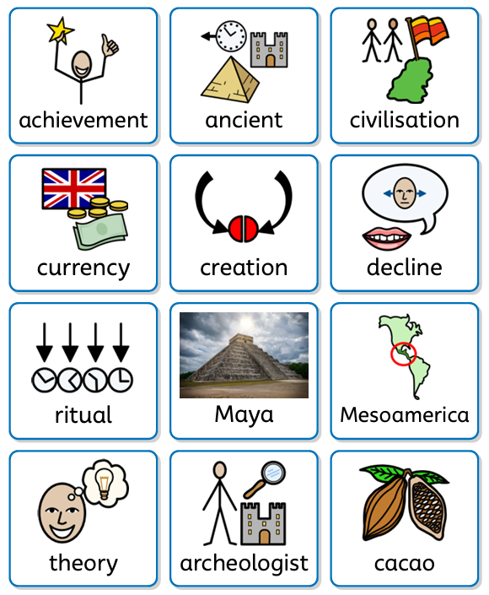
History – How did the achievements of the ancient Maya impact their society and beyond?
Through this enquiry question children will learn to:
Sequence the key periods of the Ancient Maya civilisation.
Identify periods that were happening in Britain at the same time.
Explain how the Ancient Maya settled in the rainforest and the challenges they faced.
Describe Ancient Maya beliefs.
Name the features of the Ancient Maya cities.
Make deductions about the Ancient Maya cities.
Evaluate the reasons for the decline of the Maya civilisation.
Understand the importance of archaeologists, archivists and historians in constructing our understanding of the past.
Computing – Programming B repetition in games
This unit explores the concept of repetition. Learners look at the difference between count-controlled and infinite loops, and use their knowledge to modify existing animations and games using repetition. Their final project is to design and create a game which uses repetition.
Online safety: Cyber superheroes
In their online safety lesson pupils will recap the journey of learning across the entire year and summarise this through creating and online safety superhero character.
P.E. - Outdoor (Friday) Athletics
Children will develop flexibility, strength, technique, control and balance. Through this we will be preparing for sports day.
Indoors – (Thursdays) Tennis
Children will use running, jumping, throwing and catching in isolation and in combination. They will also play competitive games.
PSHE – Changing me
This unit explores the meaning of 'change', how some changes are in or out of our control, and how the experience of change can make us feel. Within this unit there are some discussions of bodily changes experienced at puberty. The unit ends by looking at the feelings associated with change and how to manage these. Children are introduced to Jigsaw’s Circle of change model as a strategy for managing future changes.
RSHE – My rights and responsibilities
Pupils will be taught how to recognise when they may need help to manage a situation and ill develop the skills to ask for help.
learning outcomes:
recognise situations that I will need help to manage
know who I can ask for help
Practice asking for help
Year 4 Term 6
How did the achievements of the ancient Maya impact their society and beyond?
Art - Painting and mixed media: light and dark
Within this unit the children will improve their mastery of Art and Design techniques including painting. They will practice mixing tints and shades by adding black or white paint. They will also be taught about some famous artists, such as 'Paul Cézanne'.
R.E.- How and why do people mark the significant events of life?
In this unit, pupils will learn about the beliefs of people from different worldviews surrounding commitment and promises. They will discuss the meaning and importance of ceremonies of commitment for religious and non-religious people. They will take time to consider the links between ideas of love, commitment and promises within the ceremonies that they study. Pupils will learn about several rites of passage and reflect upon whether it is good for everyone to see life as a journey, and to mark the milestones.
Science – Electricity
In this unit pupils will be taught to:
identify common appliances that run on electricity
construct a simple series electrical circuit, identifying and naming its basic parts, including cells, wires, bulbs, switches and buzzers
identify whether or not a lamp will light in a simple series circuit, based on whether or not the lamp is part of a complete loop with a battery
recognise that a switch opens and closes a circuit and associate this with whether or not a lamp lights in a simple series circuit
recognise some common conductors and insulators, and associate metals with being good conductors.
Pupils will work scientifically by:
asking relevant questions and using different types of scientific enquiries to answer them
gathering, recording, classifying and presenting data in a variety of ways to help in answering questions
Music – Music and performance – Hanami Festival
Children will learn to explain what the Hanami Festival is and create a piece of music to celebrate this festival. The composed pieces will then be performed by each group to the rest of the class.

