Slide 1

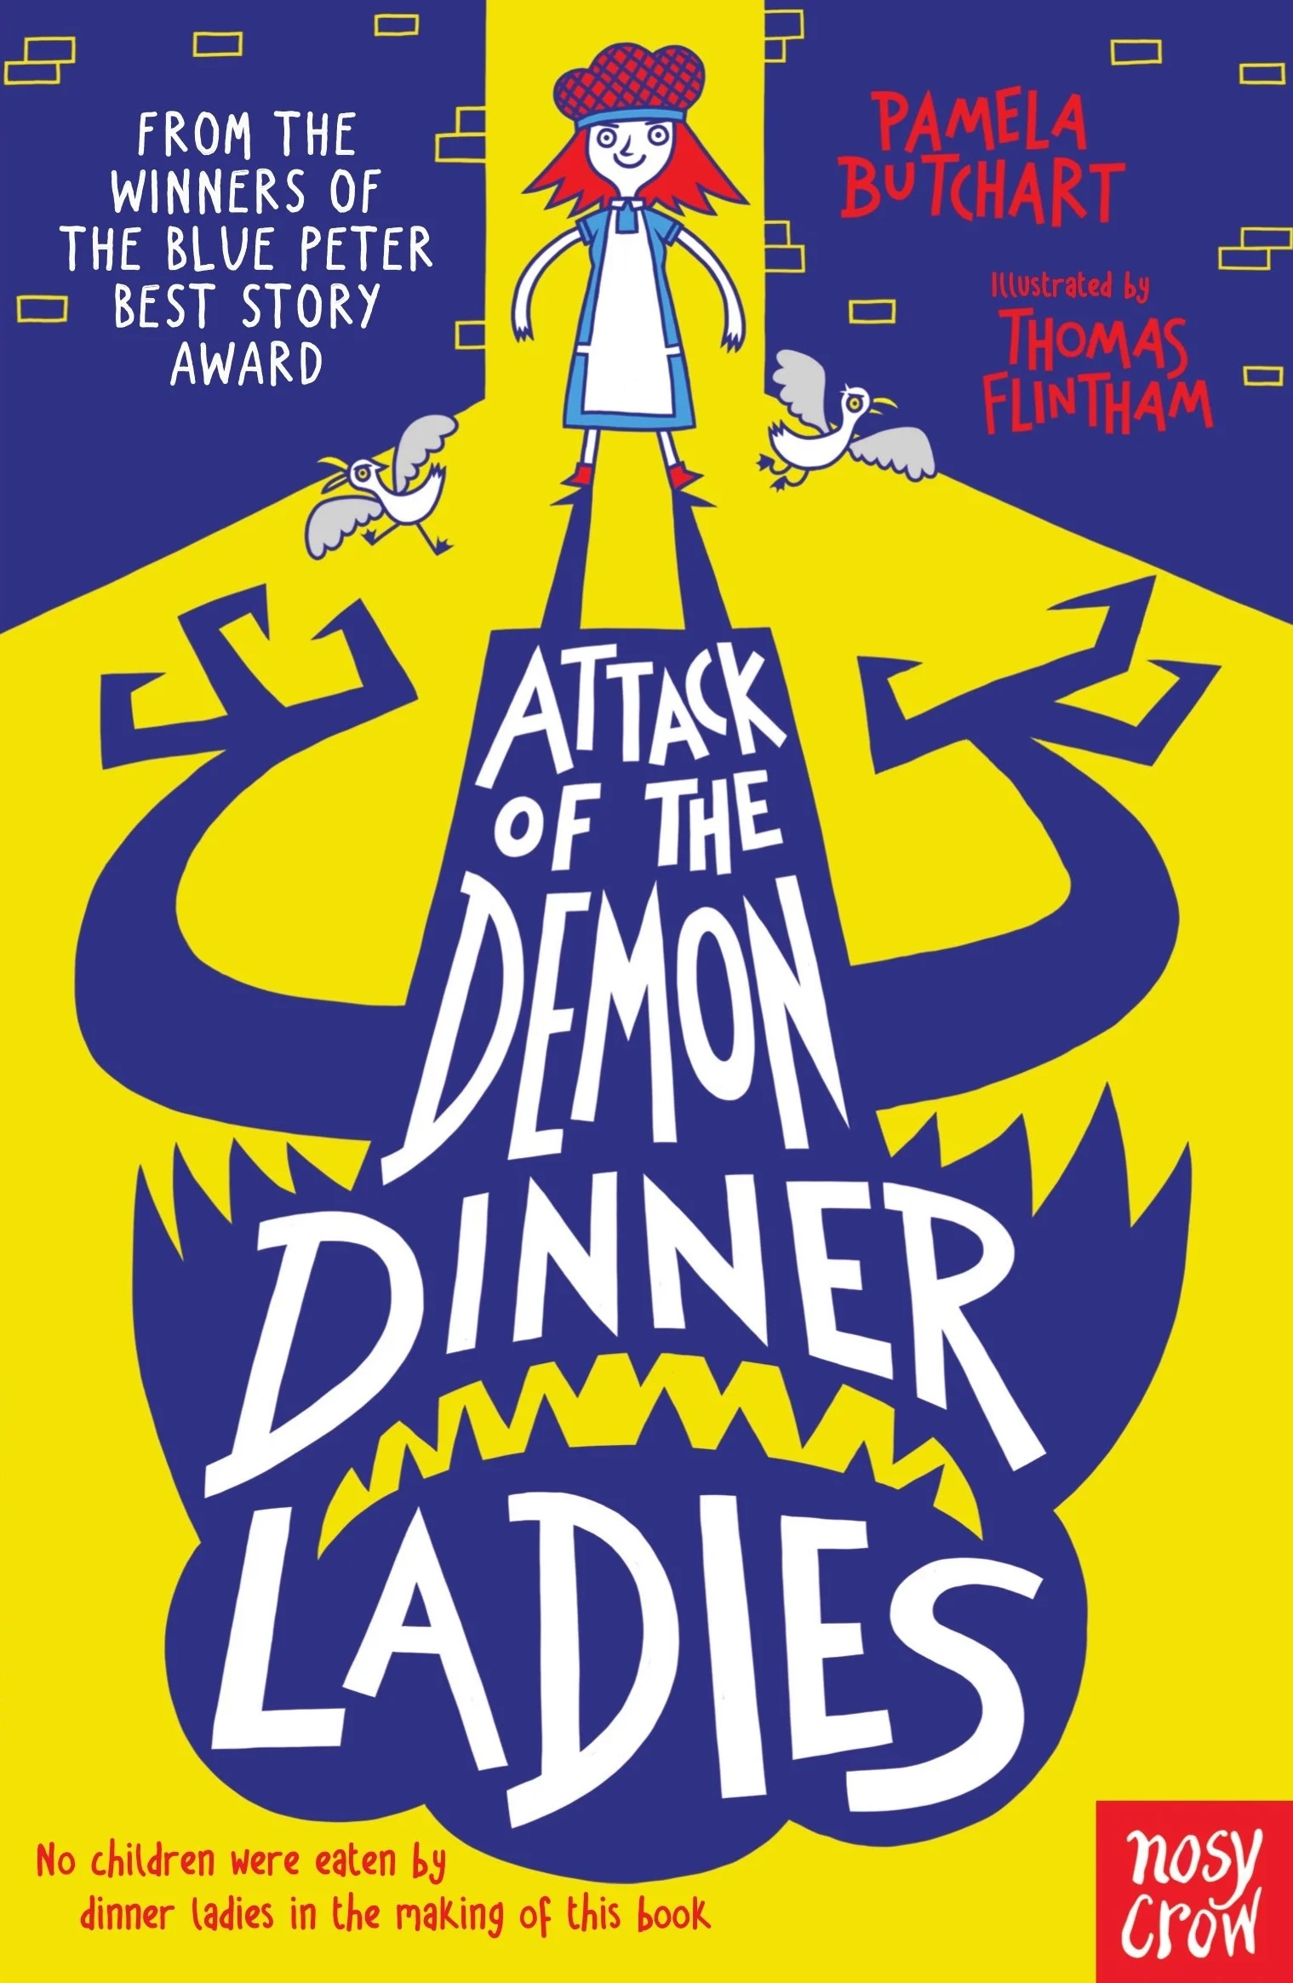
Maths
Decimals B
Recognise and write decimal equivalents of any number of tenths or hundredths
Find the effect of dividing a 1- or 2-digit number by 10 and 100, identifying the value of the digits in the answer as ones, tenths and hundredths
Solve simple measure and money problems involving fractions and decimals to 2 decimal places
Solve simple measure and money problems involving fractions
Round decimals with 1 decimal place to the nearest whole number
Recognise and write decimal equivalents to one quarter, one half and one third
Money
Estimate, compare and calculate different measures, including money in pounds and pence
Time
Solve problems involving converting from hours to minutes, minutes to seconds, years to months, weeks to days
Read, write and convert time between analogue and digital 12- and 24-hour clocks
Year 4
Orcas
Term 5
Where does our food come from?
English
Core texts
Attack of the Demon Dinner ladies – Pamela Butchart
Reading
develop positive attitudes to reading and understanding of what they read
listen to and discussing a wide range of fiction and non-fiction
reading books that are structured in different ways and reading for a range of purposes
use dictionaries to check the meaning of words that they have read
discussing words and phrases that capture the reader’s interest and imagination understand what they read, in books they can read independently
checking that the text makes sense to them, discussing their understanding and explaining the meaning of words in context
retrieve and record information from non-fiction
predicting what might happen from details stated and implied
identifying themes and conventions in a wide range of books
drawing inferences such as inferring characters’ feelings, thoughts and motives from their actions, and justifying inferences with evidence
We will also be developing our skimming and scanning skills by looking at some test-style reading questions throughout the term.
Writing:
Plan their writing by:
•discussing writing similar to that which they are planning to write in order to understand and learn from its structure, vocabulary and grammar
•discussing and recording ideas
Draft and write by:
•composing and rehearsing sentences orally (including dialogue), progressively building a varied and rich vocabulary and an increasing range of sentence structures
•organising paragraphs around a theme
•in narratives, creating settings, characters and plot
in non-narrative material, using simple organisational devices
Evaluate and edit by:
Assessing the effectiveness of their own and others’ writing and suggesting improvements
proposing changes to grammar and vocabulary to improve consistency, including the accurate use of pronouns in sentences
Grammar, punctuation and spelling
•extend the range of sentences with more than one clause by using a wider range of co-ordinating conjunctions and subordinating conjunctions
•choose nouns or pronouns appropriately for clarity and cohesion and to avoid repetition
•use conjunctions, adverbs and prepositions to express time and cause
•use fronted adverbials, with commas correctly placed after
indicating possession by using the possessive apostrophe with plural nouns
Handwriting
-Use the diagonal and horizontal strokes needed to join letters.
-Write capital letters and digits of the correct size, orientation and relationship to one another and to lower case letters.
- increase the legibility, consistency and quality of their handwriting

Slide 2
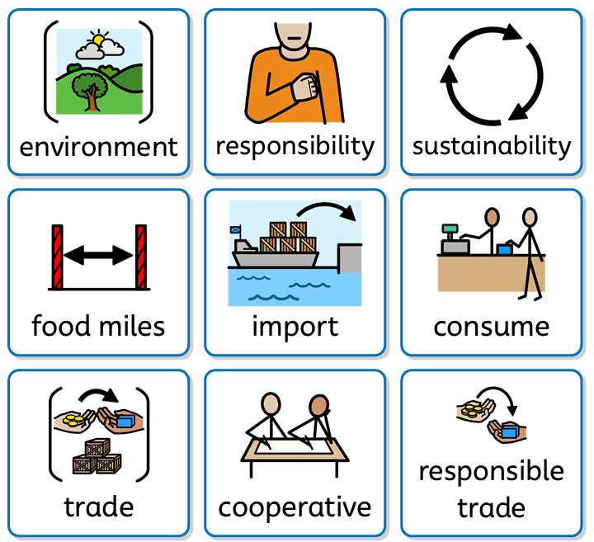
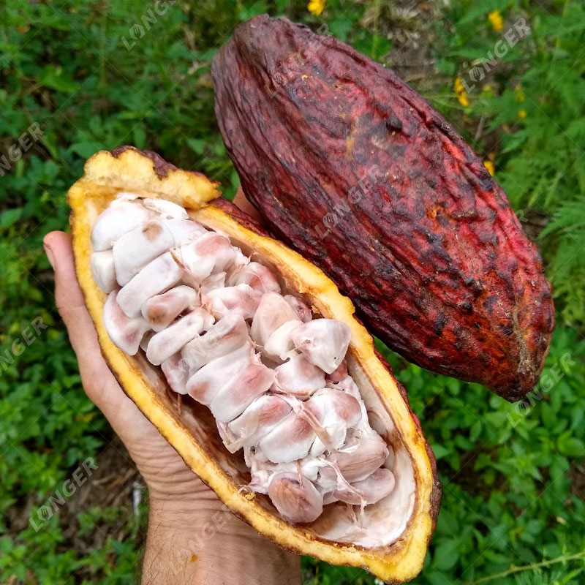
Geography – Where does our food come from?
Through this enquiry question children will:
Identify that different foods grow in different biomes and say why.
Explain which food has the most significant negative impact on the environment.
Consider a change people can make to reduce the negative impact of food production.
Describe the intentions around trading responsibly.
Explain that food imports can be both helpful and harmful.
Describe the journey of a cocoa bean.
Locate countries on a blank world map using an atlas.
Use a scale bar correctly to measure approximate distances.
Analyse interview responses to answer an enquiry question.
Computing – photo editing
Learners will develop their understanding of how digital images can be changed and edited, and how they can then be resaved and reused. They will consider the impact that editing images can have and evaluate the effectiveness of their choices. Online safety: The online community
Children will identify a range of ways to report concerns about content and contact online in the context of giving examples of how to be a good digital citizen.
P.E. - Outdoor Football with Mr. Channer (Monday)
Play competitive games, modified where appropriate, and apply basic principles suitable for attacking and defending
Indoors – Fitness (Thursdays)
Use running, jumping, throwing and catching in isolation and in combination; and develop flexibility, strength, technique, control and balance
PSHE – Relationships
In this unit children explore jealousy and loss/ bereavement. They identify the emotions associated with these relationship changes, the possible reasons for the change and strategies for coping with the change. The children learn that change is a natural in relationships and they will experience (or may have already experienced) some of these changes. Children revisit skills of negotiation particularly to help manage a change in a relationship. They also learn that sometimes it is better if relationships end, especially if they are causing negative feelings or they are unsafe. Children are taught that relationship endings can be amicable.
RSHE – My rights and responsibilities
Pupils know that marriage is a commitment freely entered into by both people and that no one should marry if they don’t absolutely want to or are not making the decision freely for themselves.
Learning outcomes:
• I understand what marriage is and why this is something special between two people
• I have explored the reasons why some people choose not to get married
• I know that marriage should always be a choice
Year 4
Term 5
Where does our food come from?
Art - Drawing: exploring tone, texture and proportion
Pupils will:
Create a three-dimensional effect by using contrasting tones to show light and dark.
Combine lines and marks to represent different textures.
Use lines and marks in different ways to represent dark and light areas (tone).
Represent the size of one object relative to another.
Show texture in a collage.
Science – Sound
In this unit pupils will be taught to:
identify how sounds are made, associating some of them with something vibrating
recognise that vibrations from sounds travel through a medium to the ear
find patterns between the pitch of a sound and features of the object that produced it
find patterns between the volume of a sound and the strength of the vibrations that produced it
recognise that sounds get fainter as the distance from the sound source increases.
Pupils will work scientifically by:
asking relevant questions and using different types of scientific enquiries to answer them
gathering, recording, classifying and presenting data in a variety of ways to help in answering questions
R.E.- What does it mean to be a Hindu in Britain today? (Hindus)
In this unit, pupils build on their understanding of Brahman and look at lived reality through examining Puja at home, worship in the mandir and the festival of Diwali. Pupils will reflect on the idea of dharma through two stories which will sow seeds for examining this concept in more depth in Upper Key Stage 2.
Music – Samba and carnival sounds
Children will learn to explain what samba music is, clap on the off-beat, and be able to play a syncopated rhythm. They will also play their rhythm in time with the rest of their group.

