Slide 1

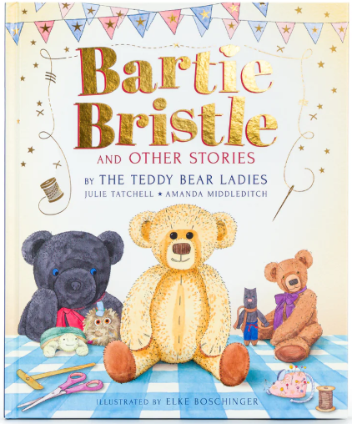
Year 1 Clownfish - Term 4
How Have Toys Changed?
Grammar, punctuation and spelling
Use capital letters and full stops.
Use finger spaces between words.
Use conjunction ‘and’ to join words and clauses.
Spell common exception words.
Use question marks
Year 1 Maths Number
Place value within 50
Step 1 Count from 20 to 50
Step 2 20, 30, 40 and 50
Step 3 Count by making groups of tens
Step 4 Groups of tens and ones
Step 5 Partition into tens and ones
Step 6 The number line to 50
Step 7 Estimate on a number line to 50
Step 8 1 more, 1 less
Measurement
Step 1 Compare lengths and heights
Step 2 Measure length using objects
Step 3 Measure length in centimetres
Step 1 Heavier and lighter
Step 2 Measure mass
Step 3 Compare mass
Step 4 Full and empty
Step 5 Compare volume
Step 6 Measure capacity
Step 7 Compare capacity
Core Values
Caring and Compassionate
English
Reading
Read aloud accurately books (both fiction, non-fiction and poetry) that are consistent with their phonic knowledge.
Re-read these books to build fluency and confidence.
Become very familiar with key stories, retelling them and considering their characteristics.
Discuss the significance of the title and events.
Make inferences on the basis of what’s said and done.
Answer and ask questions; predict what might happen on the basis of what has been read.
Writing
To say aloud what they are going to write about.
To compose a sentence (poetry phrase) before writing it.
To write down one of the sentences that they have rehearsed.
To sequence sentences to form short narratives.
To write sentences by re-reading what they have written to check that it makes sense.
To discuss what they have written with the teacher or other pupils.
To read their writing aloud clearly enough to be heard by their peers and the teacher.
Handwriting
sit correctly at a table, holding a pencil comfortably and correctly
begin to form lower-case letters in the correct direction, starting and finishing in the right place
form capital letters
form digits 0-9

Slide 2



Science: Everyday Materials 2
Scientific Enquiry
Year 1: Exploring Everyday Objects
Apply knowledge to explore how materials are used in practical and creative ways.
Investigate the suitability of different materials for specific purposes.
Design and build a structure strong enough to withstand wind, considering the strength and stability of materials.
Create a waterproof structure, exploring how materials repel water.
Be introduced to how materials are chosen for furniture based on their properties, by examining a variety of fabrics, understanding their textures, durability and other properties.
Explain the uses of materials and why they are suitable for specific purposes, consolidating their learning through critical thinking and application.
Years 1 - Term 4
How Have Toys Changed?
History: How Have Toys Changed?
Discuss their favourite toy using language related to the past.
Ask questions about toys in the past.
Make comparisons between toys in the past and present.
Sequence artefacts from different periods of time.
Identify changes between teddy bears today and those from 100 years ago.
Describe how toys have changed over time
PSHE Celebrating Differences
Computing -
Programme a robot
E-safety
PSHE – Healthy and Unhealthy Me
I can understand the difference between being healthy and unhealthy, and know some ways to keep myself healthy
I know how to keep myself clean and healthy, and understand how germs cause disease/ illness.
I know that all household products including medicines can be harmful if not used properly
Music-
Create sound patterns
RSHE – My Rights and Responsibilities
Understand that some diseases are spread.
Know that I have a right to be protected from diseases.
Know that we have a responsibility to protect others from diseases.
Design and Technology
Explore, design, make and evaluate stable structures.
RE – What do Christians believe God is like?
P.E.
Net and Ball Games
Yoga

